Slide 1

AFP Philadelphia Trea$ury Initiatives Getting It Right: Balancing Profitability, Liquidity and Risk
May 2017
PRESENTED BY
KROLL BOND RATING AGENCY, INC. &
STONECASTLE CASH MANAGEMENT

Slide 2
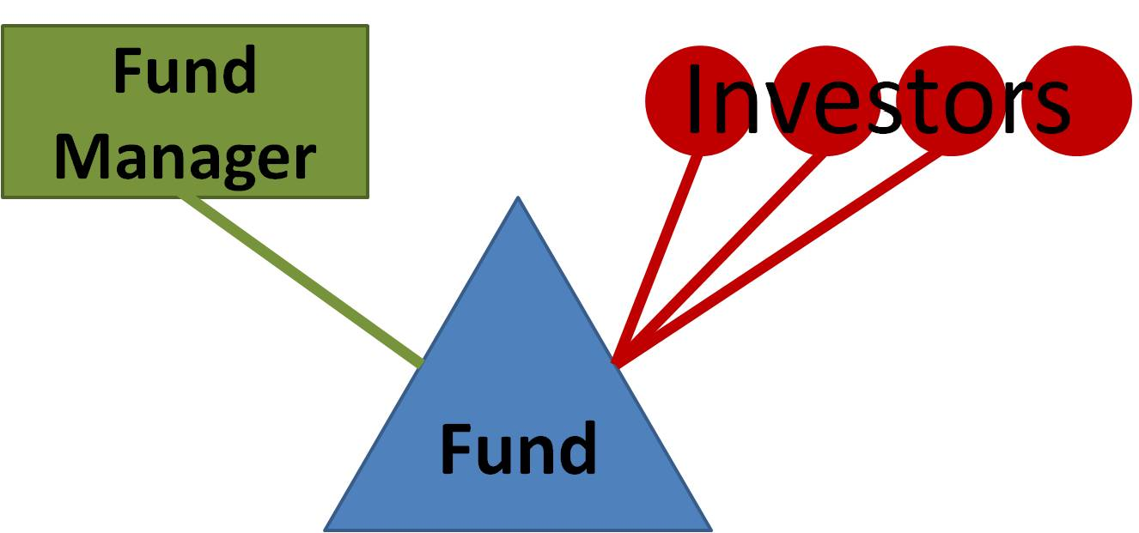
TABLE OF CONTENTS
Overview of Investment Funds
Investment Funds Market
Rating Approach
Quantitative Factors
Qualitative Factors
Trends

Slide 3
OVERVIEW OF INVESTMENT FUNDS
Investment strategies utilized and offered to investors come in a number of structures, including, but not limited to, funds, pools, trusts and special purpose vehicles (herein referred to as “funds”)
The “fund” universe is large and diverse, and invested assets can be a reflection of that: bonds, corporate loans, mortgage pools, equities, commodities, hard assets, real estate, etc.
It is estimated the shadow banking system is some $75 trillion in size. According to the Investment Company Institute (ICI), worldwide open-end mutual funds in third quarter 2016 were about $41 trillion in AUM.
Of that $41 trillion, about 23% or $9.2 trillion is in bond funds, and $5.1 trillion, or 12%, is in money market funds.
Source: ICI

Slide 4
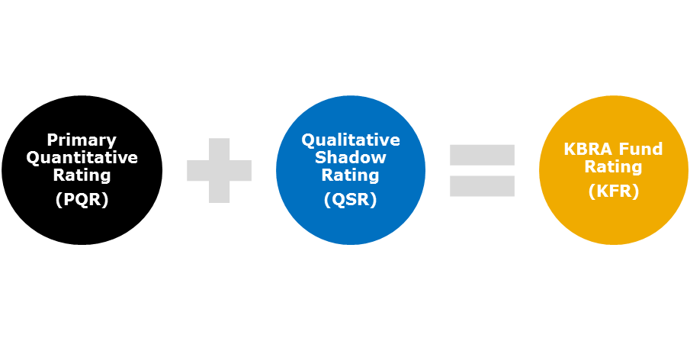
RATING APPROACH
A KBRA Fund Rating (KFR) is meant to indicate the quality of a fund's underlying portfolio and quality of the management team deploying that fund’s investment strategy, as well as the likelihood of maintaining that credit quality going forward
KFRs are not considered to be traditional credit ratings and are differentiated from long-term credit and issuer ratings by the usage of a distinct ‘kf’ subscript. Thus, KFRs will be quite distinguishable from long-term credit and issuer ratings in appearance (e.g. ‘AAAkf’, ‘AAkf’, etc.).
KFRs assigned are based on two main determinants: quantitative and qualitative.
The quantitative determinant utilized is based on a matrix approach, and produces a primary quantitative rating (PQR).
The qualitative determinant utilized is based on a review of management and other operational and administrative aspects of running the fund, with a determination of whether those aspects may or may not impact the credit quality of the fund, and which ultimately is used to produce a qualitative shadow rating (QSR).
The QSR is an overlay to the PQR which then determines the final KFR.

Slide 5
KBRA BOND FUND RATINGS DEFINITIONS
The KBRA Fund Rating (KFR) applies only to investment funds. A KFR is a forward-looking opinion meant to indicate the quality of a fund’s underlying portfolio as well as the management team’s ability to deploy the fund’s investment strategy. KFRs are not considered to be traditional credit ratings, and are differentiated from long-term credit and issuer ratings by the usage of a distinct ‘kf’ subscript. A KFR does not provide an indication of performance as it relates to returns, as measured versus peers, volatility or yield.

Slide 6
RATING APPROACH: PRIMARY QUANTITATIVE RATING (PQR)
A quantitative analysis of the fund portfolio by using a matrix approach. Output from the usage of the matrix is primarily driven by the credit quality of the underlying portfolio, and if relevant, any method of credit substitution that might be relied upon for the identifying of credit risks of individual investments.
The default probability factors utilized for each rating category are based on KBRA idealized default probabilities.
The KBRA model computes an expected cumulative default rate based on the portfolio holdings, and then benchmarks that default rate to historic idealized default rates to determine portfolio credit quality.
KBRA utilizes 1-year idealized default probabilities for investment funds with a duration of 1.5 years and less, and 5-year idealized default probabilities for investment funds with a duration of greater than 1.5 years.

Slide 7
RATING APPROACH: QUALITATIVE SHADOW RATING (QSR)
The ability to navigate the current regulatory environment as well as the management of the fund itself is of paramount importance. As such, the assessment of a manager is a key aspect of the investment fund rating methodology.
The assessment of the manager will focus on four key Rating Determinants and respective sub-determinants for each determinant. Rating Determinants include: Management, Structure and Ownership; Credit Process; Fund Investment Guidelines and Process; and Risk Management.
Each Rating Determinant, and sub-determinant, will be classified as:
  Strong: determinants and sub-determinants exceed what is considered typical when compared to peers and can shift the overall rating higher than what is suggested purely by the PQR.
  Average: determinants and sub-determinants are found to be not greatly different from peers and may represent typical industry practices and operations.
  Weak: determinants and sub-determinants are considered to have more disadvantageous characteristics when compared to peers and may not represent typical industry practices and operations. This can shift the overall rating lower than what is suggested purely by the PQR.
It is important to note that an assessment that results in a “strong” outcome for the QSR, can lead to an overlay that can boost the PQR rating, and ultimately result in a higher overall IFR than a fund with a similar PQR whose management assessment results in an “average” or “weak” outcome.
Generally a management assessment that results in a “weak” outcome will result in a fund’s overall IFR being lower than that indicated by the PQR. However, it also, in certain instances, could indicate that KBRA would be unable to get comfortable with management, and thus, be unable to assign a rating to that fund.

Slide 8
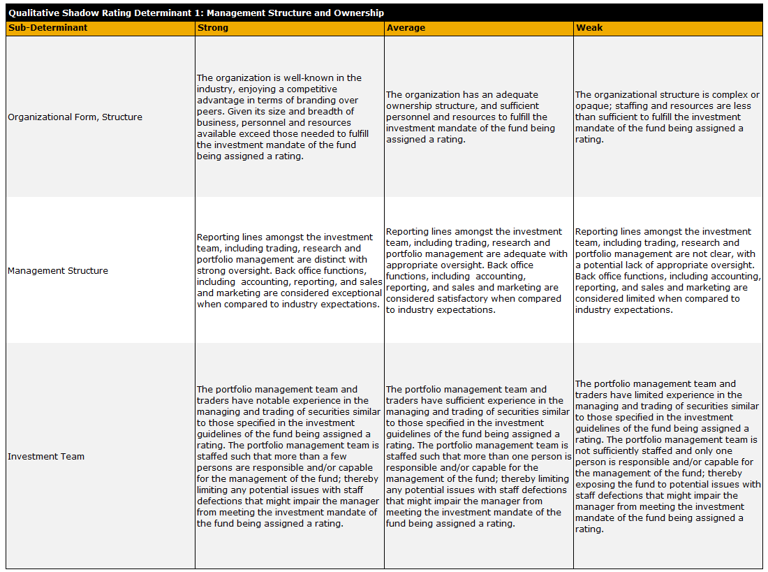
RATING APPROACH: QUALITATIVE SHADOW RATING (QSR)

Slide 9
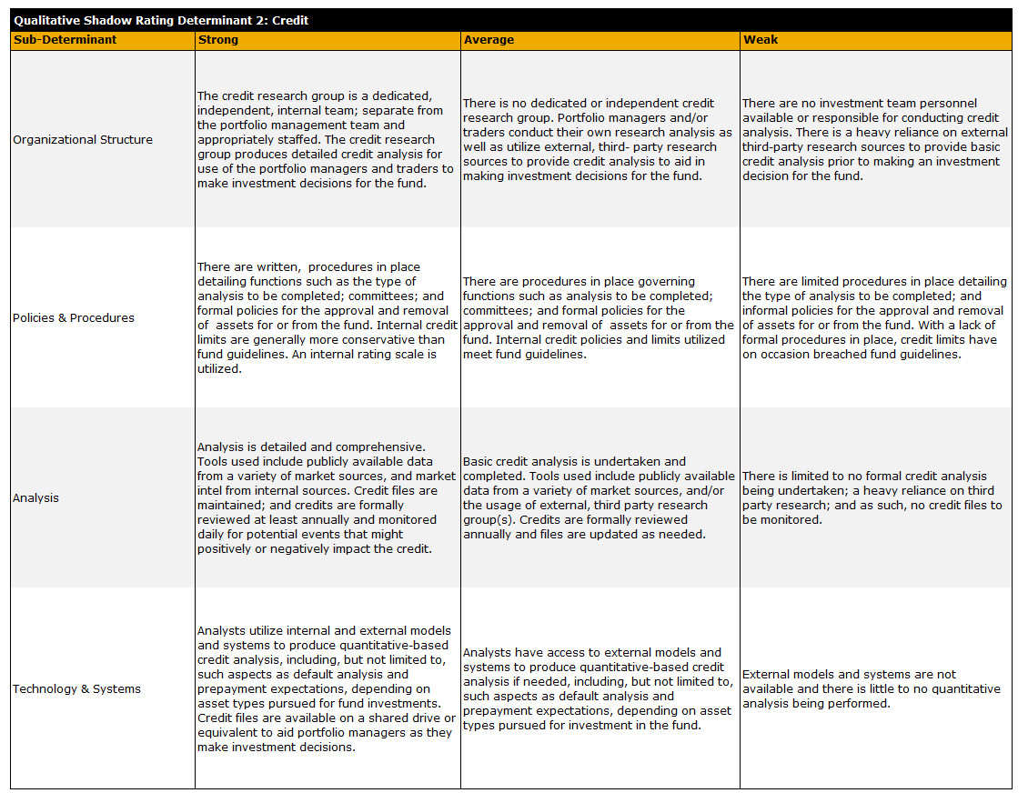
RATING APPROACH: QUALITATIVE SHADOW RATING (QSR)

Slide 10
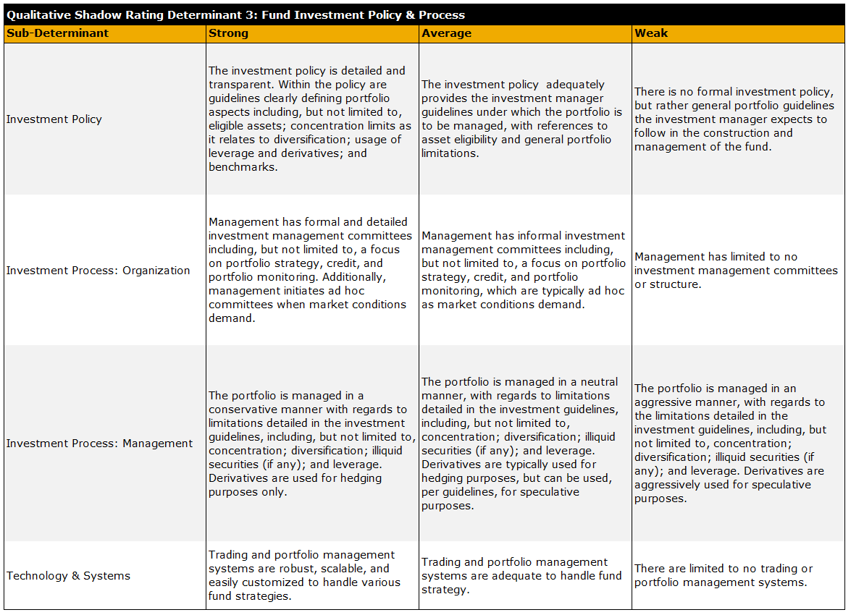
RATING APPROACH: QUALITATIVE SHADOW RATING (QSR)

Slide 11
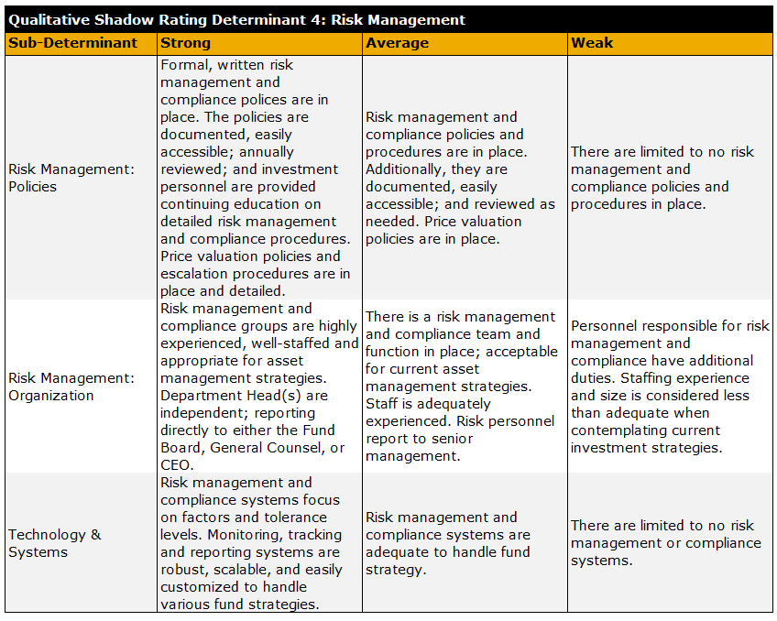
RATING APPROACH: QUALITATIVE SHADOW RATING (QSR)

Slide 12
SURVEILLANCE
KBRA will review portfolios of rated funds typically on a quarterly basis.
However, under certain circumstances and market conditions, fund management may be asked to provide portfolio information more frequently.
Management is responsible for providing portfolio holdings and performance data, as well as other management, operational and investment details KBRA finds important with regards to monitoring the fund and supporting KBRA fund ratings.

Slide 13
TRENDS – MONEY MARKET FUND REFORM
Rule 2a-7 regulatory reforms went into effect on October 14, 2016.
Floating NAV – Prime Institutional Funds
Liquidity Fees & Gates
  30% weekly liquidity
    30% - discretion fee up to 2%
    10% - required fee of 1% up to 2%
Government Funds – 95% Rule
Removal of references to credit ratings for underlying portfolio investments (not ratings on funds themselves).

Slide 14
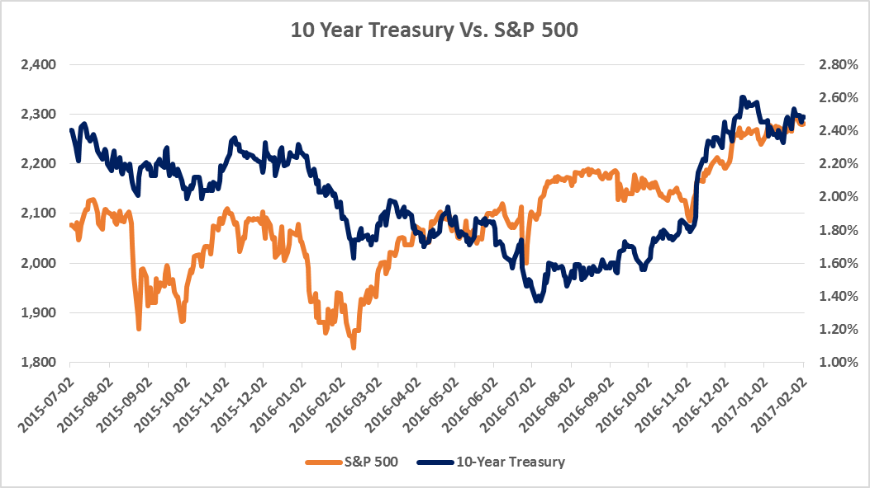
TRENDS
Source: Federal Reserve, Bloomberg

Slide 15
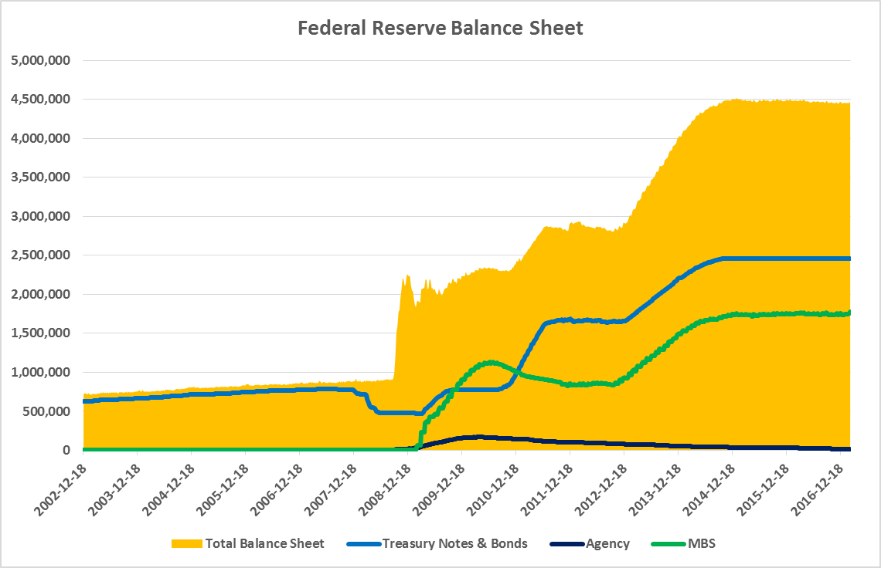
TRENDS
Source: Federal Reserve

Slide 16
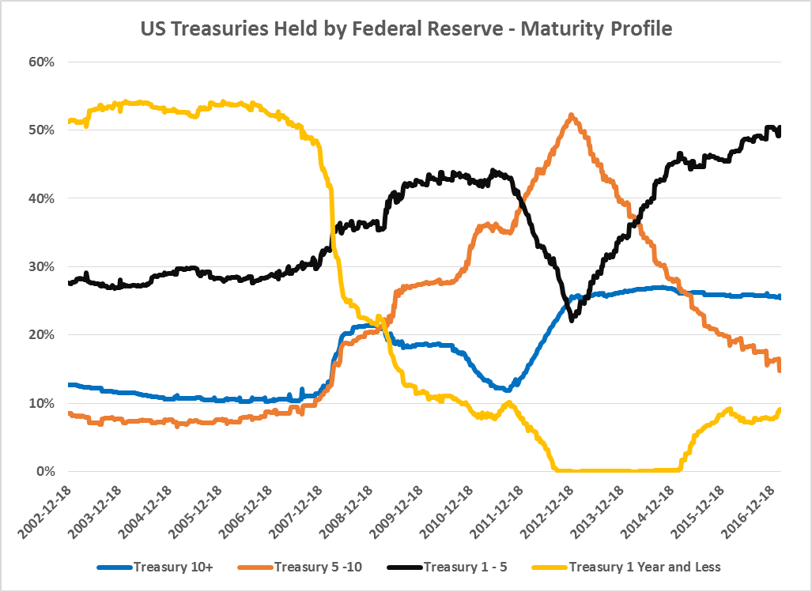
TRENDS
Source: Federal Reserve

Slide 17
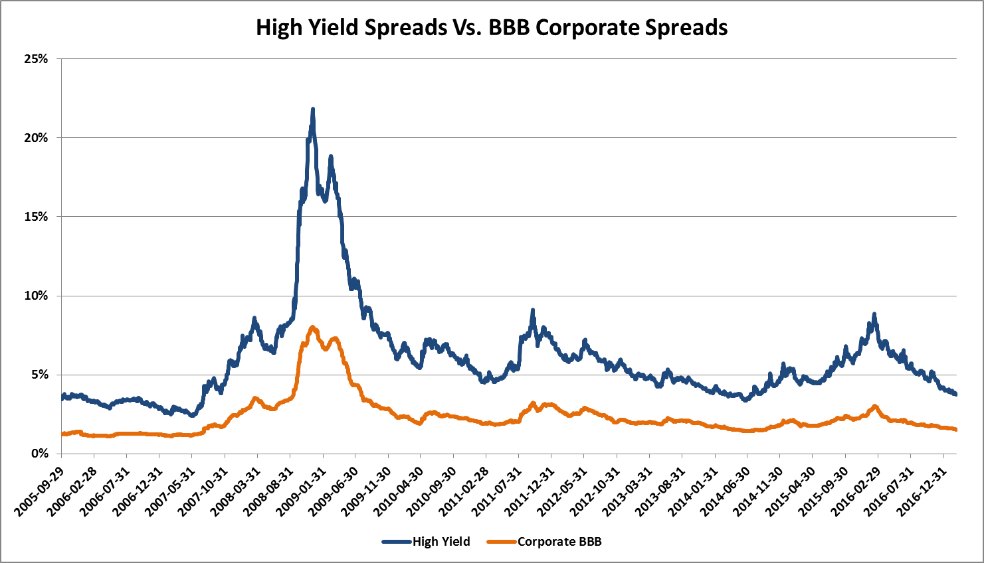
TRENDS
Source: BofA Merrill Lynch

Slide 18
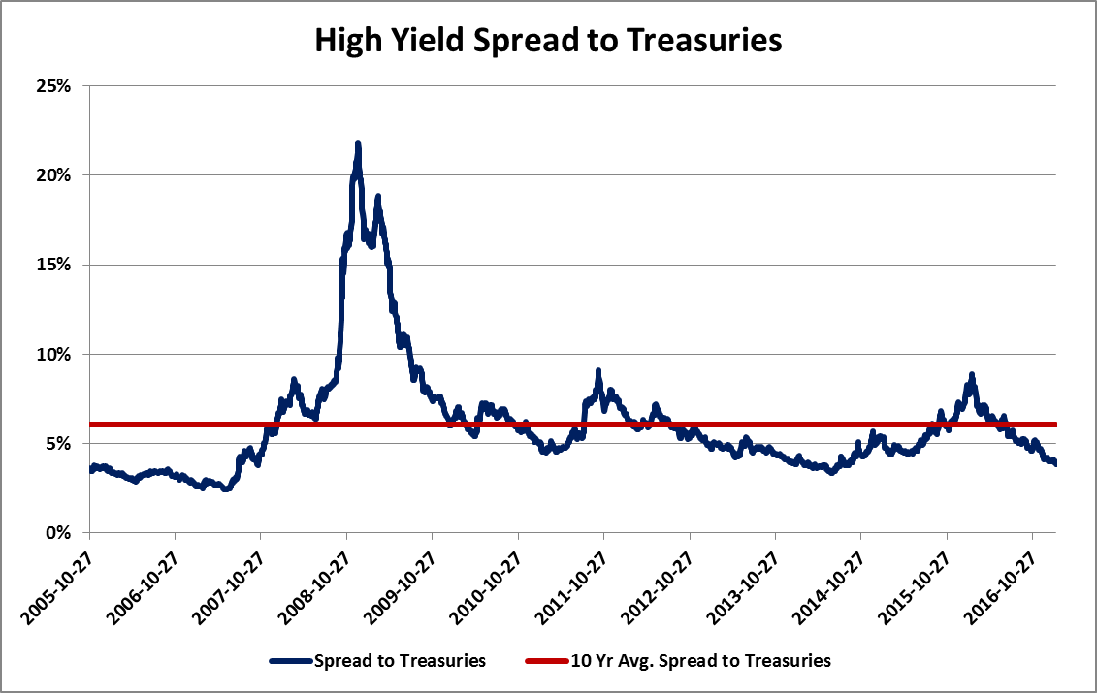
TRENDS
Source: BofA Merrill Lynch

Slide 19
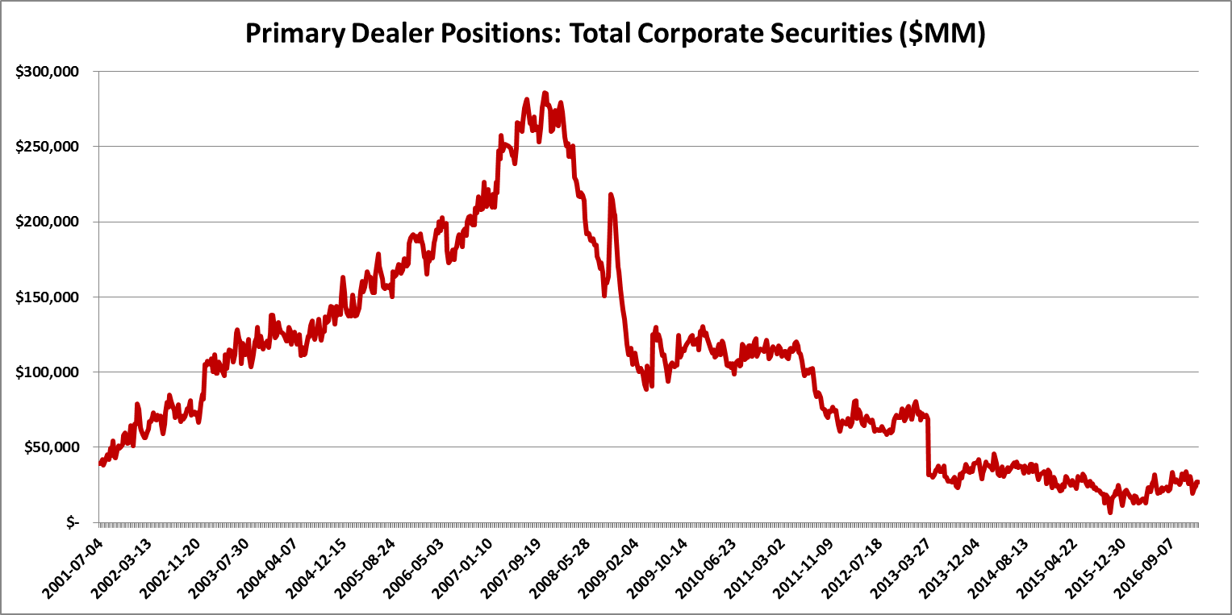
TRENDS
Source: Sifma

Slide 20
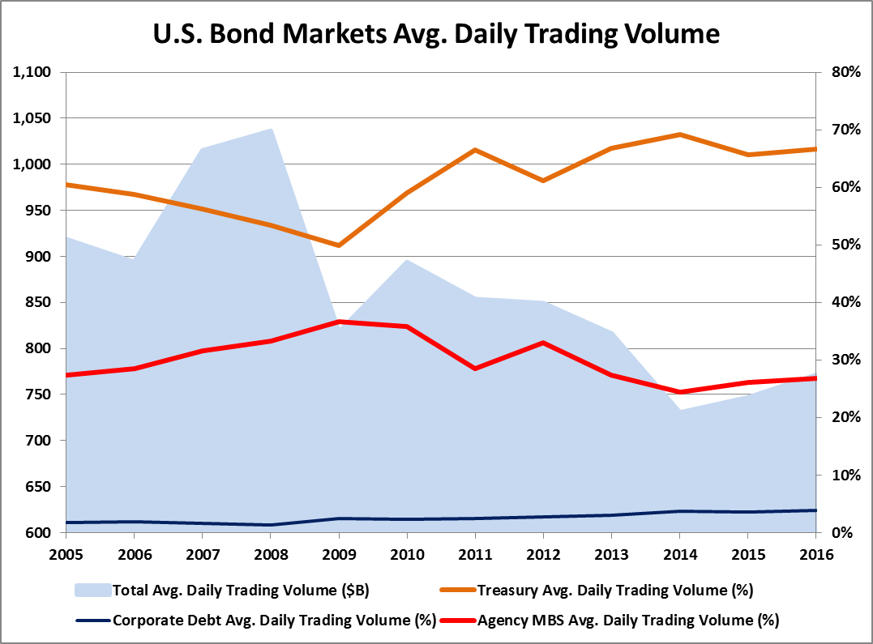
Trends
Source: Sifma

Slide 21
TRENDS
Source: ICI

Slide 22
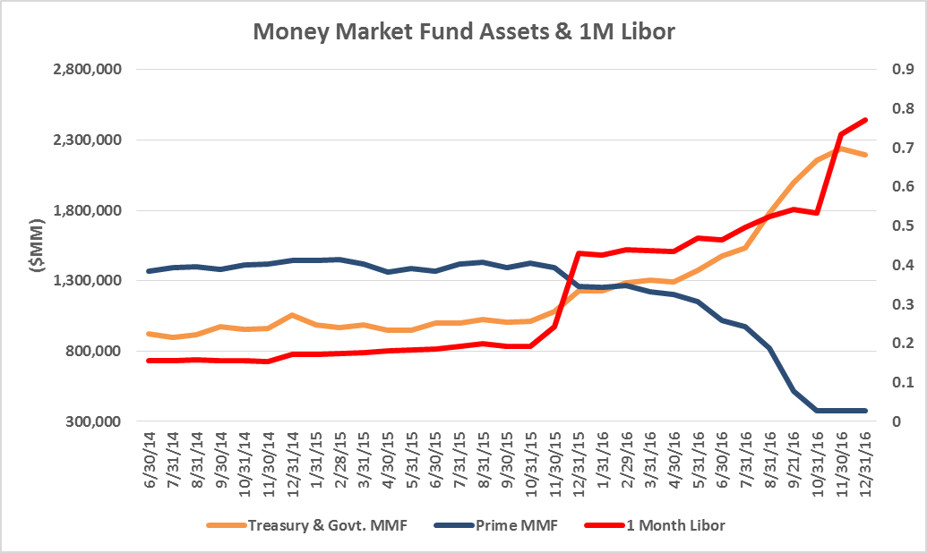
TRENDS
Source: ICI, Bloomberg

Slide 23
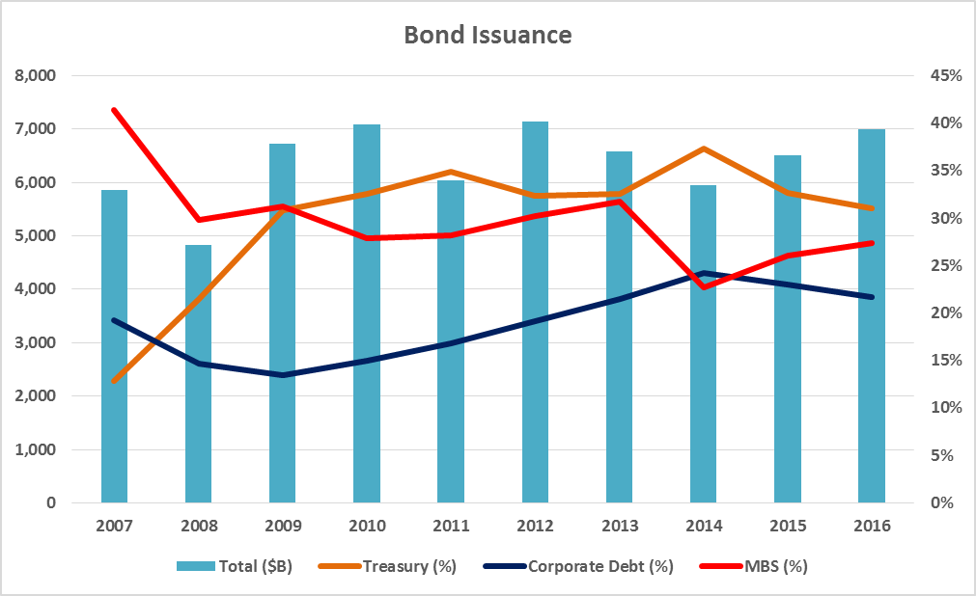
TRENDS
Source: Sifma

Slide 24
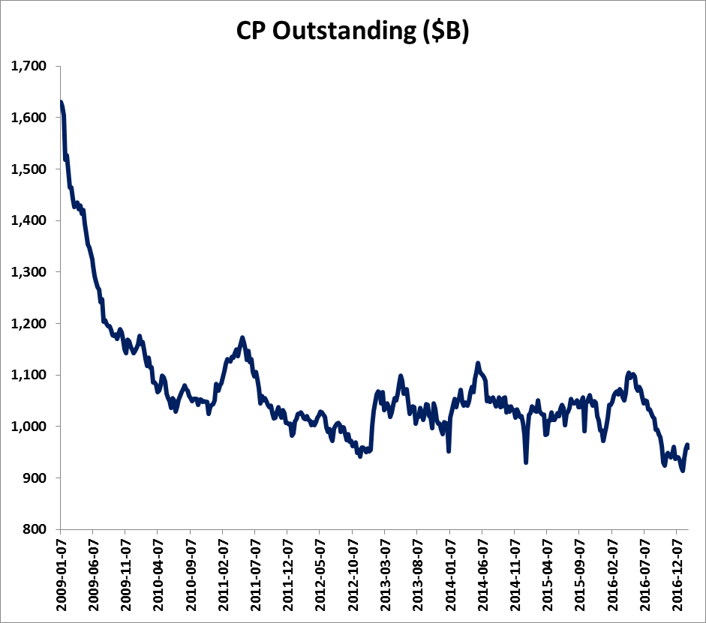
TRENDS
Source: Federal Reserve

Slide 25
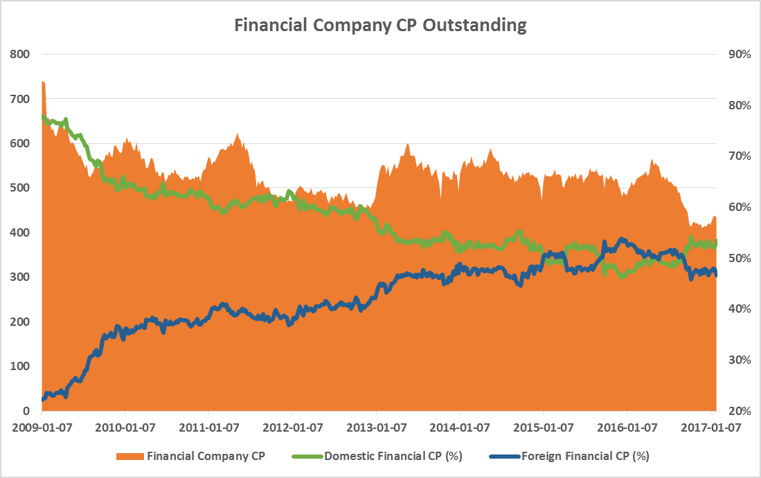
TRENDS
Source: Federal Reserve

Slide 26
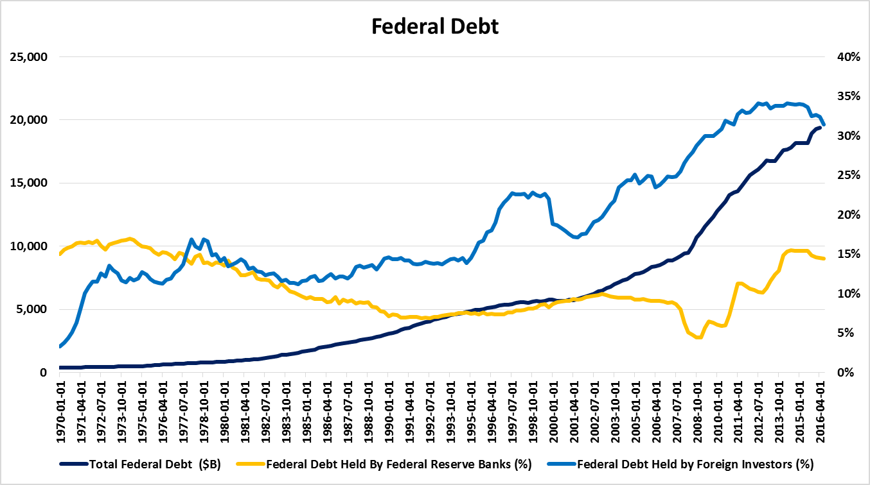
TRENDS
Source: Federal Reserve

Slide 27
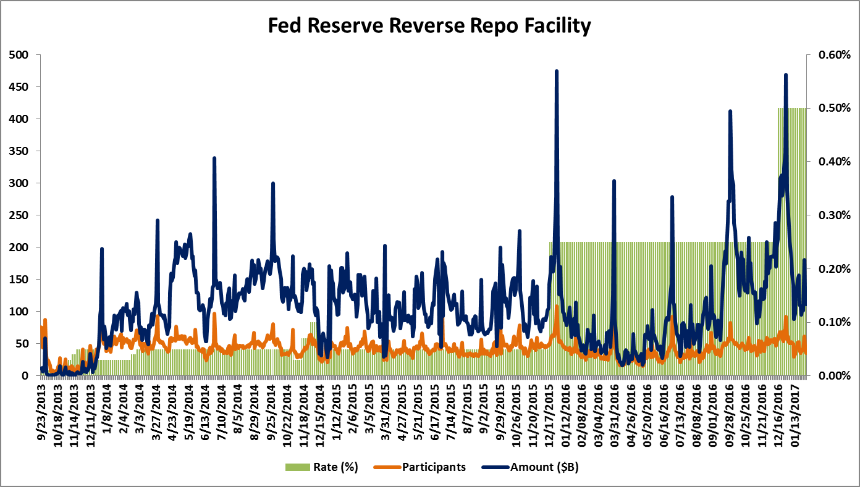
TRENDS
Source: Federal Reserve

Slide 28
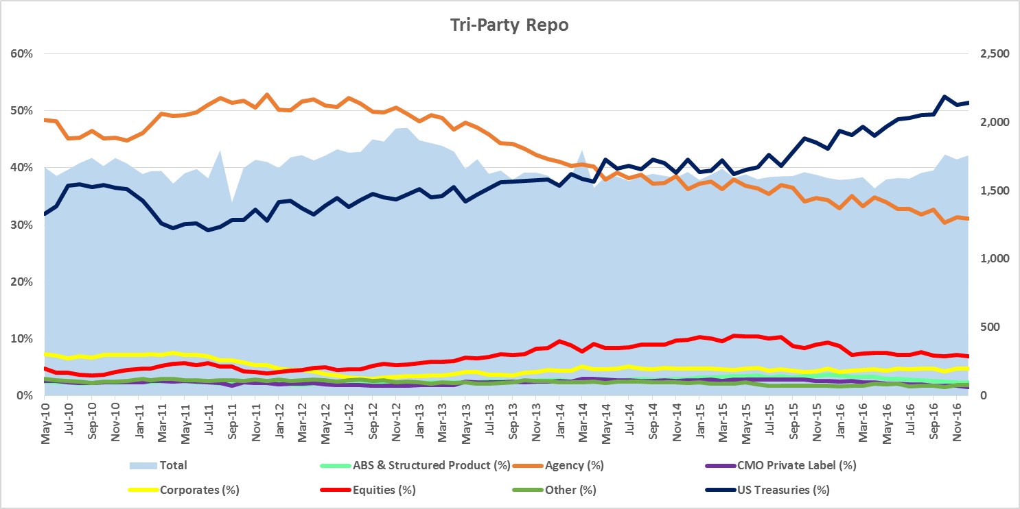
TRENDS
Source: Federal Reserve, SIFMA

Slide 29
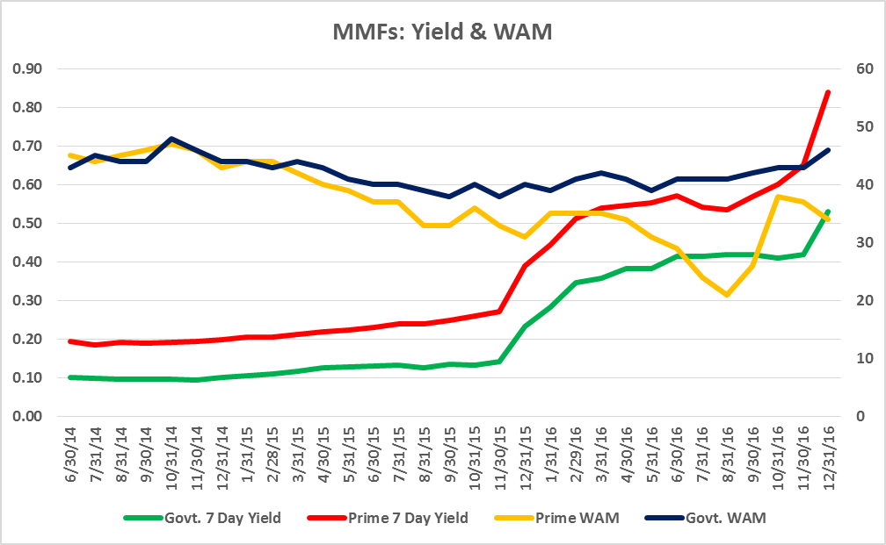
TRENDS
Source: Crane Data, ICI, Bloomberg

Slide 30
About StoneCastle
Year Founded: 2003
Assets: $12B+
Headquarters: New York, NY
Employees: 60+
“StoneCastle has emerged as one of the leading innovators in the cash management arena.”
— Cash Management That Could Crush Money Markets, InvestmentNews
StoneCastle Cash Management is a leading provider of deposit, liquidity and cash management solutions.
Our client-focused approach, coupled with a strong network of depository relationships, helps us to navigate complex issues and challenging market and regulatory environments, and to respond quickly and creatively to the needs of our clients.
Our cash management solutions focus on preservation of capital, liquidity and competitive yields.
30

Slide 31
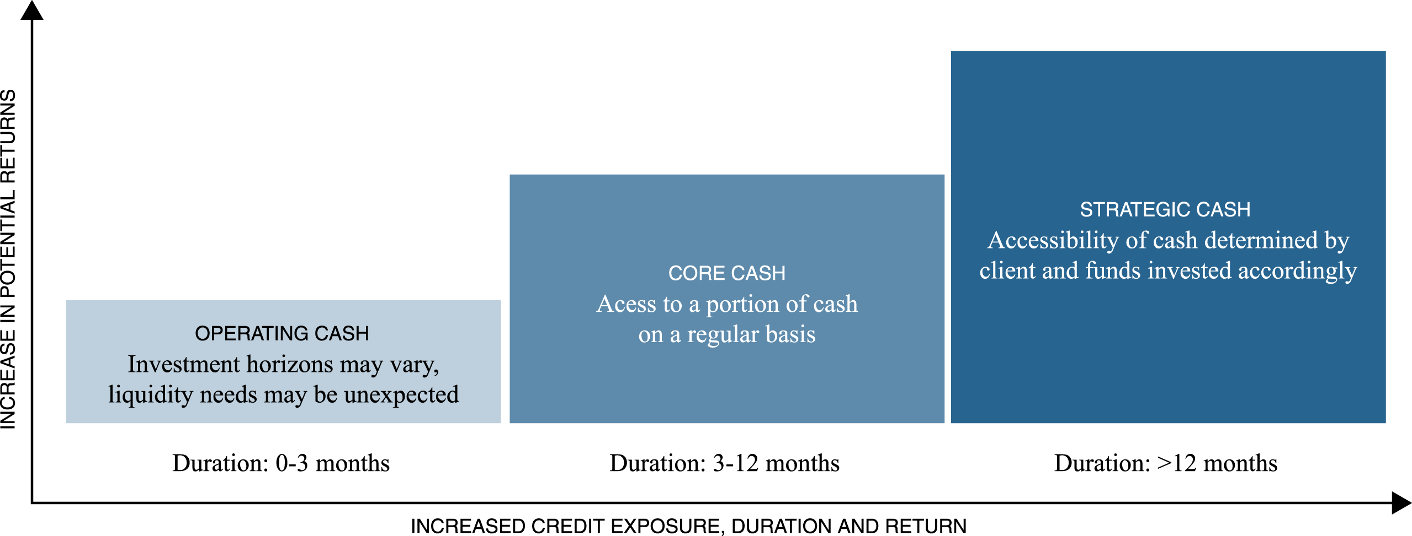
Allocating Your Cash
Allocation of Cash
Access to a portion of cash
on a regular basis
31

Slide 32
Options For Operating Cash
Limited Options for Operating Cash Balances
Prime money market funds no longer viable for operating cash balances
Significant decreases in prime fund AUM
  More than $1 trillion in assets have left prime funds, resulting in most funds having a fraction of their assets, limiting the ability for companies to invest consistent with investment policy guidelines
NAV fluctuations
32

Slide 33
Prime MMFs Fluctuating NAVs
Source: CraneData,  12/14/2017 Interest Rate Hike

Slide 34
History of FDIC Insured Accounts
Structured Insured Bank Deposit Vehicles
Structured Insured Bank Deposit Vehicles have gained recognition as alternatives to other cash vehicles and according to the most recent AFP Liquidity Survey, now represent 23% of institutional bank deposits.
Instruments Used When Investing in Bank Deposits
(Percent of Organizations that Maintain Cash and Short-Term Investment Holdings in Banks)
All
Responses
Annual
Revenues
Under $1B
Annual
Revenues
At Least $1B
Net
Borrower
Net
Investor
Investment
Grade
Non- Investment
Grade
Publicly
Owned
Privately
Held
Time Deposits (e.g., CDs)
57% 54% 59% 54% 61% 59% 55% 69% 49%
Non-interest bearing deposit accounts
42 43 44 47 40 41 46 41 43
Structured Bank Deposit Products (e.g., FICA)
23 18 25 14 19 17 15 16 16
Structured certificates of deposit (e,g,, CDARS)
16 17 15 14 19 17 15 16 16
Other Bank Products
10 10 11 8 12 11 9 10 9
Source: 2016 AFP Liquidity Survey
34

Slide 35
About FICA®
Federally Insured Cash Account (FICA®)
FICA® is a proprietary cash management vehicle that offers a high level of FDIC insurance, next day liquidity, and an attractive yield
Provides over 1,200 institutional depositors with access to a network of 700+ carefully screened insured institutions via a single, convenient account
SAFETY
LIQUIDITY
PERFORMANCE
Deposits are backed by the full faith and credit of the U.S. government
Highly diversified—no single bank holds more than $250,000 per depositor
No market or credit risk
No term commitment
Next day liquidity with same day purchase credit¹
No fees, gates or redemption fees
Unlike a money fund liquidity
is not adversely affected by other investors
Superior yield when compared
to government money market funds, U.S. Treasuries, commercial paper, CDs, time deposits and all other risk free vehicles
35

Slide 36
Why FICA®
Why is FICA® Attractive?
Stability
  Stable principal value (no floating NAV)
Yield
  Competitive yield compared to government money funds and other short-term investments
FICA®: .75%*
Crane Inst. Gov’t MF Index: .51%**
Control
  Unlike a money fund or pool, investors have direct ownership of underlying deposit (vs. owning a percentage of a fund/pool), not impacted by actions of others
  Ability to opt out of specific institutions; single statement; 1099; online access
Diversification
  Offers a premium over government and treasury money funds, direct treasuries, and short-term CDs
Transparency
  Ability to view where all deposits are invested
*As of May 1, 2017. FICA rate sourced to StoneCastle.
** As of May 1, 2017 Money fund 7-day yields sourced to Crane Data.
36

Slide 37
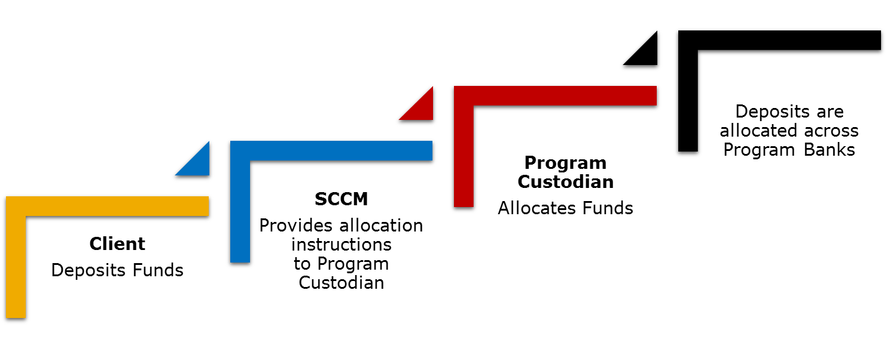
STONECASTLE - FICA
Source: StoneCastle

Slide 38
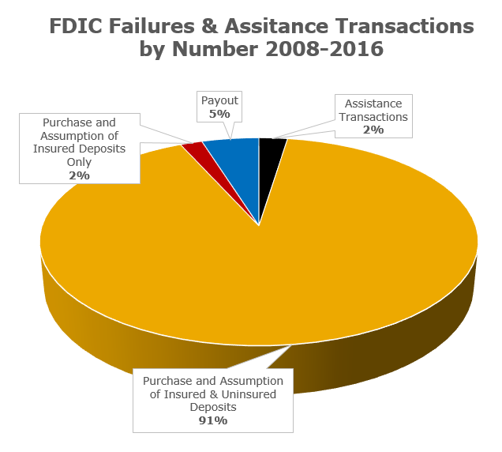
STONECASTLE - FICA
Source: FDIC

Slide 39
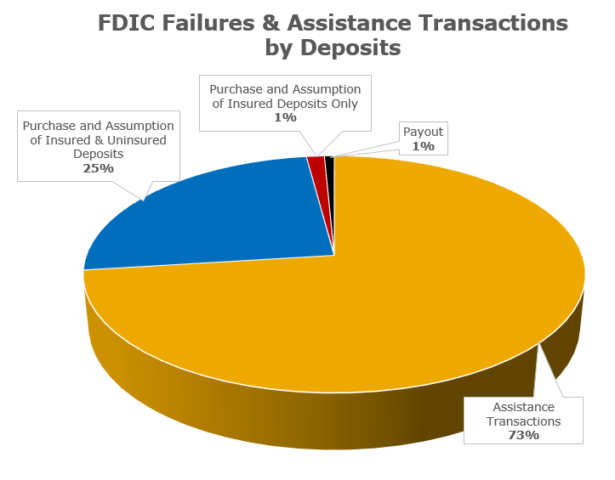
STONECASTLE - FICA
Source: FDIC

Slide 40
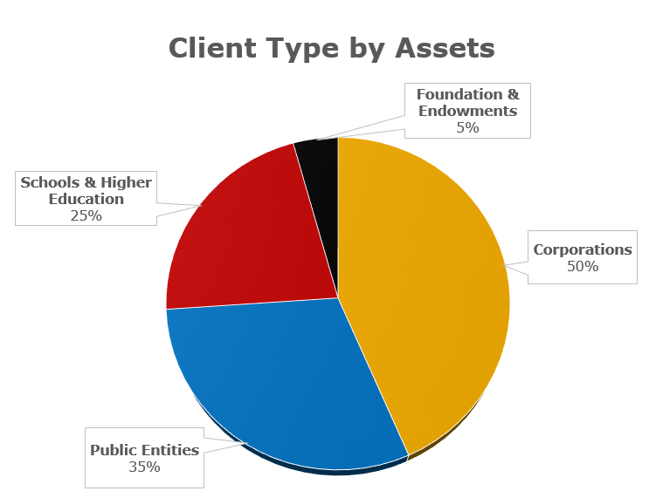
STONECASTLE - FICA
Source: FDIC

Slide 41
STONECASTLE - FICA
Qualitative Shadow Rating Determinant 1: Management Structure and Ownership
Sub-Determinant | Strong | Average | Weak
Organizational Form, Structure | ü
Management Structure | ü
Investment Team | ü
Qualitative Shadow Rating Determinant 2: Credit
Sub-Determinant | Strong | Average | Weak
Organizational Structure |  | ü
Policies & Procedures | ü
Analysis | ü
Technology & Systems | ü
Qualitative Shadow Rating Determinant 3: Fund Investment Policy & Process
Sub-Determinant | Strong | Average | Weak
Investment Policy |  | ü
Investment Process: Organization | ü
Investment Process: Management | ü
Technology & Systems | ü
Qualitative Shadow Rating Determinant 4: Risk Management & Compliance
Sub-Determinant | Strong | Average | Weak
Risk Management & Compliance: Policies |  | ü
Risk Management & Compliance: Organization |  | ü
Technology & Systems |  | ü
Source: KBRA

Slide 42
STONECASTLE - FICA
StoneCastle Federally Insured Sweep Account
Rating Determinants | Sub-Determinant Assessment | Score
PQR
 |  | AAA
QSR
Management | Strong
Credit | Strong
Fund Investment Policy & Process | Strong
Risk Management | Average
 |  | Strong
Final KFR |  | AAAkf
Source: KBRA

