Slide 1
Blockchain And Distributed Ledgers: What You Need to Know Now
Philadelphia AFP
Steve Mott, Principal-BetterBuyDesign
May 2017

Slide 2
Overview of Session
X
While Bitcoin and other virtual currencies continue to titillate the investment community and arose regulatory ire, cautious corporations remain at arm’s length to their mainstream use
Dozens of industries are busily deploying the underlying technology of virtual currencies, however. The financial services sector is leading the way, but blockchain innovations are making their way into industrial products, autos, travel and hospitality, retail, healthcare, media government and energy to re-craft important aspects of how they operate in order to gain both better security and greater efficiency.
This session will profile the innovations underway, and their potential to gradually disrupt the status quo of how business gets done—harnessing the humble power of public (distributive) ledgers

Slide 3
What This Presentation Covers
What you need to know about blockchain and distributed (public) ledgers right now
Where this technology taking root in Industry
Where this technology is innovating in Financial Services
What standards are being generated
Big ideas vs. Skeptics
Appendix: The Bitcoin Blockchain

Slide 4
1. What You Need to Know about Blockchains/Ledgers Right Now
Bitcoin and other virtual currencies per se do not yet offer adequate protection for financial services (and do little for related business automation so far)
Blockchain technology is the hype-word de jour, but it’s not quite ready for retail transactions—such as payments (you need more stuff…)
Blockchain in its simplest form is a distributed, shared database technology that works like a public ledger (see next slide)
When distributed among known and vetted participants, public ledgers appear to work best in complex and unexciting processing environments (they’re not sexy)
e.g., Smart contracts, custody/settlement, insurance
They can be very efficient and save a ton, but there are few standards for building and deploying them so far
And then, there’s this issue about confidentiality among competitors….

Slide 5
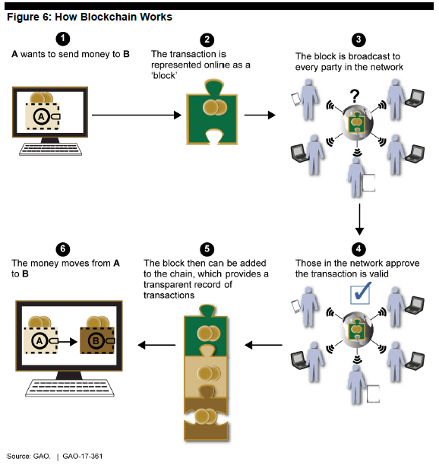
General Accounting Office View of Blockchain in Payments

Slide 6
Distributed Ledger: A Formal Definition (though the Current Term in Favor is “Distributive Ledger)
Source: Blockchain Technologies

Slide 7
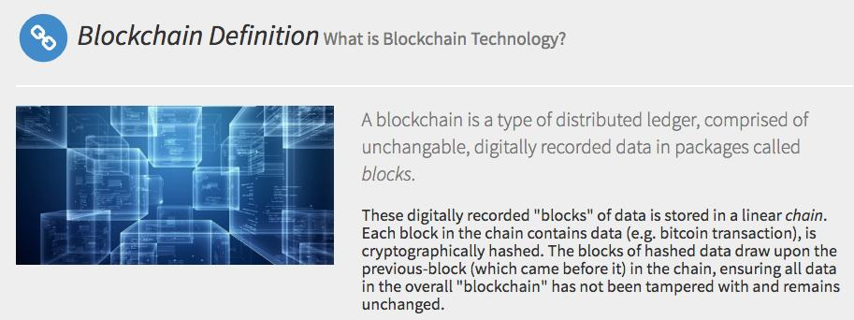
Blockchain is a Type of Distributed Ledger that Links Uniquely Blocks of Data
Source: Blockchain Technologies

Slide 8
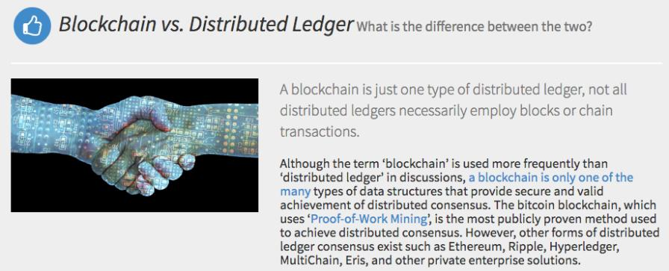
The Difference—Blockchain is One Specific Type of Distributed Ledger
Source: Blockchain Technologies

Slide 9
A Working Definition for Today
At its simplest, a blockchain may be defined as (a) a database architecture (b) comprising a distributed network of nodes that (c) collectively validates and maintains a growing list (or chain) of transactions (d) initiated by actors interacting with that network
It works best like ledgers, which have been around since the 6th century, but can work flexibly based on requirements of the automation application

Slide 10
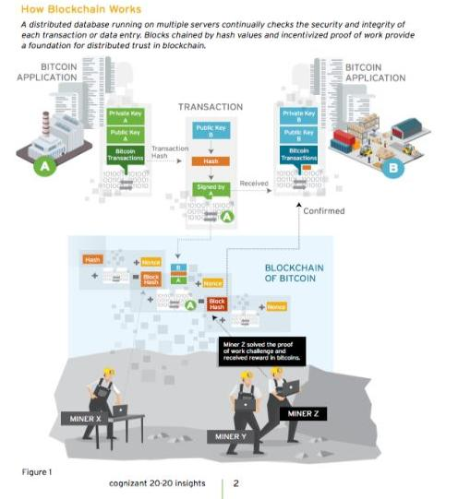
Bitcoin Blockchain: Con-structed by Miners Who Prove their Work as They Go

Slide 11
Public Ledgers: The Next Evolution of Databases
Multiple organizations often work with the same databases in order to perform exacting tasks; e.g., transaction clearing, custody and settlement, time-stamping, repetitive contracts, etc.
Authoritative access control is required
Synchronization is difficult, time-consuming and expensive
Consolidated Database
Access and Validation Rules
Client
Client
Client
Client
Source: Terence Spies

Slide 12
A Consolidated Database Shared by Many
Secure operation is provided with uniform cryptography
Access is distributed, based on consensus participation
Database is state dependent, upon majority agreement for validity of updating
Database
Validator
Validator
Validator
Client
Client
Client
Client
Source: Terence Spies

Slide 13
What is Distributed…
Trust
Integrity
Access
Partnerships
Security
Irrevocability (often)
etc.

Slide 14
2. Where This Technology Taking Root in Industry
Smart Contracts/Manufacturing
Supply chain
Energy
Mobile access to trading databases

Slide 15
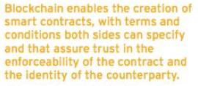
Smart Contracts = More Agile Supply Chains
[Trust and enforceability,
but does it need
a Central Authority
if the assets are fungible?]

Slide 16
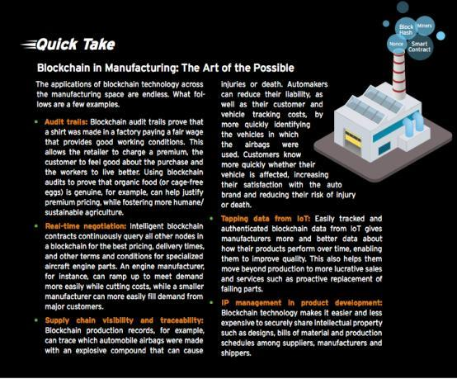
Source: Cognizant 20-20 Insights: Blockchain’s Smart Contracts

Slide 17
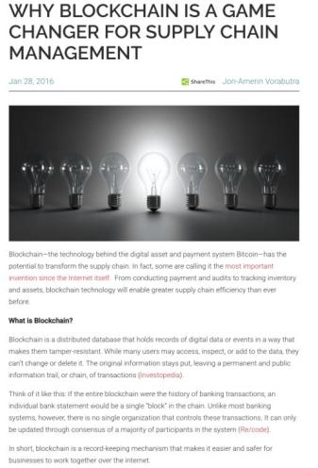
A Game-Changer for Supply Chains?
Source: loaddelivered.com

Slide 18
Smart Containers Next Up on Board
Source: loaddelivered.com

Slide 19
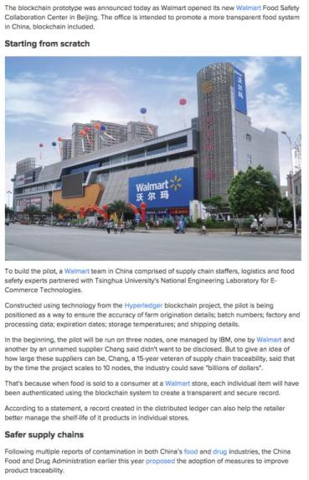
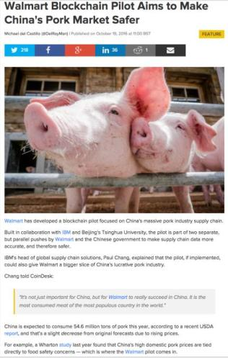
Supply Chain Example: Tracking Meat in China
Source: CoinDesk.com

Slide 20
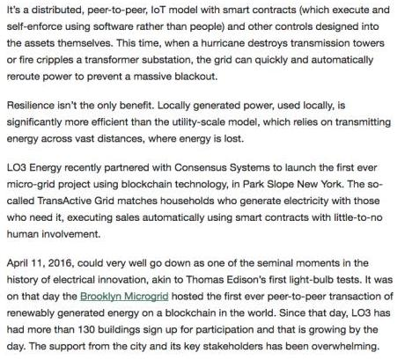
Reinventing the Energy Grid
Source: CoinDesk.com

Slide 21
3. Where This Technology is Innovating in Financial Services
Cross-border transfers
Card-based B2B transactions
Insurance
Wire transfer networks

Slide 22
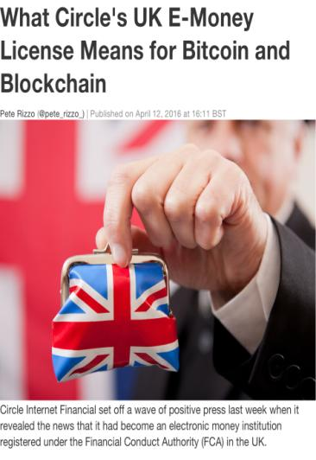
Cross-border a Magnet for Innovators
Market leader
Most immediately, commentators agreed that the announcement further positioned Circle as a market leader in the digital currencies space. Founded in 2013 by Brightcove founder Jeremy Allaire and its senior architect Sean Neville, Circle has already raised $76m over three funding rounds, boasting investors such as Goldman Sachs and Fenway Summer.
Wester indicated that Circle’s license would now allow it to perform limited cross-border and cross-currency transfers from Europe to the US, a move that would allow them to test a prominent use case for blockchain at scale.
"[This] is particularly interesting given that those transactions have often been cited as a good use case for blockchain," he said.
Circle is also notably the only bitcoin services company to have received a license from New York state since the introduction of its state-specific regulatory regime, the BitLicense, in early 2015. According to CoinDesk estimates, more than 20 companies remain waiting for a formal approval for this designation, though the NYDFS has promised forthcoming news.
BuckleySandler LLP counsel Dana Syracuse, who helped develop the BitLicense application in New York, said that the licensing is an example of how companies in the financial services industry can use regulation to compete for investment and business.

Slide 23
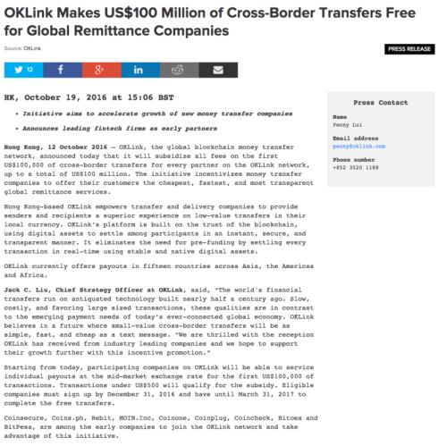
Cross-border Transfers for Free—Limited Time Only!
Source: CoinDesk.com

Slide 24
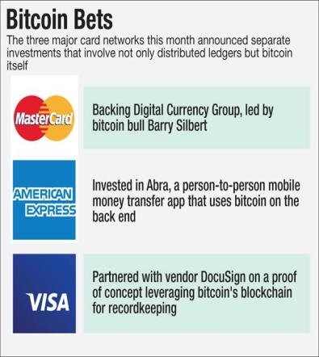
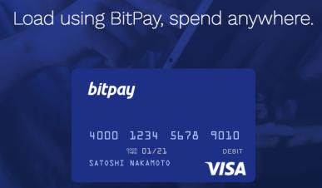
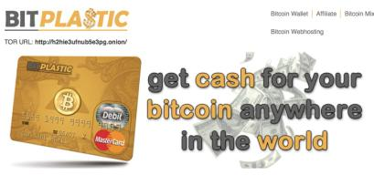
What About the Card Networks…?

Slide 25
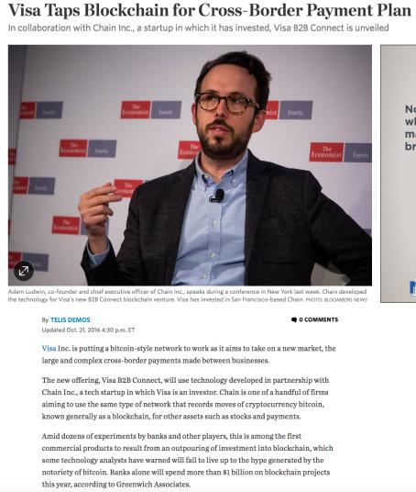
Lo, and Behold: Visa Taps Blockchain to Compete in B2B Transfers

Slide 26
And Insurance Dips Toes in the Water…
Source: CryptoCoins.com

Slide 27
SWIFT—Struggling with User-side Security—Joins the Fray

Slide 28
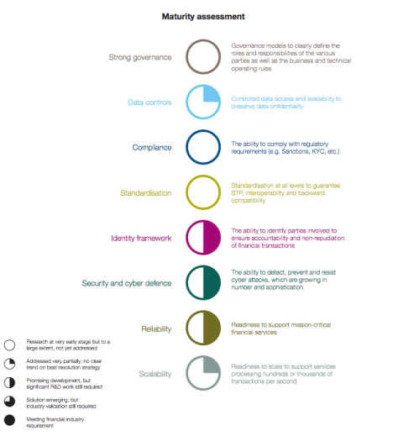
SWIFT’s View of Distributed Ledger Technology: Promising Development in Security, Identity and Reliability
Source: SWIFT/Accenture Position Paper: SWIFT on Distributed Ledgers

Slide 29
4. The Move to Generate Near-Term Standards
HyperLedger
R3
X.9
New ones?

Slide 30
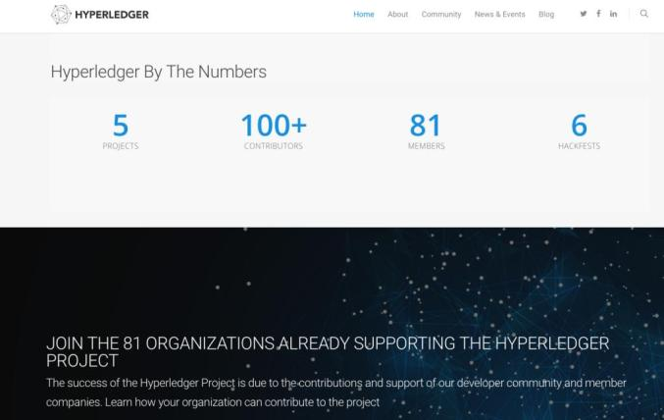
Hyperledger Points to Open Standards

Slide 31
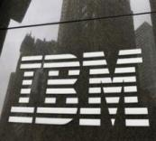
IBM has released a set of blockchain cloud services built to meet security and compliance standards for companies in regulated industries — particularly, financial services, healthcare and government.
The offering provides a protected, "tamper-proof" operating environment that allows production on trusted blockchain networks to be deployed in minutes and prevents information leaks through shared memory or hardware, the tech giant said in a Friday news release.
As part of the Hyperledger Project, IBM has been collaborating with big names financial services and technology to create a common blockchain fabric on which companies can build their own blockchain applications, like logging transactions between banks and international businesses or allowing the two to share the same record-keeping system. JPMorgan Chase, Wells Fargo, State Street, Swift, Cisco, Intel and the Linux Foundation are among them.
"Clients tell us that one of the inhibitors of the adoption of blockchain is concerns about security," Jerry Cuomo, IBM's vice president of blockchain, said in the release. "While there is a sense of urgency to pioneer blockchain for business, most organizations need help to define the ideal cloud environment that enables blockchain networks to run securely in the cloud."
The service will provide auditable log data to support forensics and compliance.
Separately, IBM has made its version of the Hyperledger blockchain code available to use on Docker, an open platform for developers to build, ship, and run distributed applications. Users can expect dashboards, analytics, chat support and "exclusive network services" in future updates, it said. It also released its blockchain offerings in beta on Bluemix, a platform similar to Docker for developers interested in testing applications.

Slide 32
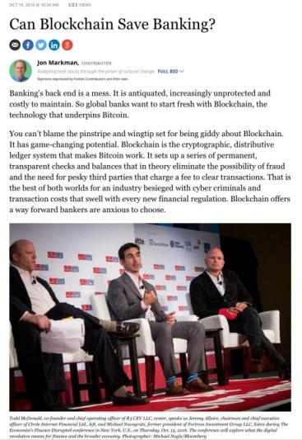
R3, Ripple Target Banking
Source: CoinDesk.com

Slide 33
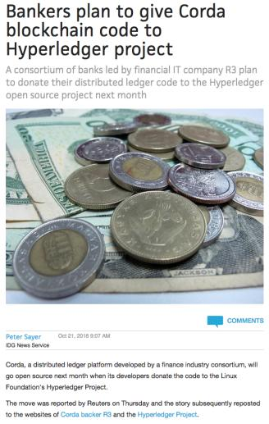
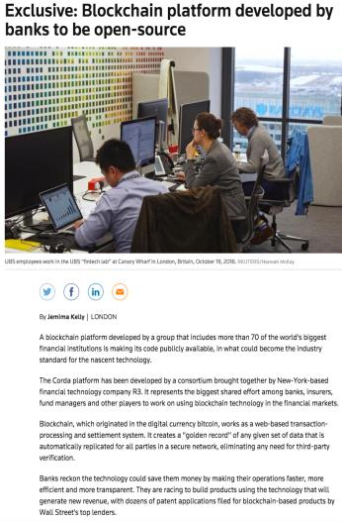
R3 Do-nates Corda Code to Hyper-Ledger as Open Source
Source: PC World; Reuters

Slide 34
ANSI X.9 FIN7: Research Into Decentralized Ledger Technologies
Principle | Bitcoin | Ethereum | Stellar | IPFS | Blockstack | Hashgraph
Confidentiality | None | None | None | Hash-based content addresses | None | None
Information Availability | Block Mirroring | Block Mirroring | Ledger Mirroring | Graph and file Mirroring | Block Mirroring / DHT Mirroring | Hashgraph Mirroring; optional event history
Integrity | Multiple block verifications | Multiple block verifications | Latest block verification | Hash-based content addressing | Multiple block verifications | Consensus with probability one
Non-repudiation | Digital signatures | Digital signatures | Digital signatures | Digital signatures | Digital signatures | Digital signatures
Provenance | Transaction inputs/outputs | Ethereum state machine and transition functions | Digitally signed ledger transition instructions | Digital signatures and versioning | Transaction inputs & outputs and virtualchain references | Hashgraph Mirroring; optional event history
Pseudonymity | Public keys | Public keys and contract addresses | Public keys | Public keys | Public keys, but public information encouraged | Not supported; could be layered
Selective Disclosure | None | None | None | None | Selective access to encrypted storage | Not supported; could be layered

Slide 35
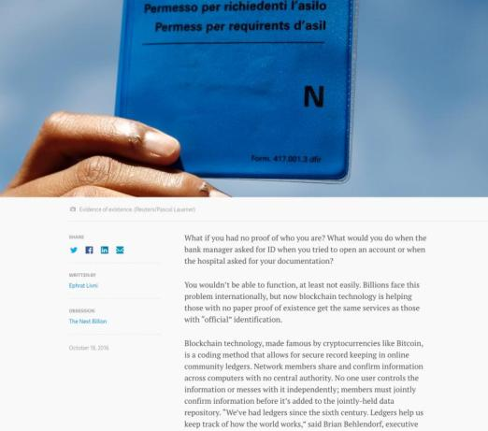
5. Big Ideas: Ledger Proofs of ID

Slide 36
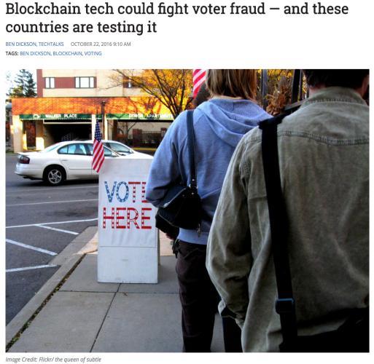
Voter IDs
Source: VentureBeat.com

Slide 37
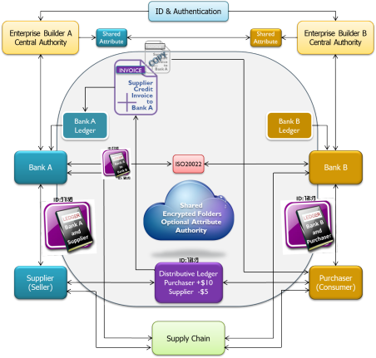
Secure Transaction Model Via Distributive Ledger Can Move Payments into Real-time
Source: TecSec-2016

Slide 38
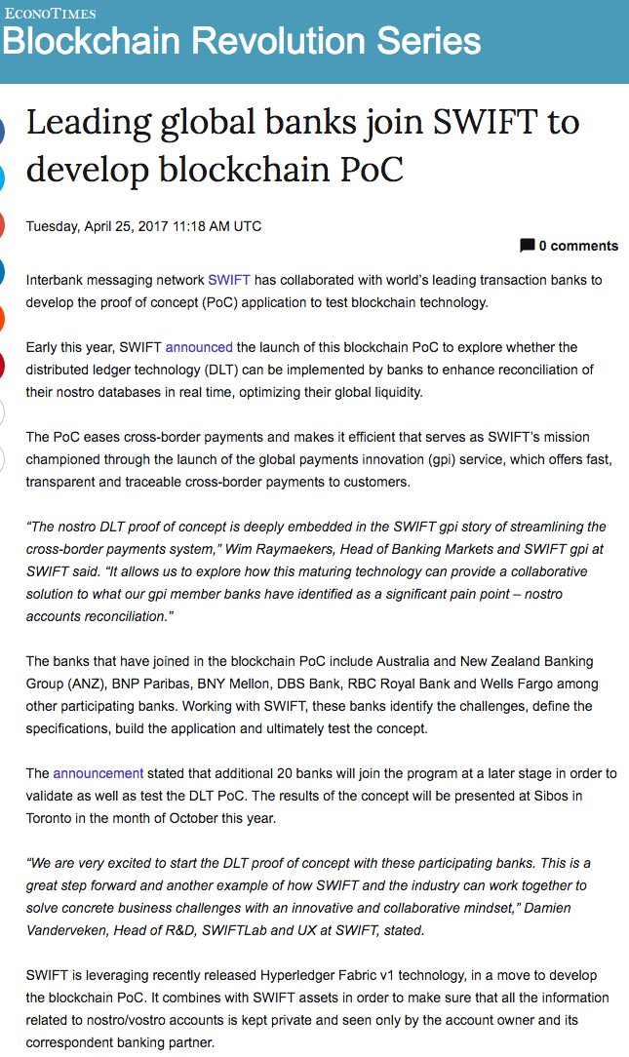
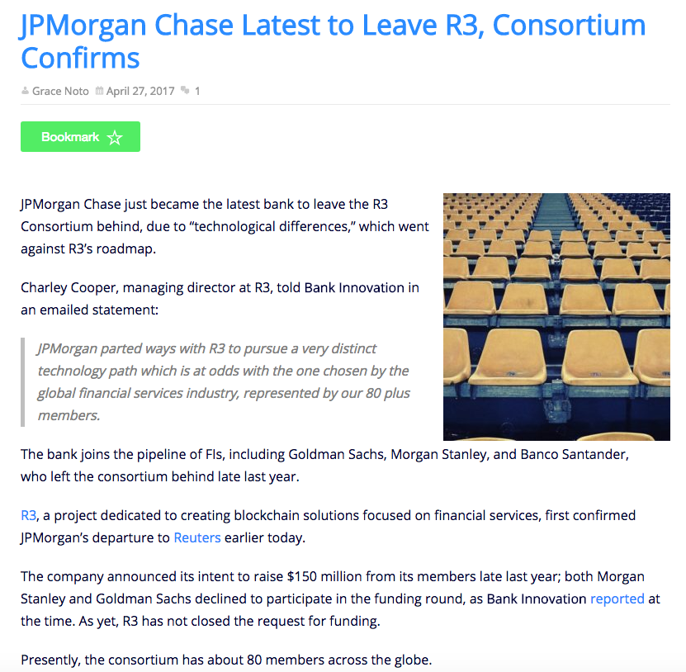
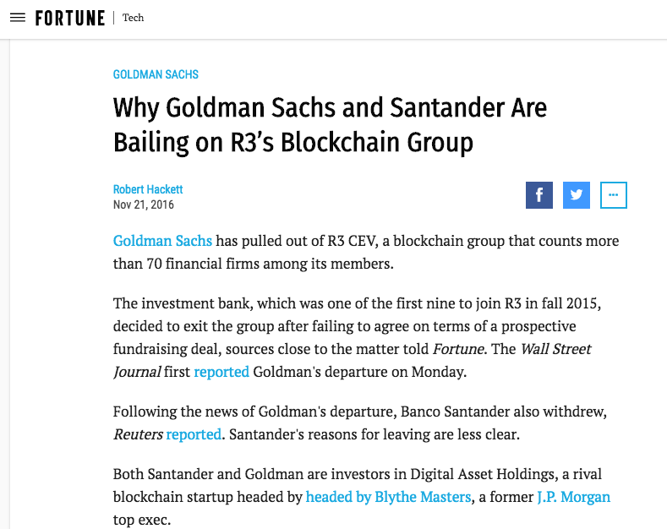
Jockeying Continues….

Slide 39
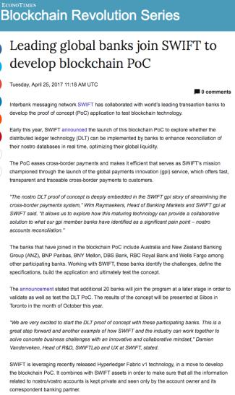
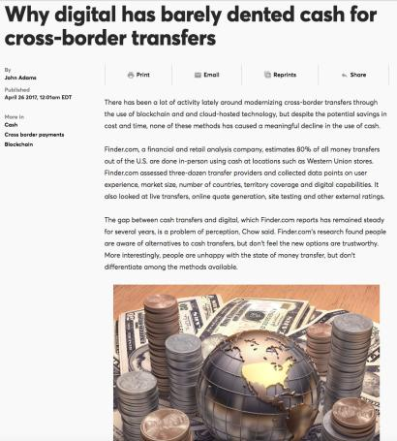
A Role in Cross-Border Payments?

Slide 40
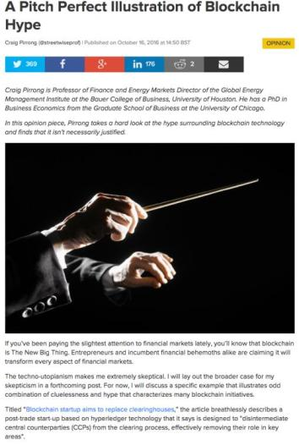
But Skeptics of the Blockchain Hype Persist—e.g., “disintermediating central counterparties from the clearing process…”
Source: CoinDesk.com

Slide 41
Healthcare: To Defy Automation (again)?
“It’s just not possible for the healthcare industry to be real time as it relates to claims,” said Dr Alyssa Hoverson Schott, a physician at Sanford Health who started this conversation at the Distributed Health conference earlier this month.
Hoverson Schott sees about 39 patients per day, inputting medical visit and procedural codes for each patient in between visits.
“There’s often not time right then to input the codes,” she said.
These codes are then sent to insurance providers who review the claim and negotiate down the bill. This negotiation process, which goes back and forth between the hospital and the insurance provider, can go on for 90 days.
Source: CoinDesk.com

Slide 42
Steve Mott’s Contact Info
0 1 0 1 0 1 0 1 0 1 0
1 0 1 0 1 0 1 0 1 0 1
0 1 0 1 0 1 0 1 0 1 0
1 0 1 0 1 0 1 0 1 0 1
0 1 0 1 0 1 0 1 0 1 0
1 0 1 0 1 0 1 0 1 0 1
0 1 0 1 0 1 0 1 0 1 0
1 0 1 0 1 0 1 0 1 0 1
0 1 0 1 0 1 0 1 0 1 0
1 0 1 0 1 0 1 0 1 0 1
0 1 0 1 0 1 0 1 0 1 0
Steve Mott BetterBuyDesign
1386 Long Ridge Road
Stamford, CT 06903
and 1214 Querida Drive
Colorado Springs, CO 80909
(o) 203.968.1967
(c) 203.536.0588
email: stevemottusa@gmail.com
website:www.betterbuydesign.com

