Slide 1
Corporate & Bank Relationships: The New Normal
Moderator:
Sandi Mellema‐Higgins
Hilary Farone,
Dawn L. Budd,
CTP, Relationship Management & Business Development
Assistant Vice President, Global Treasury
Assistant Treasurer, Executive Director
ETS
BNY Mellon Treasury Services
Chubb
May 4, 2017

Slide 2
Who We Are
The world’s largest publicly traded property and casualty (P&C) insurer, based on market capitalization of $61.5 billion.*
A truly global company, with local operations in 54 countries and territories.
Insurance is our only business.
Well balanced by product and customer:
  A global leader in traditional and specialty P&C coverage for industrial commercial and
  mid-market companies
  The leading commercial lines insurer in the U.S. and the largest financial lines writer globally
  The leader in U.S. high net worth personal lines and a large personal lines provider globally
  A global leader in personal accident and supplemental health insurance
  A P&C reinsurer
  An international life insurer focused on Asia
Chubb Limited, the parent company of Chubb, is listed on the New York Stock Exchange (NYSE:CB) and is a component of the S&P 500 index.
Exceptional financial strength, managing risk conservatively in both underwriting and investing.
Core operating insurance companies are rated “AA” for financial strength by S&P and “A++”
by A.M. Best.
*At December 31, 2016

Slide 3

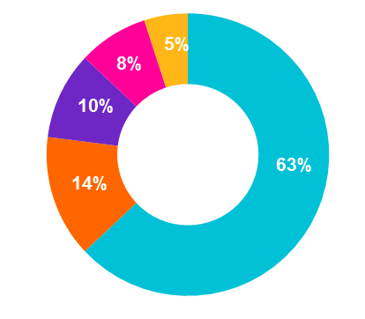
Global Reach
Chubb has an extensive local presence globally, with insurance professionals and operating subsidiaries in 54 countries.
Thirty-seven percent of the company’s business is transacted outside the United States.
Argentina
Australia
Austria
Bahrain
Belgium
Bermuda
Brazil
Canada
Chile
China
Colombia
Czech Republic
Denmark
Ecuador
Egypt
Finland
France
Germany
Gibraltar
Hong Kong
Hungary
Indonesia
Ireland
Italy
Japan
Korea
Macao
Malaysia
Mexico
Netherlands
New Zealand
Norway
Pakistan
Panama
Peru
Philippines
Poland
Portugal
Puerto Rico
Russia
Saudi Arabia
Singapore
South Africa
Spain
Sweden
Switzerland
Taiwan
Thailand
Tunisia
Turkey
United Arab Emirates
United Kingdom
United States
Vietnam
Geographic Sources of Premium (YTD)*
Bermuda/Canada
Latin America
United
States
Asia
Europe/
Eurasia & Africa
North America
Europe/Eurasia & Africa
Asia
Latin America
Premiums* $24.6 billion
Employees 17,758
Offices 203
Premiums* $5.0 billion
Employees 3,745
Offices 93
Premiums* $3.6 billion
Employees 5,379
Offices 230
Premiums* $2.7 billion
Employees 4,299
Offices 132
*Gross premiums written inclusive of the first 14 days of January prior to the acquisition close.

Slide 4

Company Business, Products & Operations
Treasury Organization
Controls all Incoming and Outgoing Cash
Educational Testing Service is the World’s Largest Private w/revenue $1.8B Educational Assessment and Research Organization with over 3,000 employees, and 125,000 proctors/readers worldwide.
Billing
Today, our nonprofit organization develops, administers and scores more than 50 million tests annually in more than 180 countries at over 9,000 locations.
Accounts Receivable
Incoming Cash
Areas of expertise:
  Research
  Assessment Development
  Test Administration
  Test Scoring
Credit Card - E Payments
Collections
ETS Subsidiaries:
  ETS Global B.V. - based in the Netherlands.
  Prometric - based in Maryland.
  Edusoft, Ltd - based in Israel
  Quester Assessment, Inc. - based in Minnesota
Cash & Investment Management / Bank Relationship Management
Accounts Payable & Travel Expense
Non Trade Payables
(Proctors/Readers)
ETS owned brands:
  GRE - Graduate level administration test
  TOEFL – English language test for admission
  TOEIC – English proficiency test
  PRAXIS – Educational licensure
  HiSET – High School equivalency test
Outgoing Cash
Payroll
Risk Management & ERP Solutions

Slide 5
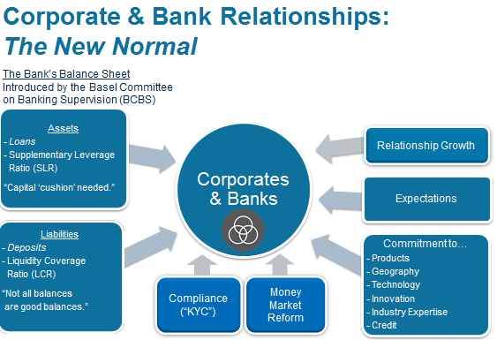

Slide 6
For more information, contact:
Sandi Mellema‐Higgins, BNY Mellon Treasury Services
sandi.mellema-higgins@bnymellon.com
Dawn L. Budd, ETS
dbudd@ets.org
Hilary Farone, Chubb
hilary.farone@chubb.com
This presentation is for private circulation and for general information and reference purposes only and is not intended to provide legal, tax, accounting, investment, financial or other professional advice on any matter. Not all BNY Mellon products and services are offered at all locations, and all are subject to final contractual agreements. BNY Mellon information, as presented on slide 5, does not undertake to update or amend this information and expressly disclaims any liability for any loss arising from this information or data.
Trademarks and logos belong to their respective owners.
©2017 The Bank of New York Mellon Corporation. All rights reserved.

