Slide 1
S&P Global Ratings:
An Introduction
Tara Ashmore
Director
May 4, 2017
Philadelphia PA
Permission to reprint or distribute any content from this presentation requires the prior written approval of S&P Global Ratings.
Copyright © 2017 by Standard & Poor’s Financial Services LLC. All rights reserved.

Slide 2
S&P Global Inc.

Slide 3

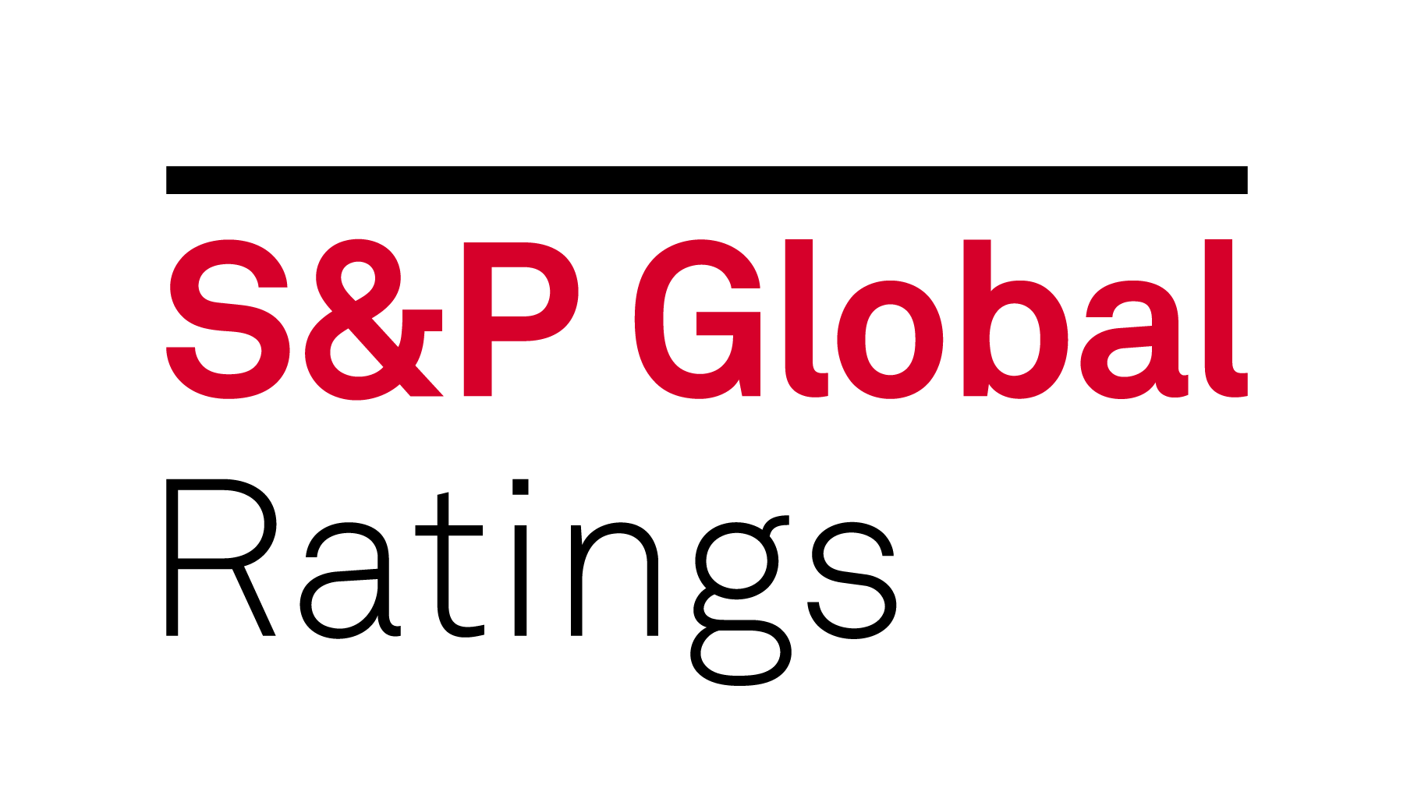


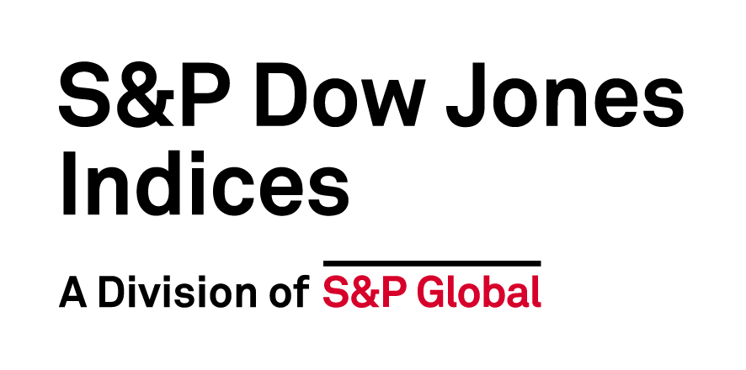

Our divisions work together to give you a 360 degree view.

Slide 4


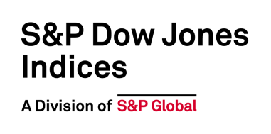



Our sister divisions
We provide data,
analytics, and sector
intelligence to gain
unrivaled insight
into the markets.
8,000+
As the world’s largest resource for iconic and innovative indices, we help investors identify, measure and capitalize on global investment opportunities.
daily prices assessments products
60%
more than 60% of the world’s internationally traded crude oil is priced against Dated Brent
>500
99%+
S&P Global Platts-based natural gas contracts listed on ICE and CME
120 years
global market capitalization covered
We are the leading
provider of energy
and commodity market
data, delivering information and analytics across more markets and more countries than anyone else.
existence of the Dow Jones Industrial Average
145,000+
$7.5T
automated data quality checks
in global assets (USD) benchmarked to our indices,
96%
>1M
client satisfaction rating for our
24/7/365 support
indices covering a wide range of asset classes
across the globe

Slide 5
Who We Are
S&P Global Ratings is a leading provider of credit ratings.
Our ratings are essential to driving growth, providing transparency and helping to educate market participants so they can make decisions with confidence.
Notes:
On the highest level, this is who we are and what we do

Slide 6
Who We Are (cont’d.)
We are part of S&P Global, the world’s foremost provider of credit ratings, benchmarks and analytics in the global capital and commodity markets. S&P Global’s divisions are:
S&P Global Ratings
S&P Global Market Intelligence
S&P Dow Jones Indices
S&P Global Platts
S&P Global’s goal is to provide the essential intelligence you need to make decisions with conviction
S&P Global’s principles:
    Integrity
    Excellence
    Relevance

Slide 7
Our Views And What We Do
  We believe that there is a marketplace need for financial information and transparency
    To provide investors with metrics for comparability
  Since 1860, this has been one of our core principles, starting with our founder, Henry Varnum Poor and his commitment to “the investor’s right to know”
  We update and refine our processes to align with developments
  in the marketplace
  This enables us to offer insightful opinions that help market participants make more informed decisions

Slide 8
S&P Global Ratings: Global Reach
  In business for 150+ years
  Provides global reach and local knowledge with an office
  network spanning 28 countries
  Approximately 1,500 ratings
  analysts issuing ratings on
  125+ countries
  More than 1 million credit ratings outstanding on government, corporate, financial sector and structured finance entities and securities
  More than $3.7 trillion in new debt rated in 2016
  Provides perspective on the creditworthiness of an entity
  or the debt it issues
Source, $ in new debt rated: Harrison Scott Publications, Thomson Reuters, S&P Global Ratings.

Slide 9

Our capabilities are foundational for our customers to make critical decisions every day.
Data & Analytics
Benchmarks
Credit Ratings
Research & Commentary

Slide 10


We drive value for our customers with our scale and expertise.
1000
$46.3T
public and private sector organizations in over 150 countries depend on our commodities pricing
par value of outstanding ratings
135B
#1
data points harnessed a year
index provider based on
the number of ETFs linked
to our indices and assets
in these products

Slide 11
Our Analytic Coverage
We cover these broad sectors:
Corporates
Financial institutions
Infrastructure
Sovereigns/international public finance
Structured finance
U.S. public finance
Insurance companies

Slide 12
What Are
Credit Ratings?
Notes:
Notes for What Are Credit Ratings?
This section helps you tell a broader story. It sets the work of S&P Global Ratings into the broader context of what credit ratings are, what role credit ratings play in the capital markets and what marketplace needs credit ratings can help meet. It also includes slides about our ratings categories, our ratings process, external regulations and a comparison of business models.

Slide 13
What Is A Credit Rating?
What It Is
And What It Is Not
  A forward-looking opinion about the ability and willingness of an issuer, such as a corporation or government, to meet its financial obligations in full and on time (i.e. creditworthiness)
  Strives to be globally comparable
  across sectors
  Incorporates views on the relative likelihood of default that are applied to entities (issuers) and securities (issues)
  One of many inputs available to investors as part of their decision-making process
  A guarantee of credit quality or default probability
  Investment advice or recommendation (buy, sell or hold)
  A measure of liquidity or price
  A way of defining “good” or “bad” companies
  An audit of the company
13
Notes:
Notes:
Please note the Statutory Definition:
Statutory Definition
an assessment of the creditworthiness of an obligor as an entity or with respect to specific securities or money market instruments". [Section 3(a)(60) of the '34 Act]

Slide 14
What Credit Ratings Do
They foster the development and smooth functioning of capital markets by providing transparent information and insight to market participants.
Smooth functioning of the capital markets enables:
Additionally, credit ratings provide investors with:
People to start and grow businesses
Governments to improve infrastructure
Manufacturers to build factories and
create jobs
Common terminology to describe different levels of creditworthiness (e.g., AAA)
Third-party opinions
Information to help make more informed decisions

Slide 15
Raising Capital Through Rated Securities
Issuers issue rated securities to raise capital
Issuers
Intermediaries
Investors
Investors purchase rated securities

Slide 16
Ratings: Filling A Gap Between Issuers And Investors
If borrowers/issuers seek to:
Optimize the cost of funding
Expand the pool of investors and available capital
Lengthen the terms of financing
Diversify funding sources
If investors seek:
A third-party opinion of credit quality
A basis for comparison across asset classes, geographies
and peers
Information and metrics to make informed decisions
Then consider credit ratings
Third-party perspective
Comparable
Forward-looking

Slide 17
S&P Global Ratings: Meeting Issuer Needs
When you want to:
Consider our:
Access the debt capital markets
Issue ratings for bonds or bank loans
Assist in pricing discovery and market liquidity
Find a tool to help negotiate
credit conditions with banks and other financial counterparties
Bank loan ratings
Assist in pricing discovery and market liquidity
Reduce your cost of funding
Issue ratings for bonds or bank loans
Assist in pricing discovery and market liquidity
Improve your bargaining
power with suppliers/other
non-financial counterparties
Corporate credit ratings
Describe your credit strength, a credit credential

Slide 18
Our Global Economics and Research Groups
Ratings Analyst Community
Global Economics
Research and Commentaries
Macroeconomic forecasts
and research
Research that looks across the
universe of rated securities
and entities
Issuers
Investors
Other Market Participants
Notes:
Circa 2500 research commentaries p.a.
research and commentaries includes Global Fixed Income Research

Slide 19
S&P Global Ratings: Meeting Investor Needs
Consider our broad range of products and services when you want to:
Assess credit risk
Compare different issuers
and/or debt issues
Supplement internal credit analysis
Establish thresholds for credit risk;
establish investment guidelines

Slide 20
Our Ratings Categories
AAA | Extremely strong capacity to meet financial commitments. Highest rating.
AA | Very strong capacity to meet financial commitments.
A | Strong capacity to meet financial commitments, but somewhat susceptible to adverse economic conditions and changes in circumstances.
BBB | Adequate capacity to meet financial commitments, but more subject to adverse economic conditions.
BBB- | Considered lowest investment grade by market participants.
BB+ | Considered highest speculative grade by market participants.
BB | Less vulnerable in the near term, but faces major ongoing uncertainties and exposure to adverse business, financial or economic conditions
B | More vulnerable to adverse business, financial and economic conditions, but currently has the capacity to meet financial commitments.
CCC | Currently vulnerable and dependent on favorable business, financial and economic conditions to meet financial commitments.
CC | Highly vulnerable; default has not yet occurred, but is expected to be a virtual certainty.
C | Currently highly vulnerable to non-payment, and ultimate recovery is expected to be lower than that of higher rated obligations.
D | Payment default on a financial commitment or breach of an imputed promise; also used when a bankruptcy petition has been filed or similar action taken.
Investment Grade
Speculative
Grade
Ratings from ‘AA’ to ‘CCC’ may be modified by the addition of a plus (+) or minus (-) sign to show relative standing within the major rating categories.
See “Ratings Definitions” on www.spglobal.com/ratings.

Slide 21
Comparison Of Rating Agencies’ Business Models
Subscriber Model
  Certain investors, such as hedge
  funds and financial companies,
  would contract and pay for ratings reports to receive them on a
  non-public, proprietary basis.
Government Utility Model
  A ratings organization is run or directed by a government and
  may be funded by investors, subscribers, or a public tax on issuance or outstanding debt.
Issuer-Pay Model
  Issuer organizations pay fees
  to a rating firm as part of the
  process to issue securities
  in the marketplace.
Each business model has distinct advantages and disadvantages.
S&P Global Ratings utilizes the Issuer-Pay model.
We believe this model provides the greatest transparency to the market.
By allowing public ratings to be made available free of charge to all investors, this model
avoids selective disclosure and levels the playing field for all market participants.
Public disclosure of ratings means our opinions are subject to market scrutiny every day.

Slide 22
What Are
Our Capabilities?
Notes:
Notes for What Are Our Capabilities?
This section comes back to Ratings Services and helps you give the audience a closer look at what we do. It summarizes the breadth and depth of our analytic coverage – by sector, industry and asset class. It includes a slide on our global economics and research groups. It also gives examples of our ratings criteria for corporates and sovereigns.

Slide 23
The Breadth of Our Analytic Coverage
(Number of Issues Rated)
Corporate Ratings
50,672
Financial Institutions Ratings
58,582
Insurance Companies Ratings
6,859
Government Securities Ratings
952,910
Structured Finance Ratings
49,162
Source: S&P Global Ratings, year-end 2016.

Slide 24
Our Rating Process
1. Origination
  A customer requests a rating and receives our Terms and Conditions. S&P Global Ratings will determine whether it has the resources and information available to issue a rating.
2. Analytic Review
  An analyst collects and evaluates information and prepares the recommended rating action.
3. Rating Committee
The analyst presents the recommended rating action. The committee reviews the recommendation and committee presentation materials and votes on the credit rating action.
6. Surveillance
The goal of surveillance is to keep the rating current by identifying issues that may result in a change to the rating.
5. Publication
  We publish a press release announcing the public rating and post the rating on our external website, www.standardandpoors.com.
4. Rating Notification &
Pre-Release
  The analyst may notify the customer of the rating decision and provide an opportunity to review the written rationale for fact-checking and accuracy purposes.
Notes:
24
Depending on audience, consider noting that our rating process is generally similar for all issuers, including corporations, governments and financial institutions. There may be some differences, including with respect to rating structured finance instruments. These differences involve the way the process is initiated and conducted, which ratings criteria and models apply, and the kinds of information that analysts review.

Slide 25
Primary Elements Of Our Corporate Rating Criteria
Country Risk
Industry Risk
Competitive Position
Cash Flow/Leverage
Rating
Diversification/Portfolio Effect
Capital Structure
Financial Policy
Liquidity
Management/Governance
Comparable Ratings Analysis
Group or Government Influence

Slide 26
Ratings Distribution: Global Corporates
Share of corporate issuers by rating category and by region as of March 31, 2016. Source: Ratings Distribution In Emerging And Developed Markets, Including The U.S. And Europe, as of First Quarter 2016, May 23, 2016, Table 1.

Slide 27
Ratings Distribution: U.S. Corporates
Share of corporate issuers by rating category and by region as of March 31, 2016. Source: Ratings Distribution In Emerging And Developed Markets, Including The U.S. And Europe, as of First Quarter 2016, May 23, 2016, Table 1.

Slide 28
Ratings Distribution: Asia Pacific Corporates
Data as of April 21st, 2017. Source: S&P Global Fixed Income Research and S&P Global Market Intelligence's CreditPro.

Slide 29
Ratings Distribution: European Corporates
Share of corporate issuers by rating category and by region as of March 31, 2016. Source: Ratings Distribution In Emerging And Developed Markets, Including The U.S. And Europe, as of First Quarter 2016, May 23, 2016, Table 1.

Slide 30
Ratings Distribution: U.S. Corporates (non Financial)
Data as of Dec. 31, 2016. Source: S&P Global Fixed Income Research; Standard & Poor’s CreditPro®.

Slide 31
Ratings Distribution: U.S. Corporates (Financial)
Data as of Dec. 31, 2016. Source: S&P Global Fixed Income Research; Standard & Poor’s CreditPro®.

Slide 32
Thank you
Tara Ashmore
Director -- Southeast
T: 212.438.3252
tara.ashmore@spglobal.com
Charles Greenwald
Director -- Northeast
T: 212.438.2280
charles.greenwald@spglobal.com

Slide 33
How Have Ratings Performed?
Notes:
Notes for How Have Ratings Performed?
This shows our ratings performance, set against default rates over five-, 10- and 20-year time periods. Using corporates for the examples, key takeaway is that our ratings have performed over time – with much lower default rates for corporates rated investment grade and much higher default rates for those rated below investment grade.

Slide 34
Default Risk: What Our Research Shows
The lower the corporate rating, the higher the likelihood of default
The higher the corporate rating, the lower the likelihood of default
Of all the companies we rated as “investment grade” (BBB- and above) between 1981 and 2016, just 1% defaulted within 5 years
Of all the companies we rated “below investment grade,” (BB+ and below) 15% defaulted within 5 years
Source: Default, Transition, and Recovery: 2016 Annual Global Corporate Default Study And Rating Transitions, Apr. 13, 2017,
S&P Global Fixed Income Research. Table 24.

Slide 35
Global Corporate Issuers
Average Cumulative Default Rates Over 10 Years
Ratings Performance Over Time
60%
50%
40%
30%
20%
10%
0%
Percentage of defaulted corporate issuers by rating category, combined to obtain cumulative default rates for the 10-year period. Source: Default, Transition, and Recovery: 2016 Annual Global Corporate Default Study And Rating Transitions, Apr. 13, 2017,
S&P Global Fixed Income Research, Table 24.

Slide 36
Global Default Rate By Ratings Category
60%
50%
40%
30%
20%
10%
0%
Percentage of defaulted corporate issuers by rating category, combined to obtain cumulative default rates for the 20-year period. Source: Default, Transition, and Recovery: 2016 Annual Global Corporate Default Study And Rating Transitions, Apr. 13, 2017,
S&P Global Fixed Income Research, Chart 4.
Notes:
Speaker note: data for this chart comes from 1981-2014 and the graph represents the average of any 20 year period within this time frame.

Slide 37
Copyright © 2017 by Standard & Poor’s Financial Services LLC. All rights reserved.
No content (including ratings, credit-related analyses and data, valuations, model, software or other application or output therefrom) or any part thereof (Content) may be modified, reverse engineered, reproduced or distributed in any form by any means, or stored in a database or retrieval system, without the prior written permission of Standard & Poor’s Financial Services LLC or its affiliates (collectively, S&P). The Content shall not be used for any unlawful or unauthorized purposes. S&P and any third-party providers, as well as their directors, officers, shareholders, employees or agents (collectively S&P Parties) do not guarantee the accuracy, completeness, timeliness or availability of the Content. S&P Parties are not responsible for any errors or omissions (negligent or otherwise), regardless of the cause, for the results obtained from the use of the Content, or for the security or maintenance of any data input by the user. The Content is provided on an “as is” basis. S&P PARTIES DISCLAIM ANY AND ALL EXPRESS OR IMPLIED WARRANTIES, INCLUDING, BUT NOT LIMITED TO, ANY WARRANTIES OF MERCHANTABILITY OR FITNESS FOR A PARTICULAR PURPOSE OR USE, FREEDOM FROM BUGS, SOFTWARE ERRORS OR DEFECTS, THAT THE CONTENT’S FUNCTIONING WILL BE UNINTERRUPTED OR THAT THE CONTENT WILL OPERATE WITH ANY SOFTWARE OR HARDWARE CONFIGURATION. In no event shall S&P Parties be liable to any party for any direct, indirect, incidental, exemplary, compensatory, punitive, special or consequential damages, costs, expenses, legal fees, or losses (including, without limitation, lost income or lost profits and opportunity costs or losses caused by negligence) in connection with any use of the Content even if advised of the possibility of such damages.
Credit-related and other analyses, including ratings, and statements in the Content are statements of opinion as of the date they are expressed and not statements of fact. S&P’s opinions, analyses and rating acknowledgment decisions (described below) are not recommendations to purchase, hold, or sell any securities or to make any investment decisions, and do not address the suitability of any security. S&P assumes no obligation to update the Content following publication in any form or format. The Content should not be relied on and is not a substitute for the skill, judgment and experience of the user, its management, employees, advisors and/or clients when making investment and other business decisions. S&P does not act as a fiduciary or an investment advisor except where registered as such. While S&P has obtained information from sources it believes to be reliable, S&P does not perform an audit and undertakes no duty of due diligence or independent verification of any information it receives.
To the extent that regulatory authorities allow a rating agency to acknowledge in one jurisdiction a rating issued in another jurisdiction for certain regulatory purposes, S&P reserves the right to assign, withdraw or suspend such acknowledgement at any time and in its sole discretion. S&P Parties disclaim any duty whatsoever arising out of the assignment, withdrawal or suspension of an acknowledgment as well as any liability for any damage alleged to have been suffered on account thereof.
S&P keeps certain activities of its business units separate from each other in order to preserve the independence and objectivity of their respective activities. As a result, certain business units of S&P may have information that is not available to other S&P business units. S&P has established policies and procedures to maintain the confidentiality of certain non-public information received in connection with each analytical process.
S&P may receive compensation for its ratings and certain analyses, normally from issuers or underwriters of securities or from obligors. S&P reserves the right to disseminate its opinions and analyses. S&P's public ratings and analyses are made available on its Web sites, www.standardandpoors.com (free of charge), and www.ratingsdirect.com and www.globalcreditportal.com (subscription), and may be distributed through other means, including via S&P publications and third-party redistributors. Additional information about our ratings fees is available at www.standardandpoors.com/usratingsfees.
Australia
Standard & Poor's (Australia) Pty. Ltd. holds Australian financial services license number 337565 under the Corporations Act 2001. Standard & Poor’s credit ratings and related research are not intended for and must not be distributed to any person in Australia other than a wholesale client (as defined in Chapter 7 of the Corporations Act).
STANDARD & POOR’S, S&P and RATINGSDIRECT are registered trademarks of Standard & Poor’s Financial Services LLC.

