Slide 1
Making Real Time Transfer of Money and Data a Reality
November 2019

Slide 2




LANDSCAPE
The world is transforming and demanding Real-time Payments
Rising customer expectations
Consumer expectations in an on-demand society are driving up business expectations for payments to be as modern as in their personal lives
Constant disruptive technologies
Rapid digital growth and technological advances like machine learning, AI, cloud, APIs, open banking are changing how payments work every day and driving efficiencies
85%
of FIs globally believe that Real-time Payments are the foundation for growth and innovation¹
Explosion of fintechs
New entrants are aggressively innovating and gaining traction -In 1H 2019 alone, 470 funding deals for fintechs valued at $18B were secured in the US²
Increasing government engagement
Governments globally are getting into the game, pushing a modernization agenda – several governments are taking the lead on RTP network development
©2018 Mastercard. Proprietary and Confidential.
Sources: 1. ACI Worldwide, 2018 Global Payments Insight Survey: Retail Banking; 2. KPMG, “The Pulse of Fintech, 2019”
Notes:
Intro – If we think about all the transformations, RTP sits at the epicenter of them all
RTP is one of the most exciting transformations we will see – because as we talk about all these other transformations taking place, RTP will benefit from so many of them and serve as a key foundation for innovation
New payment advances – open banking, real time payments
Technology- Machine learning Cloud, APIs
Governments are increasingly getting into the game – here and especially abroad
The fintech space is hot
Customer expectations continue to rise – and this is transcending into the B2B space
Massive disruption in payments is demanding modernization
Digital growth and technological advances – machine learning, AI, cloud, APIs, open banking, etc.
Consumer expectations continue to rise, and this is transcending into the business payments space
We live in an “on-demand society” where consumers experience most services in real-time and a wave of new digital tools have transformed how consumers shop, travel, and manage their finances. With high costs and inefficiencies, businesses are increasingly demanding their payment processes to be as simple and seamless as in their personal lives.
Corporate clients are demanding value-added services that support omni-channel payment integration, vertically integrated services inside their banks, and more comprehensive data capabilities that will drive further innovation
The US fintech space is hot (pitchbook.com to be sourced)
Issuers are looking toward new ways to cut costs through fintech engagements. Issuers in NAM can cut up to $30B in operational costs this way (BCG, 2019)
Governments are increasingly getting into the game – in the US and especially abroad

Slide 3


LANDSCAPE
RTP has taken hold globally and becoming the norm
Many prior markets were government mandated, but models are increasingly bank-driven today
Japan launches
1st quasi real-time payments system
Real-time payments adoption starts to accelerate globally
Singapore FAST launches
to keep pace with business
& consumer needs
2014
Real Time Payments launches in the USA, its 1st major payments infrastructure in 40+ years
2017
Switzerland
Taiwan
Iceland
Mexico
Chile
Turkey
Australia
Romania
Japan
India
Bahrain
Poland
Denmark
Hong Kong
Bulgaria
Nigeria
Argentina
Czech Republic
Croatia
Brazil
South Africa
England
China
Ghana
1973
1980s
South Korea
Sri Lanka
Philippines
Norway
2000s
Thailand
Sweden
Malaysia
Russia
2008
UK Faster Payments launches, revolutionising banking in Britain*
2017
PromptPay Thailand launches, contributing towards 83% rise in digital payments**
70+
countries have or are
implementing real-time payments†
87%
of the world’s GDP is in markets
with real-time payments†
67%
of the world’s population has
access to real-time payments†
2x
transaction volumes have
doubled globally in the last year†
Sources: * Fis Flavors of Fast 2018; **Bank of Thailand; ***McKinsey Global Payments 2018; †Internal estimates
Notes:
RTP systems are proliferating globally at an accelerated pace. Markets representing 87% of the world’s GDP have or are launching RTP systems. As of 2019, 46 RTP systems are live with an additional 12 under development
Vocalink technology powers many markets – UK, Singapore, Thailand, US in 2017
RTP is becoming the norm
87% of the world’s GDP is in markets (the population in those markets/the GDP in those markets = 87%) – get a list of all countries

Slide 4
RTP OVERVIEW
The U.S. RTP system is poised to unlock a new level of innovation, driving value beyond speed
First RTP system to widely adopt ISO 20022 standard and deploy advanced data and messaging capabilities
Rich RTP message types open up new product development opportunities
Payment messages
Contain credit transfer transaction information sent by the debtor FI to the creditor FI for single payment transaction (e.g., payment instruction and status)
COMMON, PREFERRED LANGUAGE FOR BANKS
As banks already use the robust ISO 20022 framework today, the U.S. RTP system is enabling more flexible, scalable, interoperable, and secure information with the payment and across bank channels, globally
ISO 20022
Value-added nonpayment messages
Can be used to initiate / support payment messages (e.g., payment confirmation, request for payment, remittance advice, request for information)
MORE THAN PAYMENT MESSAGES
In addition to payment messages, RTP uniquely supports rich non-payment messages like Request for Pay, Payment Confirmation, Extended Remittance Advice, and several exception and admin messages
Exception messages
Sent if RTP system does not successfully complete a message (e.g., questionable transaction, system cancel, token not valid, payment rejected by receiver)
EXTENSIVE MESSAGING
Admin messages
Serve to notify users of any service disruptions to the RTP system
Notes:
Unlike other markets, the Real Time Payments System in the United States has a strong emphasis on data and messaging.
With 5 messaging types supported, and the adoption of the ISO20022 data standard, the RTP system is the most advanced payment system in the world
Banks are not only able to offer their customers a real time settlement option, but are able to innovate around customer pain points and inefficiencies in the market by taking advantage of the data standard and messaging functionality
ISO 20022 is an international framework that enables a real-time, common language: for global financial communications across debtors, creditors, and their Fis – it enables more scalability and uniformity with banks, who have already been using the ISO 20022 standard
The most powerful messaging type supported is the Request for Payment. This simple message type allows a biller to request payment from a payer. In the example shown on the slide you can see how the process of bill presentment, payment and confirmation are simplified through the RFP messaging.
The US RTP system, with is advanced data and messaging functionality, has the opportunity to unlock even more profit pools and opportunities than in other markets.
*** In the right hand – create a glossary of terms for those in the appendix
Admin – anything that is a non payment message. A lot of these are about outages.

Slide 5






MARKET OPPORTUNITY
The promise of RTP lies in the information synced with the payment and rich messaging capabilities
RTP KEY BENEFITS
Confident commerce
Instant funds availability 24/7/365
Irrevocable, yet safe & secure
Contextual commerce
Information and payment via same channel
Information and payment arriving in sync
Richer information with the payment
Conversational commerce
Payment + non-payment messages
Bi-directional communication
Supplier
Buyer
1
2
3
Notes:
Key benefits of the RTP system beyond speed, which no other payment system can collectively offer as compared to traditional channels:
Information with the payment
Only payment system where information and payment move together in the same channel
Information and payment arrive at the same time, in seconds, 24/7/365 and are irrevocable
More robust information can be coupled with the payment
Rich messaging allowing for conversational commerce
Both payment and non-payment messages can be supported
Messages can go back and forth, allowing for richer2-way communication
These benefits in practical terms:
Information with the payment can enable more robust and complete reconciliation data
Enhanced messaging capabilities allow corporate senders to know the moment their payment hits the receiver’s account, dramatically improving payment settlement transparency

Slide 6
MARKET OPPORTUNITY
Large and inefficient, B2B flows are the biggest opportunity for RTP
RTP can help businesses solve for traditional payment channel issues for like - high processing/reconciliation costs, working capital challenges, low transparency and insufficient data
Checks and ACH dominate a huge market
Data gaps are driving inefficiencies
Checks are adding costs to the system
$19T
Key blockers for businesses to migrate to digital payments²…
$31
71%
No standard format for remittance info
Trading partners cannot send or receive digital payment info
U.S. B2B payments market size,
dominated by paper & batch ACH¹
per transaction
costs for traditional manual processing vs. electronic methods³
©2018 Mastercard. Proprietary and Confidential.
58%
Sources:
Kaiser Assoc, McKinsey, Oxford Economics, Euromonitor Passport & Mastercard analysis. Nilson and Moffett Nathanson estimates
AFP Electronic Payment Survey 2016 and consulting research report
RPMG, 2015 Electronic Accounts Payable Benchmark Survey
Notes:
B2B payments today are large and inefficient.
Business payments have seen relatively little innovation, but that is changing with the emergence of fintechs and challenger banks.
The business opportunity sits at $125T globally, split amongst C2B payments and B2B ($110T for B2B, $15T in C2B payments) The NAM opportunity is ~$19T
Only 2% of total B2B flows carded globally / 7% in NAM
Checks and ACH dominate the B2B market, yet checks are costly ($31/transaction) and businesses are far from satisfied with batch ACH
Additionally, with traditional payment channel issues like insufficient data, lack of data standardization, and the data and payment commonly moving out of sync – all leading to high operating and reconciliation costs – RTP rich information/messaging capabilities are a key opportunity for payments innovation and solving real business pain points.

Slide 7


MASTERCARD RTP STRATEGY
Mastercard is leading the RTP shift with a multi-tiered go-to-market approach
INFRASTRUCTURE
Power the underlying technology and rails for The Clearing House
APPLICATIONS
Deliver end-user solutions enabled by core assets and capabilities, based on our core philosophies:
Solve real pain points
Capitalize on the data benefits
Enable payment optionality
Accelerate with partnerships
In addition to standing up critical RTP infrastructures in an increasingly common way, we are delivering overlay applications and services that sit on top of the rails – helping banks to monetize their RTP investments, driving interoperability at the application layer, and creating deeper value and relevancy for end customers
©2018 Mastercard. Proprietary and Confidential.
VALUE-ADDED SERVICES
Meet rapid changes in the ecosystem with advanced data and analytics
Fraud and verification solutions
Strategic consulting services
Notes:
Mastercard is leading the shift to RTP, bringing together market-leading technology and assets, with a culture of innovation:
We are developing RTP offerings at each level (infrastructure, applications and services), and through this approach Mastercard has the power to support the transformation of the global payments ecosystem
Infrastructure: Vocalink's technology powers the US RTP system, which is operated by The Clearing House
Applications: Overlay applications that sit on top of the rails that banks are connecting to – thereby creating deeper value for customers
Services: We offer value-added services that drive RTP strategy & performance for banks & corporates, including financial crime solutions that leverage real-time and high-volume data, overlaying machine learning and advanced technologies, to help protect schemes, financial institutions, and their customers from fraud and financial crime
Mastercard’s value is unparalleled in market. No other entity rivals us in terms of technology/assets, networks, data & security, analytics, innovation, and partnerships within the card and account-based payment environments
Vocalink is the pioneer of real time payments infrastructure globally
Nets provides leading technology and expertise that will turbo-charge our global efforts by extending Mastercard’s A2A capabilities deep into continental Europe
We’re actively working to solve business needs and payment inefficiencies with innovative applications
BPX - A solution that will enable consumers to view, manage and pay their bills instantly from their bank accounts – in a matter of seconds versus days
POD – A solution connecting banks, ERPs, buyers and suppliers to provide payment velocity, payment precision and rich messaging across the ecosystem to enable instant electronic payment and reconciliation for goods at the moment of delivery
SMB – A solution that helps SMBs get paid faster and more efficiently
Disbursements – A solution which POD sets the foundation for. A platform connecting systems of detached parties in the insurance claims approval-to-payment process, leveraging dynamic messaging to automate invoicing, payment and reconciliation

Slide 8


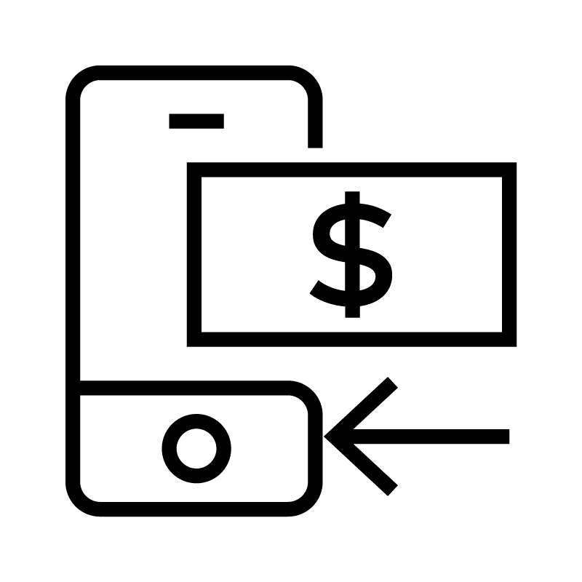

MASTERCARD RTP APPLICATION: C2B USE CASE
Mastercard Bill Pay Exchange: Reimagining bill pay with the first consumer application built on RTP rails in the U.S.
Builds on the strength of our RPPS directory (over 135k billers) to enable consumers to pay their bills instantly – in seconds vs. days – from their bank accounts to avoid late fees and service disruptions
Biller Setup
Bill Presentment
Bill Payment
Payment Confirmation
Simplified biller setup for the consumer:
  Real-time validation of biller linking to consumer account
  “Smart” Biller Set-up
New payment channel for billers
Access to view bill summary and full bill details
Ability for biller to send multiple reminders through bank channel
ACH batch (i.e. RPPS)
Real-time payment via bank account
Pay with credit, debit or prepaid card
Real-time consumer confirmation
Real-time payment confirmation and automated reconciliation for the biller
73%
of consumers said instant transfer capabilities would be important in choosing a bank
Source: Aite Research, “How Americans Pay Their Bills,” January 2017
Notes:
The consumer bank bill pay experience in the US is not optimal. For example, if need to pay your electric bill right away, or if you want to collect rewards by paying with credit card. Not to mention over 50% of bills are still sent by paper check.
Introducing Bill Pay Exchange – A new payment solution that enables consumers to pay their bills instantly – in a matter of seconds versus days – from their bank accounts, making it easier for them to avoid late payment fees or service disruptions.
Importantly, utilizing RTP, the bill pay process becomes simplified for both the consumer and the business, with the payment information staying conveniently intact with the payment itself.
It also provides financial institutions with cutting-edge services that help them to drive RTP performance as well as identifying and preventing financial fraud.

Slide 9
MASTERCARD RTP APPLICATION: B2B USE CASE
Payment on Delivery: The first step in our B2B RTP journey, addressing real customer needs
Key pain points are high costs to process/reconcile checks, plus driver safety risk and long delivery dock times
SUPPLIERS
BUYERS
“
Drivers spend 5-10 minutes per stop waiting for checks and we make 800,000 stops per year. This is the most inefficient part of the process.”
“
I check my bank account every single evening to see what checks have processed and understand our position.”
“
We need to decrease dock time and get our drivers in and out.”
“
I spend so much time writing a ton of checks. It probably takes one full working day every two weeks.”
“
“
“
Paper invoices are hard to keep track of, and sometimes get ruined.”
We have 17 FTEs waiting to receive invoices and payments from drivers as they return, to reconcile these and make deposits.”
Sources: Mastercard stakeholder interviews, January 2019
Notes:
Check/cash and manual processes like paper invoices impact all stakeholders, leading to high reconciliation/operating expenses, working capital issues, and low cash management transparency.
Distributors face other critical pain points such as long wait times at the place of delivery and driver safety with so much check/cash handling.
For merchants, the confirmation message is critical so that they know that money is out and paid, and they can rest easier with better insight into their cash position.

Slide 10
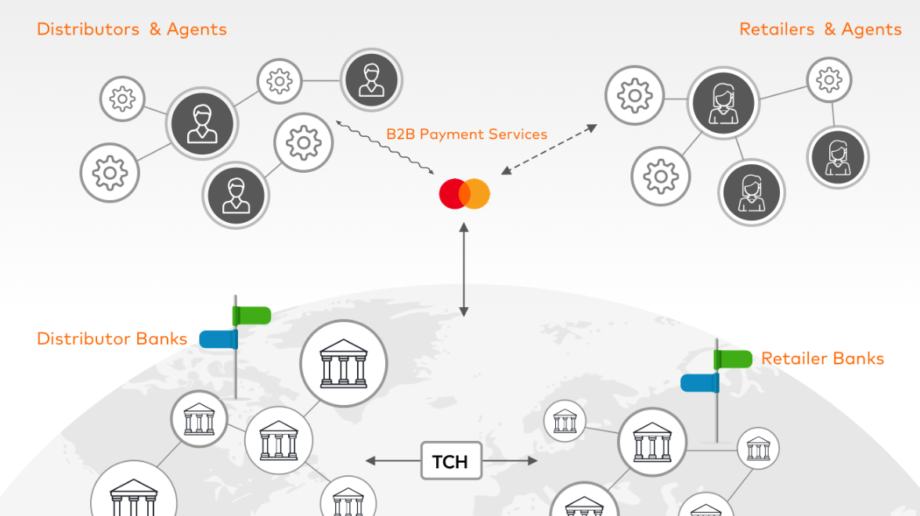
MASTERCARD PAYMENT ON DELIVERY – SOLUTION OVERVIEW
Our B2B solutions will connect banks, ERPs, suppliers and buyers at scale to enable payment velocity and rich messaging across the ecosystem
Data Transformation
Convert invoice data from ERPs into ISO 20022 request for pay message for banks
Dynamic Messaging
Facilitate messaging between retailers and banks, to authorize payment upon acceptance of delivery
Reconciliation Enablement
Confirm and sync payments at delivery with data-rich remittance messages to ERPs for auto-reconciliation
Notes:
This application enables instant payment collection and associated product reconciliation data upon delivery of goods. By connecting banks, ERPs, suppliers and buyers at scale, this service streamlines the operating fundamentals for both distributors and merchants.
Mastercard’s Payment on Delivery solution will connect banks, agents/ERPs, buyers, and suppliers at scale to enable payment velocity and precision, and rich messaging across the ecosystem. This will be enabled by: Transforming invoice data from the Supplier ERP and creating data-rich ISO 20022 request for payment messages packaged for the Supplier Bank; facilitating dynamic messaging between Buyers and their agents/banks to authorize payment upon acceptance of delivery; and confirming payment with accompanying data to buyer and supplier participants for streamlined reconciliation.
**Edit to B2B Mastercard Track Payment Services

Slide 11
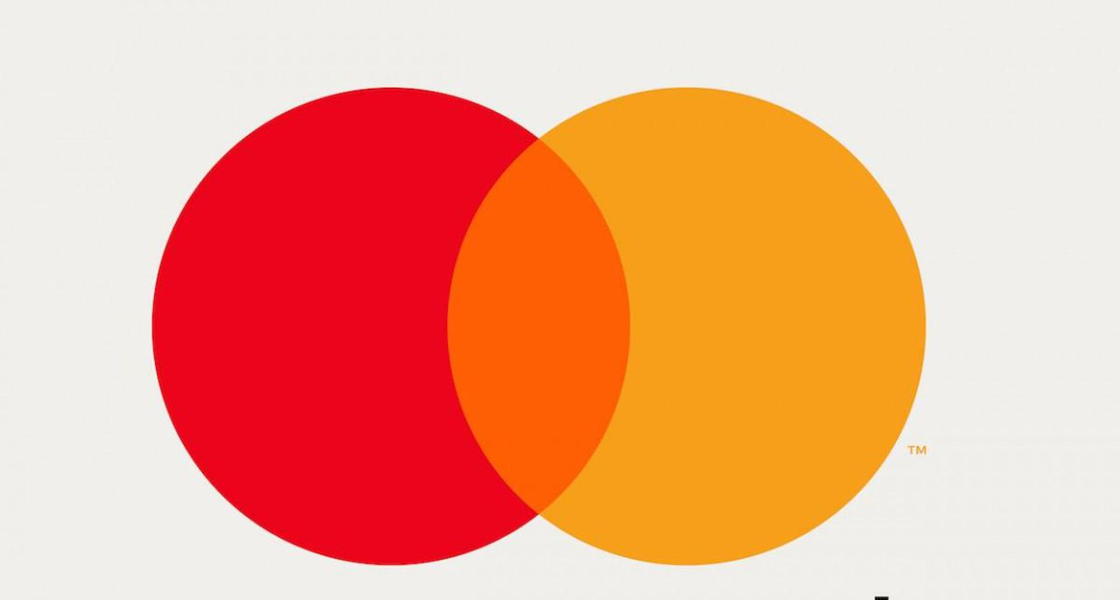







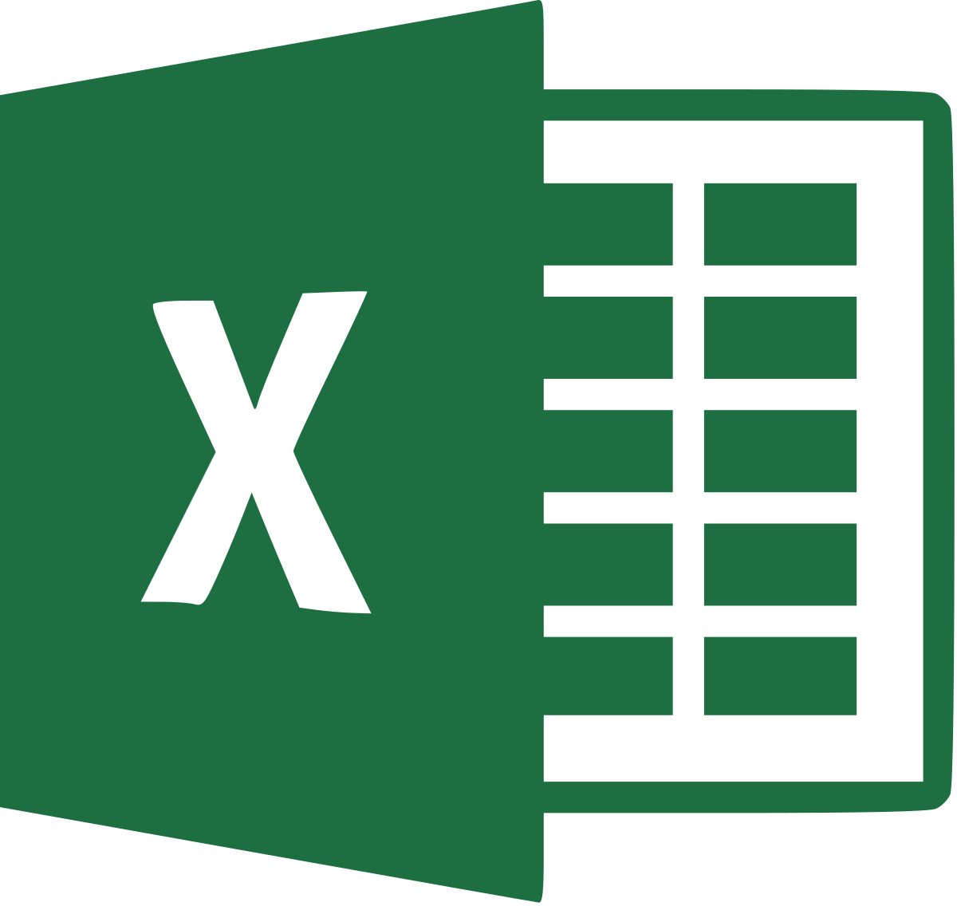


MASTERCARD B2B STRATEGIC APPROACH
Payment on Delivery is powered by the Mastercard Track Business Payment Service designed to transform B2B payments at scale
Mastercard is bringing to B2B what we brought to consumer payments over 50 years ago – a 4-party model that will optimize both sides of a transaction and deliver payment optionality and value-added services for businesses
Buyers
Players Representing Buyers
Players Representing Suppliers
Suppliers
Mastercard Track Business Payment Service
Bank
Procure to Pay
Buyer/supplier directory
Acquirer
Supplier payment rules
A/R Software
Restaurant Chain
Food distributor
Bank
A/P Software
Rich remittance data
B2B Network
Acquirer
A/P Software
Payment network interface
Procure to Pay
Manufacturer
Retail
Excel
Card
Excel
Processor
Bank
A2A; ACH, RTP, XB
BANKS
BANKS
Notes:
Payment on Delivery is being built on the Mastercard Track Business Payment Service (BPS) platform.
Mastercard’s B2B payments strategy centers on streamlining the complexity of the B2B ecosystem, where buyers and suppliers are using all different systems, formats, and processes. Mastercard is building the Business-to Business Payment Service (BPS) platform, establishing a new 4-party model to connect businesses in a robust network governed with rules, standards, and economics. The BPS network will bring together Agents (ERPs, banks, etc.) that represent Buyers and Suppliers in order to drive efficiency and standardization across both sides of a B2B transaction. Optimized payment processing, payment rail optionality, and value added services will ultimately enable improved working capital, processing/reconciliation costs, and transparency for businesses. Payment on Delivery will be an application built on the BPS framework.
When it comes to real-time payments, choice is key. Business needs are far more complex and cannot be approached with a one-size-fits-all solution:
Mastercard believes faster payments represents the future of payments, and that financial institutions globally should be out there actively testing and piloting new applications. Mastercard with its real-time payments capabilities is well positioned to help our partners do just that in both the consumer and business payments space
With Vocalink technology, we can move information with the dollars and enable rich messaging to make reconciliation easier
Through Mastercard Send, we can address the unique needs of the insurance, gig and healthcare industry – where payments are expected to keep pace with the way we live our lives
While push to card works in certain scenarios, RTP is the answer for others
By working with Mastercard on RTP applications, you can leverage our multi-rail capabilities to ensure payment certainty and optionality until RTP reaches ubiquity
Through Mastercard Track Business Payment Service (BPS), a single connection bringing together (1) multi-rail capabilities to enable payment choice from card to account-to-account/Real-time Payments; (2) greater control with common, extensible, global standards; and (3) richer data – to optimize B2B transactions for both suppliers and buyers
By combining Mastercard’s core offerings and Vocalink’s assets, Mastercard is playing a larger role in the broader payments ecosystem
Mastercard’s business payment strategy is simple yet effective; offer a robust set of payment capabilities that span multiple rails, while offering best in class innovation, safety and security.
Moreover, we fundamentally believe that it is the banks choice of which rails they choose, how they want to optimize those choices and if they offer them to the end consumer or corporate.
Real Time Payments is a critical component of our strategy and value to bank partners.
**Focus will be on payment optionality

Slide 12

MASTERCARD B2B SOLUTIONS – VALUE PROPOSITION
Value will be created for all stakeholders, improving OPEX, working capital, and transparency
Suppliers
Improve working capital
Reduce operational costs
Increase driver safety with less cash
Optimize delivery operations
Buyers
Streamline business management
Improve control in payment processes
Improve cash flow transparency
Increase safety with less cash
Agents/ERPs
Banks
Increase payment process efficiencies
Offer new, differentiated capabilities
Improve customer stickiness
Gain additional revenue
Meet expectations for digital
Reduce check costs
Improve customer engagement
Add new revenue stream

Slide 13

WHY NOW
RTP is here and coming in a big way, driven by customer demand
Early movers are positioned to win
BENEFITS FOR BANKS
Meet customer expectations
85% of business customers want to implement RTP over the next 2-3 years
67% expect RTP solutions from their bank
Monetize your investments
Get the ROI on investments in the rails
Reduce costs of paper payments
Gain revenue from value-added solutions
Deepen customer value
Create product cross-sell opportunities
Differentiate in a new space and don’t lose out to new entrants
Percent of business customers that plan to implement RTP in the coming years
6 months
45%
12 months
65%
2-3 years
85%
Source: PYMNTS.com & Mastercard, “Real Time Payments Survey,” 2019
Notes:
What this means for banks: Applications are key to meet customer demands and monetize your investments in the RTP rails
Banks have been doubling down and to date have been largely focused on hooking into the rails – There have already been many announcements by entities connecting into the rails – BNY, Chase, US Bank, Wells, etc.
15 banks currently live on the RTP system representing 50% of DDA accounts
By the end of 2019 penetration will reach 60-70%
By the end of 2019 and into 2020, there will be 100-1000 banks live due to the vendor solutions and core banking platforms connecting to RTP system
But the next and now focus needs to be on applications that sit on top of the rails to help monetize these infrastructure investments and enable customers to access the benefits of the RTP system. Your customers want this (add more data points here):
Most finance professionals say their organization will have implemented real-time payments in the next two years.
Second highest innovation that corporates are planning on implementing is RTP, which is a surprise given that the technology is in a nascent stage.
RTP allows banks to capture and create new value beyond traditional payments like never before.
RTP is a great opportunity to offer cutting edge solution and capabilities that solve real pain points to their customers.
Key benefits include: Lower payment processing costs; Potential reduced overhead from automation; Expected increase in transaction volume; Improved customer engagement; Access to increased payment data and opportunity for monetization.
In the POD use case, we’ve already started to see the bank’s in payment authorization deepen engagement with your banking app/portal. Other opportunities have already presented themselves to cross-sell existing capabilities like image check capture, reconciliation and reporting, vault capability, and other core treasury services.
Call to action – The time is now, early movers get more benefits
An Aite 2018 survey revealed that 80% of banks are planning to offer B2B real time payments.
The Fed announced in August 2019 it will develop the FedNow Service, a real-time payment and settlement service – reinforcing that RTP is real and here.
While the Fed announcement talks about a future launch date in 2023 or 2024 at the earliest, RTP infrastructure and abilities are already in place today and available to financial institutions of all sizes through TCH. TCH announced that smaller banks are now actively working to hook-in to the RTP system.
With a majority of banks planning to offer RTP, and a heightened awareness, focus, and need from corporates on RTP, inaction could create a significant opportunity loss and competitive-positioning risk.
Stand out from the competition by working with Mastercard on RTP applications.

Slide 14
NEXT STEPS
Let’s build the future together

Slide 15
Appendix

Slide 16
APPENDIX
Glossary: Real Time Payment Messaging Types
• Credit transfer: Basic multipurpose payment message
including remittance information
• Request for payment: To support e-invoice or e-billing
• Payment acknowledgement by receiver: Real-time status
messages from the receiver to the sender regarding
payment disposition
• Request for information and response: Receiver requests
additional information about a payment
• Remittance advice: Extensive remittance detail is included in
addition to the credit transfer message

