Slide 1
One Year Into Tax Reform
November 21, 2019

Slide 2
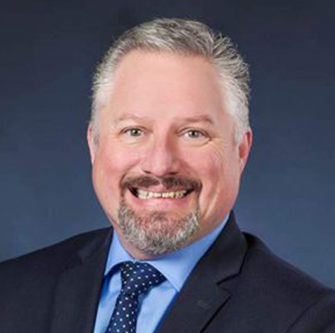

With you today
SCOTT BALESTRIER
Managing Partner
BDO USA, LLP
sbalestrier@bdo.com
MARLA MILLER
Managing Director
BDO USA, LLP
mmiller@bdo.com

Slide 3
THE TAX REFORM PROMISE
Protect American jobs
Tax reform (commonly known as Tax Cuts and Jobs Act – TCJA) promised to help protect American jobs. How can we measure this?
Unemployment rate | Labor participation rate | Job growth rate

Slide 4
Protect American jobs
WHAT HAPPENED
Unemployment rate
When TCJA enacted (January 2018): 4.1%
October 2019: 3.6% (ticked up from 3.5% in September 2019)
Labor participation rate
  2009: 65%
  When TCJA enacted: 62.7%
  October 2019: 63.3%
  Congressional Budget Office - rate to fall to 60% over 10 years
Average net monthly jobs (need a minimum of 100,000 – 150,000 net new jobs monthly to keep up with population growth)
  2010-2016: 185,000
  2017 pre-TCJA: 179,000
  2018: 223,000
  2019: 167,000 through October 2019

Slide 5
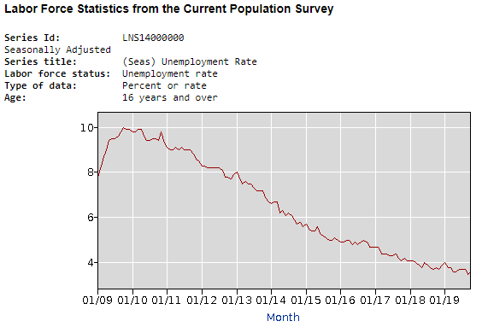
Protect American jobs
Historical unemployment rate
https://data.bls.gov/pdq/SurveyOutputServlet

Slide 6
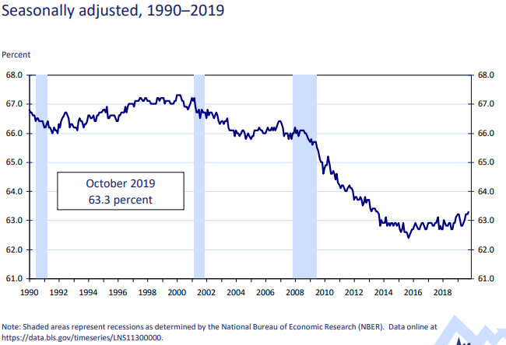
Protect American jobs
Historical labor force participation rate
https://data.bls.gov/timeseries/LNS11300000

Slide 7
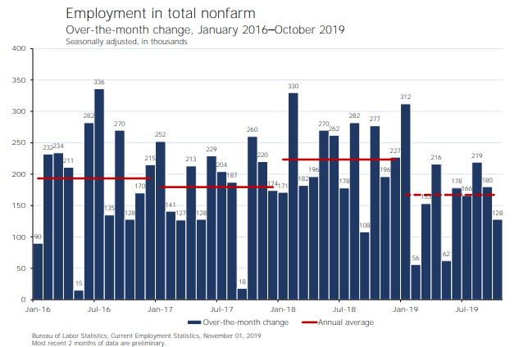
Protect American jobs
Average net new monthly jobs

Slide 8
RESULTS
Protect American jobs
GOAL ACHIEVED? NOT YET.
Unemployment rate was already declining about half a point per year since 2009
Net new job growth is now below what it was pre-TCJA
Theories regarding inability to maintain 2018 job growth rates:
Companies have hit a saturation point on how much expansion they can absorb given practical business constraints
Companies cannot find adequate numbers of skilled labor to operationalize additional investments
Increased use of automation in manufacturing and service jobs is reducing lower-skilled job demand
While simultaneously creating difficult to fill higher-skilled jobs
Other uncertainties facing businesses, including the current and pending tariff wars

Slide 9

THE TAX REFORM PROMISE
Make taxes fairer
Tax reform would broaden the taxable income base by removing special tax breaks and loopholes. How can we measure this?
Business taxes | Individual taxes

Slide 10
Make taxes fairer
WHAT HAPPENED
Business taxes
TCJA provided C corporations with 40% cut in their rate (35% → 21%)
Eliminated most U.S. taxation of normal manufacturing or service profits earned overseas
20% exemption for most small-business ordinary income earned as a pass-through entity
Individual taxes
Eliminated personal exemptions, several deductions for AGI, many itemized deductions, double estate tax exemption
Doubled standard deduction and child tax credit
Average tax rate cut of 2 - 3 points for most brackets (greater reduction in low brackets)
Higher income groups will benefit the most from cut in estate tax, 20% QBI deduction, and greater wealth from corporate tax reform

Slide 11
RESULTS
Make taxes fairer
GOAL ACHIEVED FOR SMALL BUSINESSES / MULTINATIONAL CORPORATIONS? YES.
Small businesses and multinational corporations experienced an effective rate cut and more competitiveness with foreign countries: Effective rate of 29.6% for pass-throughs and 21% for C- Corps.
GOAL ACHIEVED FOR EVERYONE ELSE? NO.
When considering that 99% of the benefit goes to the top 5%, this is perhaps not the “fairest” policy for the country over the longer term. This is compounded by the $2 trillion increase in national debt over the next 10 years combined with the impact on interest rates and reductions to come in government spending – unless economic growth takes off.

Slide 12
THE TAX REFORM PROMISE
Simplify taxes
Tax reform promised to make filing taxes much easier, like filling out a postcard. How can we measure this?
INDIVIDUAL taxes | BUSINESS taxes

Slide 13
Simplify taxes
WHAT HAPPENED
Individual taxes
Simpler (if no business)
  Doubling standard deduction
  Elimination/capping of numerous deductions
  Higher AMT thresholds
90% used standard deduction for 2018 compared to 70% for 2017
Taxpayers who have zero tax or a negative tax liability increased from 42.7% to 44.4%
Arguably achieved postcard promise, but many requirements including up to six new schedules of details

Slide 14
Simplify taxes
WHAT HAPPENED
Business taxes
Substantially more complex
  20% possible exemption on QBI (highly complex)
  Substantial complexity on multinational businesses: GILTI, FDII, BEAT, what is subject to repatriation tax, etc.
  Restrictions on interest expense deductions
Simpler accounting methods for small businesses
Higher income groups will benefit the most from cut in estate tax, 20% QBI deduction, and greater wealth from corporate tax reform

Slide 15
RESULTS
Simplify taxes
GOAL ACHIEVED FOR INDIVIDUALS WITHOUT A BUSINESS? YES (for some).
Individuals without a small business did not have to itemize (higher standard deductions) and more taxpayers had no tax liability due under the new TCJA provisions. However, taxpayers with more complex returns are required to now complete six new schedules of details that were part of the long form version in 2017.
GOAL ACHIEVED FOR BUSINESSES? NO.
The filing of the business tax returns became substantially more complex, especially for small businesses because of the 20% qualifying business income and for multinational businesses due to the new provisions under TCJA. There were some provisions, however, that did simplify businesses: small business accounting method changes, 100% expensing, repeal of alternative minimum tax for C corporations, repealing the like-kind exchange treatment for non-real estate items, and repealing the Section 199 domestic production activities deduction (DPAD).

Slide 16
THE TAX REFORM PROMISE
Lower individual tax rates
Tax reform promised to lower individual tax rates, especially for the middle class. How can we measure this?
Tax Policy Center | IRS Preliminary Data

Slide 17
Lower individual tax rates
WHAT HAPPENED
Tax Policy Center (TPC) predicted higher income households would receive larger average tax cuts as percentage of after-tax income
TPC predicted an average tax cut for:
  Bottom income quintile (income less than $25,000) = $60
  Middle income quintile (income between about $49,000 and $86,000) = $900
  95th – 99th income percentiles (income from about $308,000 and $733,000) = $13,500
  Top 1% income distribution (income of more than $733,00) = $51,000

Slide 18
Lower individual tax rates
WHAT HAPPENED
IRS preliminary data through April 15th filings for 2018 tax return filing season:
Total individual receipts down 6%
Average tax per return dropped 6%
Aggregate tax receipts as percentage of aggregate AGI down 1.4%
Average tax per return down $250 or 2.3%
Average tax for middle income quintile dropped $963
Average tax for lowest income quintile dropped only $6
Data for upper income taxpayers not yet reliable until after October 15th

Slide 19
RESULTS
Lower individual tax rates
GOAL ACHIEVED? YES.
Tax reform cut rates about 2 to 3 points for most taxpayers, and even more for taxpayers with a pass-through business (effectively down to 29.6%). However, expected average household savings is not coming in as high as originally predicted at the lower ends, and will be offset by impact of enacted and additional pending tariffs.

Slide 20
THE TAX REFORM PROMISE
Tax relief for small businesses
Tax reform promised tax relief for small businesses so they could compete with larger ones. How can we measure this?
SMALL BUSINESS TAXATION ANALYSIS

Slide 21
Tax relief for small businesses
WHAT HAPPENED
Simplified small-business taxation
Expands “qualifying small business’’ ability to use simpler accounting methods
Allows 100% immediate expensing on all machinery and equipment
Reduces C corporation rate from 35% to 21%
New deduction of up to 20% of qualifying pass-through business income (Lowers effective rate on that income to 29.6%)

Slide 22
RESULTS
Tax relief for small businesses
GOAL ACHIEVED? YES.
Small business owners enjoy the effective rate cut on their pass through earnings from 39% before tax reform to 29.6%, and small C-Corps enjoy a 40% cut in their rate from 35% to 21%. Also, enjoy simpler accounting methods and immediate expensing, without having to comply with complex rules related to interest expense limitations, repatriation taxes, GILTI, BEAT or FDII.

Slide 23

THE TAX REFORM PROMISE
Tax relief for multinational businesses
Tax reform promised tax relief for multinational businesses so they could better compete. How can we measure this?
Tax Burden after TCJA | Effective rates

Slide 24
Tax relief for multinational businesses
WHAT HAPPENED
U.S. combined federal and state income tax burden after TCJA has fallen from about 40% in total to about 25% in total
Cut in the C corporation rate from 35% to 21% on domestic income
Congressional Research Service and Peter G. Peterson Foundation report: Corporate income tax receipts down by a third from $300 billion in 2017 to $200 billion in 2018
Low-to-zero U.S. rate on most offshore “active” income earned, even when repatriated back to the U.S.
No longer the highest in the Organization for Economic Co-operation and Development (OECD) – about 40%. Closer to average (25%), so much more attractive for new foreign capital and more incentive to stay in the U.S.

Slide 25
Tax relief for multinational businesses
WHAT HAPPENED
Effective rates even lower than before
2017 Congressional Budget Office: estimated 19%
2017 Congressional Research Service: estimated 17.2%
2018 per SEC filings: (preliminary) 8.8%
Other sources: Yahoo Finance (7% for Fortune 500 compared to previous 13.6%), Wall Street Journal (19.8% compared to previous 25.5%)
Reasons: prior TCJA subsidies and loopholes still in law (i.e. check the box and CFC look through); 100% bonus expensing; low-to-no U.S. tax on most active foreign profits

Slide 26
RESULTS
Tax relief for multinational businesses
GOAL ACHIEVED? YES.
Multinational businesses experience relief both from a statutory (stated) rate perspective and an effective rate perspective.

Slide 27
THE TAX REFORM PROMISE
Businesses predominantly share savings with workers
Tax reform promised that businesses would predominantly share their tax savings with workers. How can we measure this?
Congressional research service | National bureau of economic research | Americans for tax fairness

Slide 28
Businesses predominantly share savings with workers
WHAT HAPPENED
Congressional Research Service - Average weekly wages of production and nonsupervisory workers had increased by about $22 (or 3%, to $1,248 annually)
Only shared in 2-3% of corporate tax cut
National Bureau of Economic Research - Only 4% of public companies announced additional wages/bonuses due to tax reform
Americans for Tax Fairness - Most of tax savings went to $1 trillion in stock buybacks

Slide 29
RESULTS
Businesses predominantly share savings with workers
GOAL ACHIEVED? NO.
Estimate of only 4% of public companies announced that they would pay additional wages or bonuses due to tax reform. And, bonuses amounted to only 2% to 3% of the tax cut. Instead, most of the tax savings went to fund stock buybacks (over $1 trillion by the end of 2018).

Slide 30
THE TAX REFORM PROMISE
Accelerate capital expensing to stimulate new investment
Tax reform promised accelerate capital expensing to stimulate new investment. How can we measure this?
Congressional research service | National Association of Business Economics

Slide 31
Accelerate capital expensing to stimulate new investment
WHAT HAPPENED
National Association of Business Economics (NABE) – Immediate expensing and corporate rate cut did not substantially impact capital investment
Quarterly survey at the end of 2018 - businesses reported less growth in sales, pricing, and profit margin
84% did not change hiring or investment plans
Cash from tax cut → buybacks
Congressional Research Service – 2018 results: 7.5% growth in equipment purchases, 5% growth in structures (mostly in the first half of 2018) … Continuing to decline

Slide 32
RESULTS
Accelerate capital expensing to stimulate new investment
GOAL ACHIEVED? NOT TO THE EXTENT ORIGINALLY ENVISIONED.
Tax reform did not produce long-lasting capital expensing behavior in the economy. Why?
    Tax incentives alone do not drive capital expansion plans
    Need sufficient skilled and unskilled labor
    Tariff uncertainties

Slide 33
THE TAX REFORM PROMISE
More permanence in the tax code
Tax reform promised more permanence in the tax code. How can we measure this?
INDIVIDUAL PROVISIONS | BUSINESS PROVISIONS

Slide 34
More permanence in the tax code
WHAT HAPPENED
TCJA provisions for individual taxation expire at the end of 2025
In 2026 almost all individual taxpayers will face a significant tax increase
Almost all business provisions will not expire (except 100% bonus expensing) unless Congress extends

Slide 35
RESULTS
More permanence in the tax code
GOAL ACHIEVED? PROBABLY NOT.
Based on an understanding of the expiring provisions and political and national debt reality, changes to TCJA seem inevitable over the next decade.

Slide 36
THE TAX REFORM PROMISE
Bring back jobs from overseas
Tax reform promised to bring jobs back to the US. How can we measure this?
Incentives | Federal tax research

Slide 37
Bring back jobs from overseas
WHAT HAPPENED
Incentives encouraged companies to expand efforts offshore
New 100% dividend received deduction on most active, operating income earned overseas within a normal rate of return of 10% of foreign invested tangible assets
Taxes the remaining foreign income at half the normal 21% or less after foreign tax credits
Provides a deduction for significant intangible assets located in the U.S. that generate revenue from foreign parties
Tax Policy Center, Congressional Budget Office and Institute on Taxation & Economic Policy
All concluded that TCJA created net substantial additional incentives for continued and expanded offshore profit shifting, even after the base erosion provisions
There was not even a requirement that companies must bring back their foreign earnings to enjoy the reduced rate on their “trapped” overseas earnings as of the date of tax reform
No requirement that any such repatriation must be reinvested in domestic jobs

Slide 38
RESULTS
Bring back jobs from overseas
GOAL ACHIEVED? NO.
The new tax TCJA provisions provided U.S. businesses a significant incentive to increase their foreign operations, especially increasing tangible assets (despite the base erosion alternative minimum tax – BEAT – provision). Despite the administration’s intent, U.S. multinationals increased their capital investments overseas significantly more than they did in the U.S.

Slide 39
THE TAX REFORM PROMISE
Bring back ~$3 trillion unrepatriated overseas profits
Tax reform promised to bring back approximately $3 trillion in unrepatriated overseas profits. How can we measure this?
Federal reserve and Congressional Research Service

Slide 40
Bring back ~$3 trillion unrepatriated overseas profits
WHAT HAPPENED
Estimate of $3 trillion unrepatriated earnings held overseas by U.S. companies ($1 trillion in cash)
Funds did not have to be repatriated to enjoy the 15.5% rate on cash earnings and 8% on other type
Assessed on whatever the company’s unrepatriated earnings were at the end of 2017, repatriated or not
Tax payable over 8 years
Federal Reserve and Congressional Research Services: Only $550 billion actually repatriated in 2018 above the $150 billion that would normally have been repatriated

Slide 41
RESULTS
Bring back ~$3 trillion unrepatriated overseas profits
GOAL ACHIEVED? NO.
A significant amount did get repatriated, but it was nowhere near the $3 trillion amount often mentioned, and there was no requirement to do so, especially with 8 years to pay the tax, and no conditions imposed to reinvest in capital expenditures or jobs.

Slide 42

THE TAX REFORM PROMISE
Discourage inversions
Tax reform promised to discourage inversions. How can we measure this?
Congressional budget office | Congressional research service

Slide 43
Discourage inversions
WHAT HAPPENED
Over the past seven years, Congress and the Treasury issued several anti-inversion provisions
Congressional Budget Office – As a result of this effort prior to tax-reform legislation, number of inversions slowed considerably
TCJA added additional penalties to continue discouragement
Congressional Research Services – Believes number of inversions minimal given the lack of press releases on new inversion announcements

Slide 44
RESULTS
Discouraged inversions
GOAL ACHIEVED? YES.
This is likely due more to pre-tax reform rule making.

Slide 45

THE TAX REFORM PROMISE
Stimulate economic growth by 3%
Tax reform promised to stimulate economic growth by 3% to offset the cost of tax cuts. How can we measure this?
Bureau of economic analysis | Congressional research service | Congressional budget office | Treasury Report

Slide 46
Stimulate economic growth by 3%
WHAT HAPPENED
Bureau of Economic Analysis - Official real GDP growth rate for 2018 - annualized rate of 2.5% (slower than 2017’s revised rate of 2.8%)
2019 - Slowed considerably from 3% in 1st quarter to 2.0% in 2nd quarter and 1.9% in 3rd quarter
Congressional Research Services - Required 6.7% GDP increase sustained over the long term to have generated enough tax revenues in 2018 to cover the cost of the tax cut

Slide 47
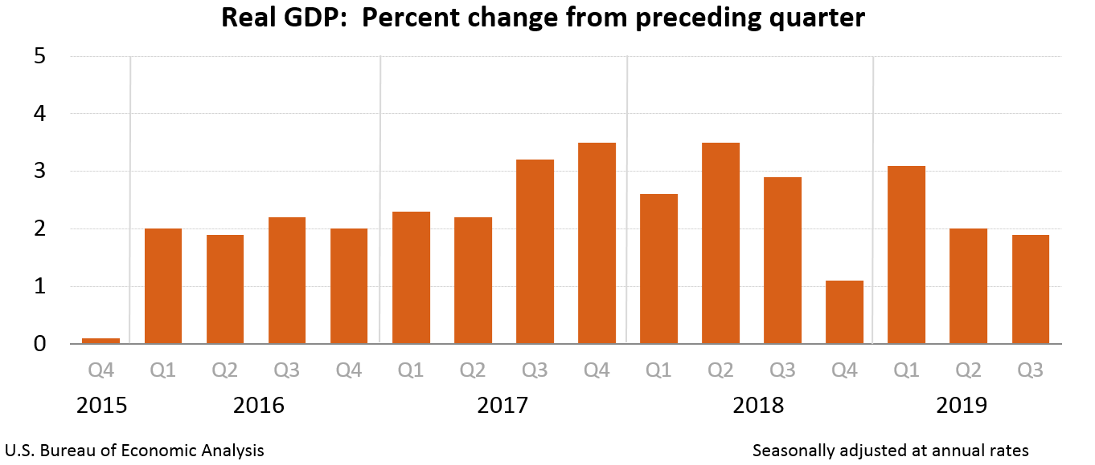
Stimulate economic growth by 3%
HISTORICAL GDP GROWTH RATE
https://www.bea.gov/system/files/gdp3q19_adv_1.png

Slide 48
Stimulate economic growth by 3%
WHAT HAPPENED
Congressional Budget Office – Projects real GDP growth of 2.4% for 2019 with annual average of 1.8% over the next decade
$2 trillion added to our national debt over 10 years
Treasury report issued October 2018 – FY 2018 deficit was $780 billion; 17% increase from the prior year
FY 2019 projected annual deficit of $1.1 trillion and more than that annually and indefinitely

Slide 49
RESULTS
Stimulate economic growth by 3%
GOAL ACHIEVED? NO.
The level of growth is relatively small and based on the data, the tax cut will not pay for itself. The GDP has slowed down from 3.1% for the first quarter to 2.1% in the first quarter. As a result, the deficit will likely increase to almost $900 billion for fiscal 2019.

Slide 50
Q&A

Slide 51
BDO is the brand name for BDO USA, LLP, a U.S. professional services firm providing assurance, tax, and advisory services to a wide range of publicly traded and privately held companies. For more than 100 years, BDO has provided quality service through the active involvement of experienced and committed professionals. The firm serves clients through more than 60 offices and over 700 independent alliance firm locations nationwide. As an independent Member Firm of BDO International Limited, BDO serves multi-national clients through a global network of more than 80,000 people working out of nearly 1,600 offices across 162 countries and territories.
BDO USA, LLP, a Delaware limited liability partnership, is the U.S. member of BDO International Limited, a UK company limited by guarantee, and forms part of the international BDO network of independent member firms. BDO is the brand name for the BDO network and for each of the BDO Member Firms.
Material discussed is meant to provide general information and should not be acted on without professional advice tailored to your firm’s individual needs.
© 2019 BDO USA, LLP. All rights reserved. www.bdo.com

