Slide 1
Autonomous Learning in Finance
AFP Learning Day
April 24, 2019
David Frigeri | Practice Lead Advanced Analytics | David.Frigeri@slalom.com

Slide 2
Today’s Key Take-Aways
Up to date view into the current Accounting and Treasury market for Artificial Intelligence (AI)
Understanding of the different domains of AI
Fundamentals of how Machine Learning (ML) works
History of ML and why it is so prevalent
Real-World applications in Accounting and other functions
How to identify potential applications of AI/ML within your organization
Outline your own ML Proof of Concept

Slide 3
About Slalom
Notes:
AE

Slide 4










Our Core Values
Do what is right, always.
Drive connection and teamwork.
Take ownership.
Get it done.
Inspire passion and adventure.
Focus on outcomes.
Celebrate
authenticity.
Fuel growth and innovation.
Stay humble and curious.
Build and shape a better future.
Smile.
Notes:
KK

Slide 5







We put people first.
We believe in a world in which every person loves their work and life.
Notes:
We are here to help you reach for and realize your vision.
A world in which every person loves their work and life.

Slide 6


6,700+
Employees
1,100+
Clients
200+
Financial Services Clients
27
Offices
7
Build Centers
Notes:
DF

Slide 7
Slalom’s Financial Services Practice
Our Financial Services practice is comprised of industry experts with an average of nearly 20 years’ experience in all functional areas of the banking, payments, insurance, and capital markets industries.
Consumer Banking
200+
300+
27
20
Lending Technology & Operations
Financial Services Clients
Consultants Specializing in Financial Services
Slalom markets with Financial Services clients
Average years of experience for Slalom FS Industry Team
Payments & Fintech
Commercial and Business Banking
Banking & Payments
Strategy Development
Market & Product Assessments
Data Analytics & Insights
Customer Insights & Experience
Digital Payments & Servicing
Legacy Systems to Next Gen
Capital Markets
Middle and Back Office Efficiency
Investor Reporting
CRM
Enterprise Risk
Wealth Management
Insurance
Product & Underwriting Strategies
Sales and Marketing Strategies
Predictive Modeling & Analytics
Customer and Agent Portal
Replacement of Legacy Systems
Investment Banking and Brokerage
Wealth Management
Operational Efficiency & Effectiveness
Compliance Program Management
Business Assessments from Target Operating Model Design to Future State Roadmaps
Technology Assessments & Delivery
Asset Management & Private Equity
Notes:
Slalom’s core competencies are aligned with the key issues facing financial services companies today.
Our Banking & Payments Expertise includes:
Credit Cards, Debit & Prepaid Cards, Consumer Lending, Commercial & Residential Mortgage, Alternative Payments
Strategy Development – Thought leadership with industry experts to enable you to execute your business or technology strategy and vision.
Develop strategies to address the disruptive forces and alternative providers in the industry today.
Align strategies with people, process & technologies
Market, Product & Partnership Assessments-
Identify & Scope Market Opportunities
Product line analysis, profitability review and portfolio rationalization as well as loyalty programs
Provide product development and market entry support for retail banking products and services
Identify ideal partners in an evolving marketplace (could today’s disruptors be tomorrow’s partners?)
Vendor Selection and Risk Management
Data Analytics– [Any tools?]
Apply contemporary analytics techniques to aid in product prioritization, go-to-market planning, establishment of a data driven marketing and risk organization
Develop a Customer Valuation System offering a single score to represent the profitability of a customer to the bank.
Customer Insights & Experience -
Operational Efficiency - Our focus is on tackling your toughest problems and solving them quickly.
Develop Target Operating Models, conduct Current State Analysis and Gap Analysis
Streamline workflows, define interactions with other teams, and add repeatable processes to improve scalability and consistency
Digital Payments & Servicing
Support product development as well as the innovation agenda focusing on social, mobile and digital transformation
Custom web-based applications
Developed a prototype appl designed to help advisors work with couples to determine their joint investment risk profile.
Technology Assessments & Delivery - With our experts familiar with the financial services Business and IT structure, we can support you to:
Select the right vendor or system to use
Platform migrations and integrations
Implement platforms such as LOS, Portals, SharePoint, CRM, Imaging, as well as innovative products and services
Increase your customer loyalty and bra
Define and execute IT strategies, from infrastructure to emerging technologies
Info Security – Data governance
Compliance – Developed a Complaint Tracker / Customer Sentiment Analysis Platform proof of concept to address CFPB requirements
Our Capital Markets Practice expertise spans:
Investment Management, including:
Funds, Institutional Accounts and Wealth Management
Equity, Fixed Income, Derivative and Alternative Asset Classes
Front, Middle and Back Office Operations
Order and Execution Management Systems
Client reporting
Performance measurement and attribution
Retail and institutional client relationship management
Regulatory and investor guideline compliance
Enterprise risk
Financial operations and reporting
Investment Banking, including:
Capital market and advisory banking
Sell-side operations
Proprietary trading
Market data and research
Client relationship management
Regulatory and conduct risk compliance
Enterprise risk
Financial operations and reporting
Investment Services, including:
Custodial operations
Transfer agent operations
Operational Efficiency & Effectiveness – We help capital markets clients address their most critical operational issues by:
Streamlining workflows, breaking down operational silos and adding repeatable processes to reduce costs and improve quality
Improving the efficiency and effectiveness of compliance and control processes to reduce cost and risk
Evaluating processes that might be outsourced to improve quality, reduce cost and accelerate operational transformation
Technology Assessments & Platform Selection/Delivery – With experts who are familiar with the capital markets business and the technologies that support it, we help capital market clients to:
Perform vendor and system identification and evaluation
Migrate to new platforms and integrate with existing solutions
Develop implementation strategies to increase adoption of new solutions, especially among front office professional staff
Define and execute IT strategies, from infrastructure to emerging technologies

Slide 8
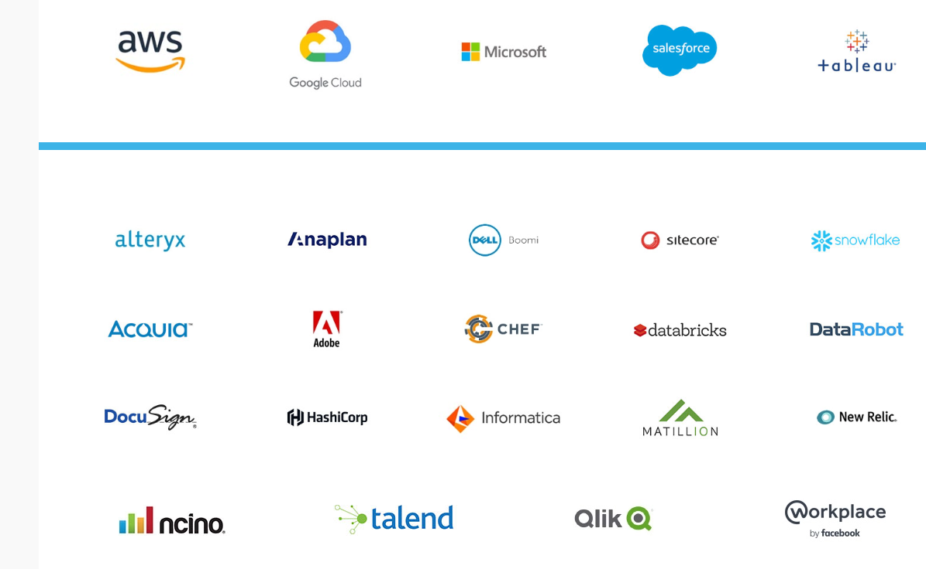
Our Partners
We partner and share knowledge with over 170 solution providers at the front edge of technology and data
Notes:
Slalom has been an Amazon Partner Network (APN) partner since 2010. In 2015, Slalom earned the APN DevOps Competency for its demonstrated experience helping clients leverage the AWS platform and DevOps best practices to build and ship great software.
Slalom has deep expertise developing tailored solutions enabled by Microsoft platforms and powered by Amazon Web Services (AWS). We’ve helped a number of enterprises adopt the AWS cloud for their Windows workloads. In fact, we chose AWS to run Slalom’s own SharePoint environment and provide the backbone for our internal collaboration solution.”
In addition to Salesforce, we partner with nearly 200 of the best technology companies in the world. Here are just a few examples. If there’s another technology that complements or needs to integrate with your Salesforce solution, we’ve got you covered.
We’re a top global systems integrator for AWS.
We’re also a 2018 Microsoft Global Partner [details]
We are the Partner of the Year for Tableau, Qlik and PowerBI in 2018
GCP Innovation Partner of the year ‘18

Slide 9
Background

Slide 10
10
It’s Early with Big Expectations
53 percent of
companies don't have a
clear understanding of
how AI or ML could
benefit their businesses.
- TechRepublic
Percentage of Fortune
1000 companies reporting
investments of greater
than $500 million
increased from 12.7% in
2018 to 21.1% in
2019…and 91.7% cited
the need to transform
their businesses and
become increasingly
nimble.
- MIT Sloan Management
Review
Up to 45% of work activities can be automated with current machine learning capabilities and potentially up to 60% depending on advanced in Natural Language Processing.
- US Bureau of Labor Statistics

Slide 11
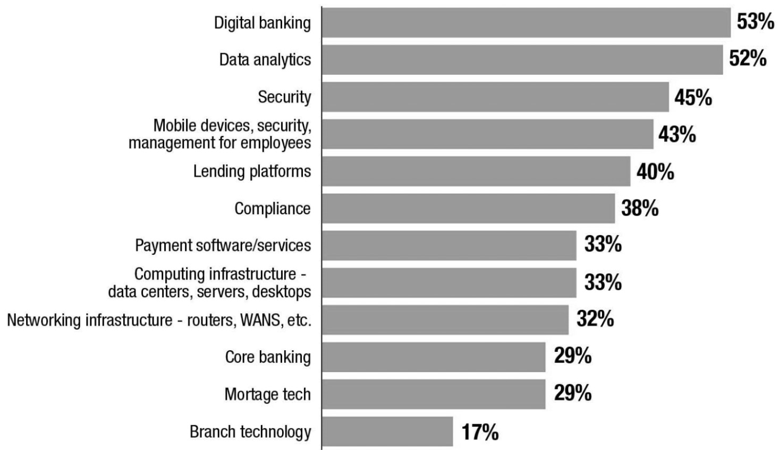
Technology Spend
A Source Media Research executive survey of 93 bankers across different-sized institutions found 72% of respondents increased technology spend as much as 15% (in a few cases even more) in 2019:
Digital Banking
Data Analytics
Security
Mobile devices, security, management for employees
Lending Platforms
Compliance
Payment software/services
Computing Infrastructure
Networking Infrastructure
Core Banking
Mortgage Tech
Branch Technology

Slide 12
AI Market Statistics
More than 80 percent of executives believe AI leads to a competitive advantage, and 79 percent believe it will increase their company's productivity (Journal of Accountancy)
Robotic process automation (RPA) has reduced audit and contractual processing times from several months to a few weeks (Forbes)
66 percent of accountants would invest in artificial intelligence (Sage Practice of Now 2018 report)
55 percent of accountants plan to use AI in the next three years (Sage Practice of Now 2018 report)

Slide 13
Machine Learning in Plain English
Notes:
AE

Slide 14

What are we referring to?
.
Our purpose
Machine Learning is a subset in Artificial Intelligence (AI) and AI is a branch of Computer Science. ML learns from patterns, associations and outcomes from historical data to make automated determinations of future events such as risk of occurrence, projections or next best action.
Natural Language Processing: Read text, hear speech, interpret it, measure sentiment and determine which parts are important.
Deep Learning is a subset of machine learning that has networks capable of learning unsupervised from data that is unstructured or unlabeled.
Picture
Image Recognition: Algorithms that extract minute features at the pixel level and uses maps and patterns of pixels to determine an outcome such as object identification, diagnosis or recommendation.

Slide 15




Autonomous Learning Landscape
Autonomous Learning Spans Multiple Interrelated and Complimentary Capabilities
RPA
Optimal character recognition
Natural language processing
Machine Learning
A new invoice arrives in the form of a PDF and it is copied to the AP document repository
OCR extracts computer readable text from the PDF.
Code, process and route invoices to appropriate approvers
Incorporates NLP’s analysis into it’s model to detect outliers, contract compliance variants and risk score for due date penalty.

Slide 16

Machine Learning is a branch of AI with the goal to learn from historical data or past experiences to solve a given problem when presented with new data

Slide 17




What Do We Need & Want From Machine Learning?
We Need Speed to Answers.
We need answers quickly; we don’t have the time, resources or ability to wait months for analytic reports or project results.
We Want to Use the Broader World of Big Data.
We would like to see insights from beyond what is isolated inside our 4 walls of a business (weather economic conditions, blogs, social media, environmental factors).
We Want to Predict AND Impact Outcomes.
We need prediction and simulation capabilities to really understand what actions are likely to result in our desired outcome (increased sales, proﬁtability, etc.)
We Need Better Alignment.
We need to connect our data initiatives with the corporate strategy, we need to educate and drive awareness across the enterprise and we need new interdepartmental processes to acquire insights.

Slide 18
Advanced Analytics
Learn
Why does it happen?
Predict
What will happen?
Influence
What can I do to change outcome?
Pattern Identification & Detection
Causal & Explanatory Analysis
Automated Predictive Scoring and Risk Analysis
Simulation & Prescription
Retrospectively evaluate hundreds or thousands of characteristics about people and events and their associated outcomes.
The probability of an outcome based on a set of inputs within a statistically validated error range.
By managing inputs that have the strongest impact on the outcome you can more effectively achieve desired outcomes.
What current customers have similar characteristics of customers who previously cancelled their service?
Based on what we learned, stack rank our current customers by ‘similarity’ or likelihood to cancel service.
What characteristics of at risk customers are both actionable and impactful?
Notes:
CFO story for descriptive analytics

Slide 19
Will a Game Be Played?
2 Data Sets:
Weather Data
Games Played
Using Machine Learning:
Using Machine Learning (Random Forest) we want to determine under what weather conditions will a game be played.
Hold Out Dataset
How Many of the Actuals Did the Model Predict Correctly?
Predicting:
Based on historical data patterns, we can predict amounts or classify objects with an accompanying accuracy score.

Slide 20
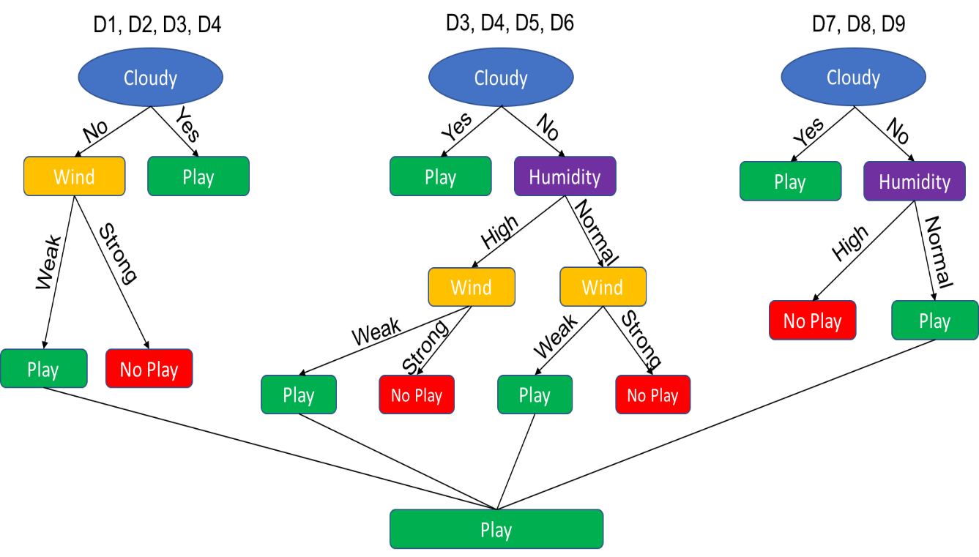
Will a Game Be Played?
Random Forest automatically incorporates thousands of different data features and quickly creates hundreds of different trees to identify patterns that produce the desired outcome
Notes:
Think of these as trees
Most of the advanced in algorithms and the rise of machine learning can be assigned to algorithms that can produce wider trees, deeper trees and therefore more trees overall or networks with nodes that also look like trees just turned on their sides or upside down.

Slide 21
What has Changed?
Notes:
AE

Slide 22
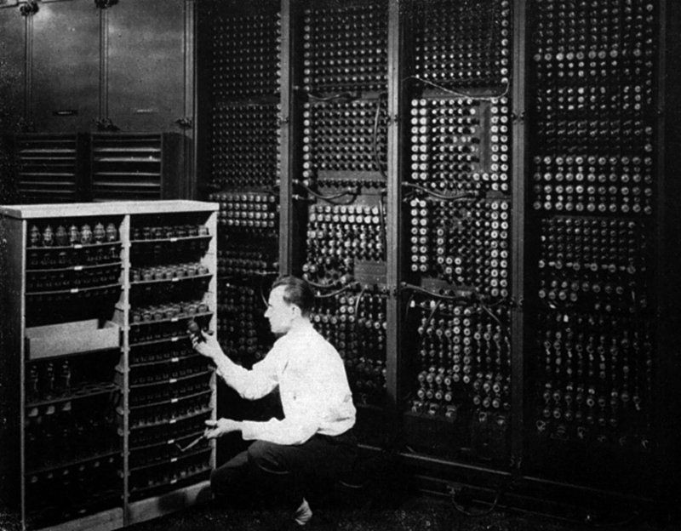
1946
ENICA
Electronic Numerical Integrator & Computer
First general purpose digital computer. Powered by vacuum tubes
Built by the US Army and used by John von Neumann to develop the H-Bomb
Heralded as a Giant Brain by the press
Prompted Alan Turing to devise a test to detect artificial intelligence.
The Turing-Test has yet to be definitively passed.
Notes:
Developed at UPENN it was initially meant for artillery firing tables reducing the time for humans to calculate from 20 hours down to thirty minutes – use bow and arrow analogy

Slide 23
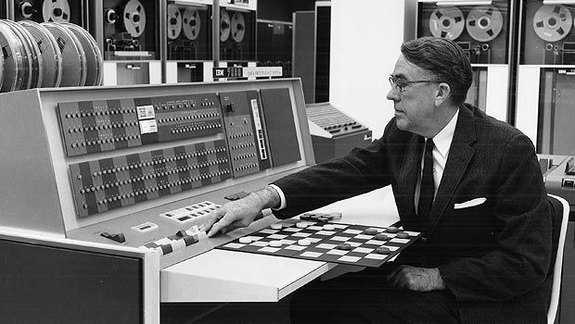

1955
“Give machines the ability to learn without explicitly programming them”
Arthur Samuel
Computer Pioneer
Arthur Samuel is recognized as the creator of the first learning machine, which learned to play (and win) checkers.
His algorithms used a heuristic search memory to learn from experience.
By the mid-1970’s his program was beating capable human players.
Notes:
Arthur coined the term "machine learning"
The main driver of the machine was a search tree of the board positions reachable from the current state.
Since he had only a very limited amount of available computer memory, instead of searching each path until it came to the game’s conclusion, Samuel developed a scoring function based on the position of the board at any given time.
This function tried to measure the chance of winning for each side at the given position.
It took into account such things
the number of pieces on each side
The number of kings,
The proximity of pieces to being “kinged”.
The program chose its move based on a minimax strategy, meaning it made the move that optimized the chance of winning assuming that the opponent was trying to optimize the value of the same function from its point of view.^{[12]}
IBM’s stock jumped 15 points the day his checkers program was demonstrated so you can hear the expectations echoing from the 50s…

Slide 24
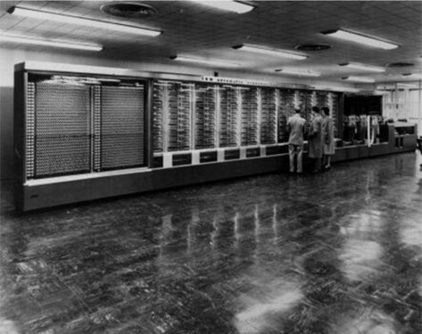
1958
Perceptron
Mark I
The Perceptron was the first artificial neural network.
Developed by Frank Rosenblatt at the US office of Naval Research for visual recognition tasks.
The New York Times reported the Perceptron to be: “The embryo of an electronic computer that will be able to walk, talk, see, write, reproduce itself and be conscious of its existence."
Notes:
Frank invented the Perceptron, essentially the first computer that could learn new skills by trial and error, using a type of neural network that simulates human thought processes.
Around this time MADALINE was the first AI real-world application used as an intelligent filter of phones to monitor, predict and exclude bad signals coming across the wire.
You can’t really talk about Frank without bringing up Marvin because Marvin throws cold water on Frank’s perceptron

Slide 25

1969
“Will robots inherit the earth? Yes, but they will be our children.”
Marvin Minsky
Cognitive Scientist
Cognitive scientist in the field of AI.
Co-founder of the MIT AI lab.
Published influential book describing fundamental limits of the perceptron
  And all 2-layer neural networks
  And has since been proven incorrect.
Marks the beginning of the Neural Net Winter
Notes:
The book's only proven result -- that linear functions cannot model non-linear ones -- was trivial but the book had nevertheless a pronounced effect on research funding and, consequently, the community resulting in what is referred to today as the “neural net winter” a period of about 15 years when there was little work done.

Slide 26
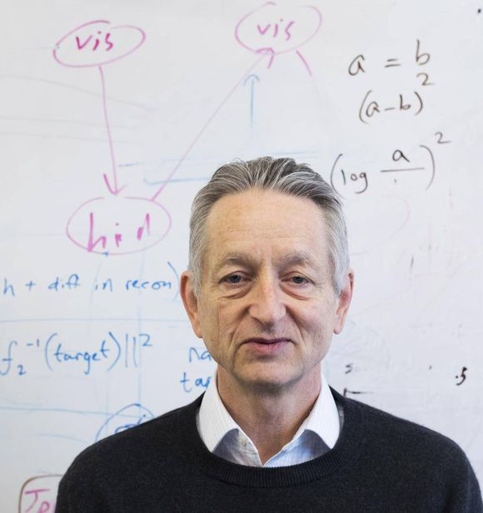
1987
Neural Networks Breakthrough
In the mid 1980’s multiple people independently (re)discovered the Backpropagation algorithm.
Allowed more powerful neural networks with hidden layers to be trained.
Geoffrey Hinton father of modern AI leads research into backpropagation or self-learning
Reinvigorated research; many people excited about Neural Nets as model for the mind/brain (connectionism) & commercial applications.
Notes:
In 1978, in the dead of the ‘neural net winter’, Geoff Hinton received his PhD in Neural Nets from Edinburgh University, the only school willing to grant a PhD in AI at the time, despite people telling him he was crazy and wasting his time.
This new wave of study on neural networks is interpreted by some researchers as being a contradiction of hypotheses presented in the book Perceptrons, and a confirmation of Frank Rosenblatt's expectations.
Another researchers adopted Hinton’s research and developed a system able to read bank checks so by the late ’80s, neural nets seemed poised to transform AI and Machine Learning.
But the systems faltered when researchers attempted more ambitious tasks. Frustrated, the machine learning community turned to simpler algorithms and more rules based systems.

Slide 27
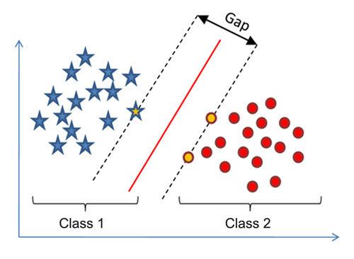
1995
Statistical Approaches to Machine Learning
By the 1990’s neural networks had fallen out of favor (again).
Lack of good theory and inability to train with small samples of data (need lots of data) were knocks against neural nets
New methods more effective with smaller amounts of data like Support Vector Machines were now in-vogue.
SVM are amenable to rigorously mathematical analysis and at the time achieved state-of-the art performance.
Notes:
By the mid 1990s the number of researchers who specialized in neural networks dwindled to fewer than half a dozen most of them at the Canadian Institute for Advanced Research.
Support Vector Machines, originally developed in 1963, were simple algorithms that learned from training what category something belonged to and when presented with new data it was very effective in assigning to the appropriate data.
SVMs also have limitations including inability natively provide probabilities and constrained memory back then meant it would take a long time to train models. But SVM do really well with small amounts of data that’s what the case was up to that point in time.

Slide 28

Digitization, Cloud & Moore’s Law
1ZB in 2010 will grow to about 50ZB (50 trillion Gigabytes) in 2020
Enterprises will produce and control 60% of the world’s data by 2025
40X increase in processing power between 2010 and the fastest today
Advent of cloud computing significantly reduces financial and project execution risk
ResearchandMarkets estimates AI market will grow from $4 billion in ‘16 to $169 billion in 2025
Notes:
To put that number in perspective, it would take Niagara Falls 210,000 years to move one quintillion gallons of water
https://www.marketwatch.com/press-release/the-global-artificial-intelligence-ai-market-by-technology-and-industry-vertical---a-1694-billion-opportunity-by-2025---researchandmarketscom-2018-08-24
https://www.seagate.com/files/www-content/our-story/trends/files/Seagate-WP-DataAge2025-March-2017.pdf
http://images.nvidia.com/content/pdf/infographic/inference-infographic.pdf
http://www.enterprisestorageforum.com/storage-management/worldwide-data-will-surge-to-163-zettabytes-by-2025.html
https://www.linkedin.com/pulse/cloud-vs-on-premises-hard-dollar-costs-revisited-greg/

Slide 29

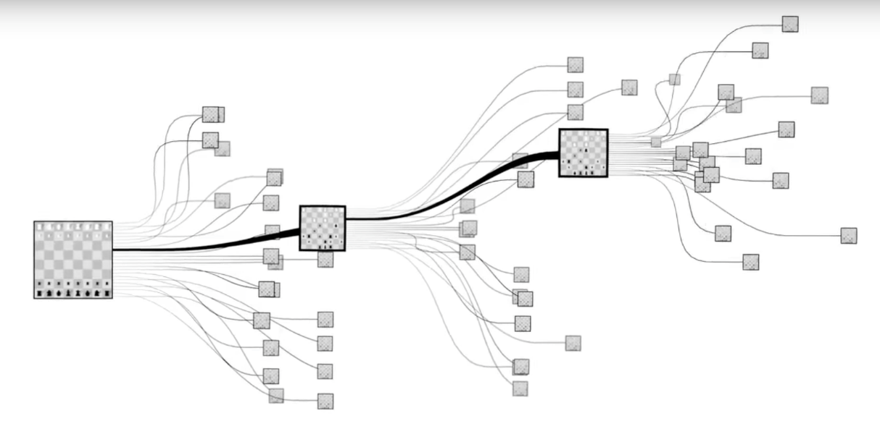
1997
IBM’s Deep Blue beats Chess
Grandmaster Garry Kasparov
Notes:
The first sign of this increase in data and compute comes in the form of Deep Blue.
Development for Deep Blue began in 1985 with the ChipTest project at Carnegie Mellon University. This project eventually evolved into Deep Thought, at which point the development team was hired by IBM.^{[4]} The project evolved once more with the new name Deep Blue in 1989. Grandmaster Joel Benjamin was also part of the development team.
Deep Blue trained off 4,000 potential positions and 700k grandmaster games.
The first match was actually in 1996, and first time a computer beat a world champion but Kasparov won the series 4-2.
Then in1997 Deep Blue won the series in a deciding game six due to a mistake Kasparov made in the opening
Deep Blue's approach has been referred to as Brute Force because at every turn it used its 30 Node RS6000 cluster to re-compute every possible move and subsequent moves about 200 million moves per second.

Slide 30

2010
Audi sends a driverless Audi TTS to the top of Pikes Peak at close to ~ 160 MPH
Notes:
The car made five runs during a week of testing, reaching the 14,100-foot summit in 27 minutes. The very fastest drivers — in cars putting down more than 900 horsepower — do it in 10 minutes and change, so clearly the car wasn’t terribly fast.
Shelley uses differential GPS to track its location to within 2 centimeters
Wheel-speed sensors and an accelerometer measure its velocity and a gyroscope controls equilibrium and direction.
The algorithms that make it all work ran on hardware developed by Sun Microsystems.

Slide 31

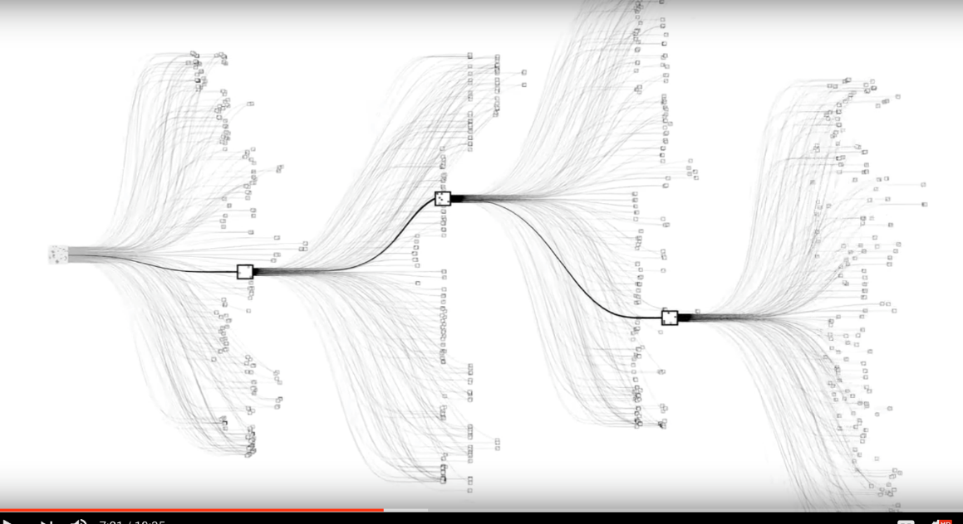
2016
Google’s AlphaGo Model Defeats
Euro Go Champion
Notes:
Alpha beat Lee Sedol a respected Go player in 2016 and then the Go #1 ranked player, Ke Jie in 2017.
AlphaGo uses a Monte Carlo tree search algorithm to find its moves based on knowledge previously "learned" by machine learning, specifically by an artificial neural network (a deep learning method) by extensive training, both from human and computer play.^{[10]}
^{You can hear Geofrrey Hinton} smiling

Slide 32

2017
Libratus AI
Computer Program Designed for Poker
This victory in no-limit Texas Hold 'em heralds a new kind of game in which the AI has to take into account that its opponent might be deliberately misleading.
- Andrew Moore, Dean, Carnegie Mellon's School of Computer Science
Notes:
Texas Hold Em’s is important because it is a first due to the imperfect information problem, before 2017 each side had the exact same information.
Libratus was pitted in a tournament against four top-class human poker players
During the tournament, Libratus was competing against the players during the days. Overnight it was perfecting its strategy on its own by analysing the prior gameplay and results of the day, particularly its losses.
Therefore, it was able to continuously straighten out the imperfections that the human team had discovered in their extensive analysis, resulting in a permanent arms race between the humans and Libratus.

Slide 33
2018
Portrait of Edmond de Belamy
Painting Co-Created by AI
Created using a type of A.I. called a generative adversarial network (GAN)
“Portrait of Edmond de Belamy” was estimated to sell for $7,000 to $10,000. It wound up selling for $432,000. Apparently people are big into art painted by a robot.
Maybe they think they’ll be spared when the rise of the machines eventually happens!
Source: Obvious Art
Notes:
https://www.digitaltrends.com/cool-tech/biggest-ai-robot-advances-2018/

Slide 34
Building the Business Case & Examples
Notes:
AE

Slide 35
Focus on Well Known and Measurable Areas to Get Started
with Machine Learning
Area of Interest
Experienced As
ML Capabilities
Business Metrics
Automation
Request/Response
Reading/Data Entry
Document Generation
Slow response
Expensive
Inconsistent
Chatbot
NLP/RPA
NLG
Cost per Support Ticket
$ Rate * Time * # Docs
Cost per Rework
Stop Loss
Stakeholder Attrition
Planned vs. Actual
Resource Misallocation
High Churn Rate
Budget Overrun
Under/Over Staffed
Gradual Risk Scoring
Scenario Planning
Scalable Computing
Cost to Acquire
Forecasting Accuracy
Monthly Cost Variance
Defect Identification
Systems Failure
Fraudulent Activity
Performance Decline
Increased Input Costs
Customer Dissatisfied
Low Productivity
Failure Prediction
Pattern Recognition
Recommended Fix
Time to Resolve
Net Promoter Score
Cost per Failure

Slide 36


Machine Learning Proves Compelling Area for Loan Risk by Commercial Bank
Analytics | Data Science | Proof of Value
Why
What
Wow
In the commercial banking sector companies are faced with a unique challenge: beat the competition through innovation yet adhere to regulatory requirements and not introduce unnecessary risk.
Our Client – seeking the next innovative idea – looked to Slalom to provide expertise on unlocking the hidden potential of the data already in their organization. Mining existing data with open-source tools meant no large technology investment and a way to prove the value of Data Science.
The Slalom team partnered with key stakeholders at the Client to model the risk of their key business: the loan portfolio. What was a simple question, “what drives the risk of our portfolio?” evolved into analyzing several sources of data with Alteryx and building an ensemble of predictive models using R with accuracy exceeding 90%.
Not only did the team produce a model with exceptional accuracy, analysis along the way illuminated other areas of insight such as valuable cross-selling opportunities for Relationship Managers.
Armed with never before seen insight of their core business function, our Client was able to take a compelling story to their Board of Directors team for the purpose of securing continued investment in data science-related activities.
Thanks to an established relationship built upon trust and a top-notch data science team, our Client has already identified subsequent opportunities and is looking to Slalom for guidance and delivery expertise.
Notes:
Client wanted to explore a low cost approach to exploring new methods for understanding what are the top risk (feature importance) in their loan portfolio.
Open source tools represents the latest advancements at little to no cost to use, excluding the data scientist’s cost.

Slide 37


Proving Automation Frees Up People Time
Financial Services Company
b
Why
A financial services organization wanted to develop an enterprise strategy for leveraging robotics process automation (RPA) to improve operational efficiency, scale their operations, and shift resources to more customer focused, high-value activities.
What
Slalom partnered with the client to define a process automation strategy that included implementing a pilot project, standing up an Automated Center of Excellence (A-COE), and defining a roadmap to scale their implementation across the enterprise.
Wow
The initial pilot implementation provided the client with cost savings and the ability to scale their operations. The pilot also provided ‘lessons learned’ that were used to define a repeatable operating and staffing model for the Center of Excellence.
37
Notes:
This client, like most, was not looking to eliminate headcount but to reallocate from boring/repetitive work to new stimulating and value add work
The POC ended freeing people time but also represented a net cost savings

Slide 38

Multi-Touch Attribution Solution for Optimizing Marketing Spend at a Regional Bank
User Experience | Portals & Collaboration | Agile Development
b
Why
Analyzing consumer behavior is getting more complex, not only because of the sheer volume of data to manage, but also because that data comes from multiple sources, including consumer touchpoints, data providers, and advertisers. This client, a large Regional bank, didn’t have a way to measure the return on it’s product marketing investments and needed a method for analyzing and informing its spend by marketing channel. The client engaged Slalom to design, implement, and deploy a Multi-Channel Attribution Solution based on a data-driven approach to gain greater insight into the behaviors influencing consumer purchases and conversion.
What
The client requested assistance in the design and implementation of a Multi-Touch Attribution solution for cross-sell channels through Advanced Analytics Modeling. Slalom focused on architecture, user experience, content analysis, and organizational enablement. Specifically, this project enabled the client to: Create Multi-Touch Attribution analytics models to predict conversions for cross-sell channels Uncover each cross-sell channel’s value in driving conversions Understand how different marketing channels impact each cross-sell channel Derive high level insights for future cross-sell campaigns
Wow
Slalom’s positioned the Retail Bank’s Marketing Team for the implementation of a successful analytic models to predict consumer conversion and calculate channel ROI. The solution provided the following results: Descriptive Analytics – analyzing historical data to obtain meaningful insights on path length, converter behaviors, and non-convertor behaviors. Predictive Analytics – Advanced predictive models are generated to determine channel’s conversion rates; determining strong assisting channels, and determining ROIs of each channel Campaign Strategy – Providing insights into campaign strategy and answer questions like “How to design effective campaigns, and how to improve customer experience?”
Notes:
With the exploding data volumes and new data sources it is becoming increasingly complex to track marketing ROI – ML proved to be up to the task in detailing the relationship between customer behavior and certain outcomes as well as predicting the effectiveness and ROI of future campaigns.

Slide 39



Automated Fraud Analytics Identifies At-Risk Clients for Non-Payment and Money Laundering
Advanced Analytics | Data Visualization | Solution Architecture
b
Why
SVB’s Financial Intelligence Unit wanted to build an automated fraud risk assessment platform for analysts that easily identified at-risk clients such as non-payment, organized crime or skimming. A platform was needed to ensure the accuracy of the information provided as well as significantly improve the speed at which it was delivered, as the assessment and development of summaries were 100% manual.
What
Slalom designed and developed a risk assessment scorecard to be sent to all clients displaying fraud-risk status, details explaining each status, and mitigation actions. In addition, Slalom partnered with the client to use advanced analytics to flag at-risk accounts for fraud and inserted logic to automate these models into the scorecard. This, along with automating the PDF process for each summary, significantly reduced the manual efforts and assessment difficulties.
Wow
Slalom successfully used advanced analytics to create an automated fraud assessment platform that improved processes from over an hour per client to under a minute of active work for analysts. The standard scorecard template was built to transform for over 95% of client accounts, almost eliminating the need for any manual manipulation
Notes:
Silicon Valley Bank, has a lot of advisory services, one of which is helping technology funds engage in cross-border trade and are exposed to risks and SVP does offerings and one of them is to help identify fraudulent risks. 1) non payment 2) known fraudsters/organized crime 3) skimming
We used clustering methods to do segmentation to identify segments or groups of customers who are at a higher likelihood of having fraud committed to them.

Slide 40

Development of a Rogue Trading Detection System for a Tier 1 Investment Bank
Information Management | Advanced Analytics | Custom Development
b
Why
Rogue trading and the employees who perpetuate this behavior are major financial and reputational risks. A tier 1, global investment bank had anecdotally identified cases where traders went “rogue”. It wanted to create a scalable and automated system to detect and flag rogue traders to mitigate risk
What
Slalom built a custom advanced analytics engine that leverages external and internal behavioral and demographic attributes to create a rogue likelihood score that helped to flag traders likely to commit a rogue trader before it happened.
Wow
Slalom integrated and ingested a number of different structured (e.g. trade transactions) and unstructured (e.g. email) data feeds and performing complex entity resolution across multiple systems. The model successfully highlighted traders at highest risk and surfaced their behavior to their supervisors for further investigations.
Notes:
This was a large global investment company that dealt with very highly financial information. There was anecdotal evidence that employees who were leaving the company were taking confidential documents with them.
We mined activity logs of people’s email communication and print jobs to identify fraudulent behavior

Slide 41
Developing Your Autonomous Learning Strategy

Slide 42




Elements of Successful Machine Learning Introductions
Business Imperatives
Foundational Data
Workflow & Automation
Expertise and Tools
Agile
Adoption

Slide 43
How to Identify Where to Apply Machine Learning & Why
Introduction to Business Imperatives
Revenue
Lifetime Value
Lead/Conversion
Churn/Sentiment
Marketing Mix
Segmentation
Bundling/Cross-sell
Efficiency
Real-time Alerts
Predictive Maintenance
Automate Business Rules
Resource Optimization
Demand Forecasting
Supply Chain Optimization
Innovation
Digitization/Categorize
Customer Self-service
Decision Support Insights
Recommendation Engine
Customized Customer Offerings
Anticipatory Customer Offerings

Slide 44



AI and ML Applications
Below are some of the top Machine Learning applications Slalom sees across banking, accounting and treasury
Accounting
Enhanced Capabilities
Emerging Channels
Pattern recognition, machine learning, robotic process automation and true artificial intelligence will all be part of common treasury processes in the near future, and some already are
Using data-driven insights to enable relevant offers, augment decision-making, and forecasting capabilities.
Extend the banking experience to emerging channels, including Conversational AI (voice and chat assistant platforms).
Supplier onboarding: Vet new suppliers by checking their credit scores or tax information
Procurement: Optimized selection of vendors e.g. price/availability
Audits: Audit 100% of organization more objectively, accurately and quickly.
Predictive fee management, automated savings
Banking service that has awareness and empathy for my situation.
Faster on-boarding for loans and new accounts
Forecasting: Use internal/external data to gain a more robust view into the future.
Access banking services across channels
Provide customers with the power of AI for better financial decision-making
Expand relationship into other products including loans, leasing, and mortgages and faster credit underwriting.
Accelerate Closings: Machines can post data from a number of sources, consolidate and reconcile it.
Expense Management: Use Natural Language Processing/ML to identify fraudulent expenses.
Meeting Minutes: Record and analyze sensitive meetings e.g. closings
Shared Services: Do more with less, AI costs about 1/3rd of an off-shore resource.
Treasury Compliance: AI to ensure that trades, customers and the business are compliant.
Hedging: Leverage AI to build more sophisticated FX hedge programs that better align with business goals and changing environment.
Utilize core banking data to offer superior customer service, attracting more profitable and loyal customers
Customer Inquiries: Instantly answer questions or queries from customers including the latest account balances, when certain bills are due, or the status on accounts.
Automated 3rd-party interactions for CRE’s

Slide 45
Exercise: Identifying Opportunities for Machine Learning
Priority
Problem
Predict
Who?
How &
When?
KPI

Slide 46
Getting Started with Your Own Proof of Concept
What would I need to
see demonstrated?
How would success
be measured?
How long should it take?
Who should be involved?

Slide 47
Thank you

