Slide 1
Your Organization’s Analysis / Insight:
Pitiful or Powerful?
©AnalyticResults 2019 All Rights Reserved

Slide 2


About the Speaker
Michael J. Alfonsi, CRM, CTP, WPT
AnalyticResults
As a principal and Managing Director, Mr. Alfonsi is the accountable party for a suite of services and advisory tools in business strategy, finance, treasury, payments, and FinTech deployment. More importantly, Mr. Alfonsi is part of a leadership team with primary responsibility to help clients succeed, via a thorough understanding of their needs and business performance expectations.
Known for his enthusiastic and content-rich speaking appearances at international, national and regional forums, Michael Alfonsi is also known as an energetic executive who leverages his leadership expertise to drive change and produce dynamic gains in revenue, profit and performance.
Michael J. Alfonsi
michael@analyticresults.com
610-329-7980
www.analyticresults.com

Slide 3
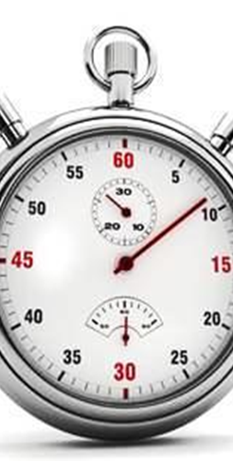
Discussion Outline
Our EIM…End-In-Mind
Why is this a problem: Why don’t we get quality analysis?
What are the elements & components of quality analysis?
Examples of quality analytics in treasury & finance
Trends
Summary
Q & A at anytime, please

Slide 4

End-in-Mind
Our EIM
  Look at this critical function
  Review attributes of it
  Develop commitment to quality analytics….and insight!
  Perhaps produce an action plan for more analytics in your specialty area
  Use the strategic point of view and make better business decisions for our organizations whether:
    Finance & Treasury Leader
    Strategist
    Operations Manager
    Client Relationship Manager
    BPM Improvement Lead
    Solutions Architect
    Product Manager
    Portfolio Manager

Slide 5
Why we do not get “quality” analytics from the team:
UNC Chapel Hill, Kenan-Flagler Treasury Executive Education Program
September 2018
Anecdotal responses in ranked order, 336 responded to this question
Not enough time – 95.8%
Don’t possess the needed skills – 86.5%
Don’t know the business – 83.5%
Don’t work hard enough / thorough – 81.5%
Can’t put the pieces together / “wrong” causality or connections of information – 78.0%
Don’t really know Excel – 71.5%
Too many iterations – 66.0%

Slide 6

CFOs, VPs of Finance, Treasurers
UNC Chapel Hill, Kenan-Flagler Treasury Executive Education Program
September 2018
When asked: “Name the skillset or skillsets you want most in analysts in your organization” – 386 respondents, 53% from companies over $250MM in annual revenue, responded with these multiple-given answers. Responses normalized for presentation purposes.

Slide 7
Classic Problem Solving Model
P
R
O
A
C
T
roblem Identification
oot Cause/s
bjectives
lternatives
onsequences
radeoffs

Slide 8
A GREAT Resource to at least determine if you have a:
“Problem Solving Problems” with a team of performers
Use the simulation not necessarily for “team building”(but call it that) – but be in observer mode and watch the interaction
The REAL learning is the uses of a combination of quantitative and qualitative skills with both data and human skills, to reach a better conclusion than on one’s own.
Evaluate using the “four-blocker” technique, below:
Quantitative
High/Low
High/High
Low/Low
Low/High
Qualitative

Slide 9
CFOs, VPs of Finance, Treasurers
UNC Chapel Hill, Kenan-Flagler Treasury Executive Education Program
September 2018
When asked: “Name the desired areas in your organization where analysis is needed” – 371 respondents, 51.5% from companies over $250MM in annual revenue, responded with these multiple-given answers. Responses normalized for presentation purposes.

Slide 10
Senior Analysts…..valuable? YOU BET!

Slide 11
Achieving Analysis
There are five components or “moves” that analysis involves:

Slide 12
Achieving Analysis
There are five components or “moves” that analysis involves:
1. Suspend judgment
    Avoid ANY initial evaluation (the “knee jerk” response)
    Recognize and account for bias
    This is a critical component for QUALITY analysis!

Slide 13
Achieving Analysis
There are five moves that analysis involves:
1. Suspend judgment
2. Look for patterns (data collection) with the EIM to discern context
  Look within the data, text, source materials
  Look outside the data, text, source materials

Slide 14
Achieving Analysis
There are five moves that analysis involves:
1. Suspend judgment
2. Look for patterns to discern context
3. Define the significant parts -- and -- how they’re related
    Pinpoint key objects, details, examples
    Organize their relationship around analytical claims
    Relate the connections to the patterns and context

Slide 15
Achieving Analysis
There are five moves that analysis involves:
1. Suspend judgment
2. Look for patterns to discern context
3. Define significant parts and how they’re related
4. Make the implicit, explicit
    Look beneath the surface
    Be brave against the politics (but be smart)
    Explain the what, the how, and the why
    Means moving from the literal to the figurative

Slide 16
Achieving Analysis
There are five moves that analysis involves:
1. Suspend judgment
2. Look for patterns to discern context
3. Define significant parts and how they’re related
4. Make the implicit explicit
5. Keep reformulating questions and explanations: posit/test/present

Slide 17
Achieving Analysis: Some Additional Tips
Analysis can be seen as an argument in that it makes a claim or gives an opinion about the communicator’s interpretation. With any good argument, then, you must prove your point with reason/s and evidence that support the claim. In other words, you have to show the audience how you came to this interpretation in a way they can follow and, hopefully, come to the same interpretation or at least believe yours.
There are many different ways to interpret, ranging from the obvious to the outlandish. If you try to think of a few different ways that something could be interpreted, and address or refute those ways in your own analysis, you will make a stronger point and also prove to be a more credible analyzer.

Slide 18
Exhibit: Treasury

Slide 19
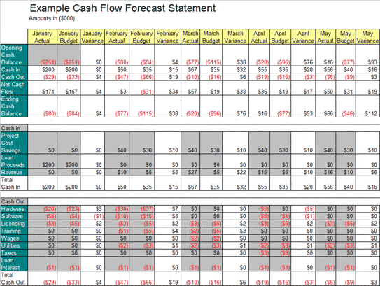
Cash Flow Forecasts….
Now “table stakes” in our profession

Slide 20
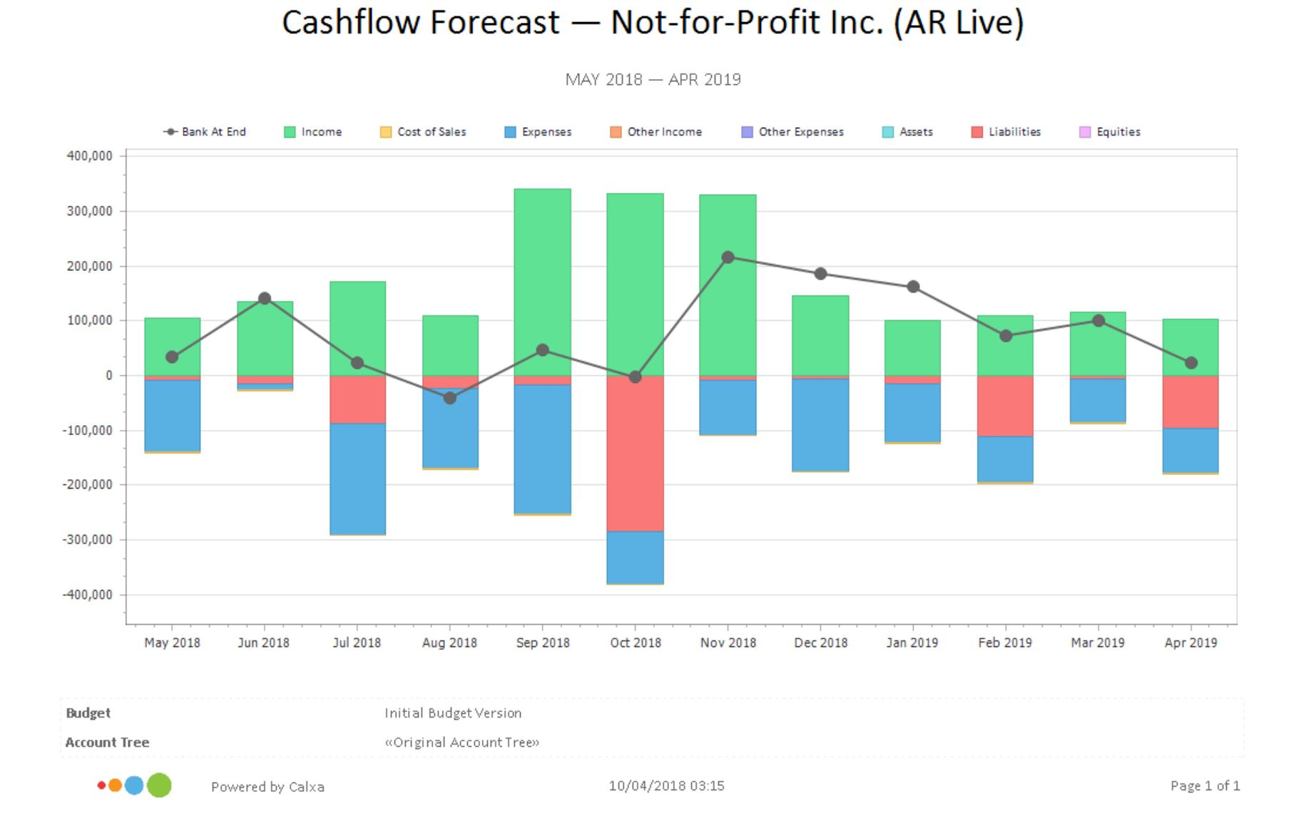

Slide 21
Payment Trends: Middle Market Payments
 |  | Middle Market |  |  | Large Corporate
 |  | 2013 | 2014 | 2015 | 2013 | 2014 | 2017
Check |  | 66.1% | 67.3% | 67.3% | 50.6% | 48.9% | 45.6%*
ACH |  | 19.0% | 18.3% | 17.8% | 33.7% | 32.7% | 36.4%*
Wire transfer |  | 8.0% | 7.8% | 6.7%* | 9.5% | 11.3% | 11.2%
Credit/debit card |  | 6.7% | 6.2% | 7.7%* | 5.8% | 6.5% | 6.1%
*Statistically significant
Source: Phoenix-Hecht

Slide 22
Exhibit: Fraud & KYC / AML

Slide 23
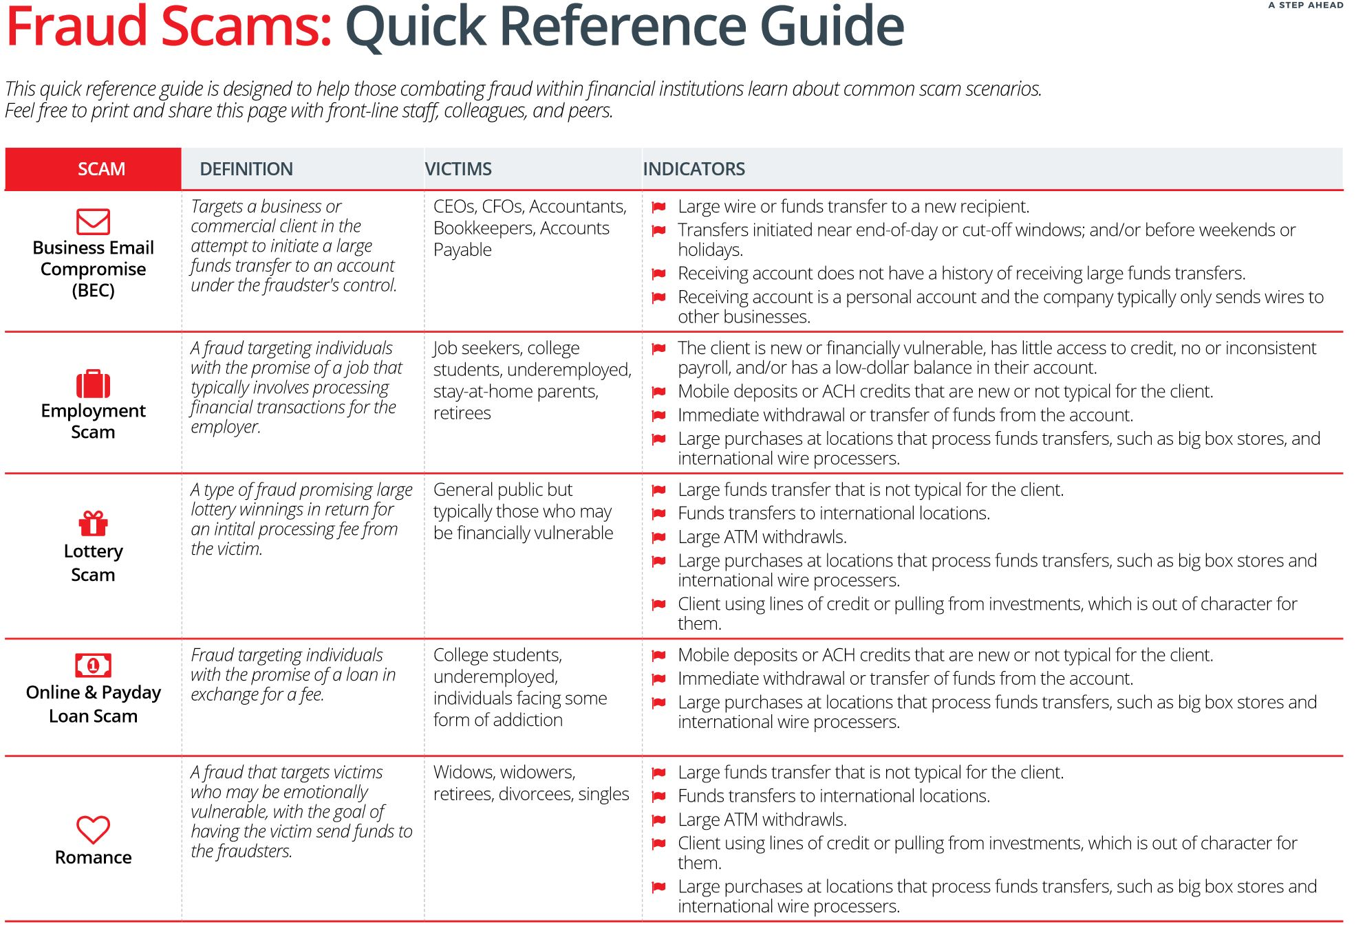
Fraud Grid Analysis:

Slide 24
Exhibit: Competitor Analysis

Slide 25
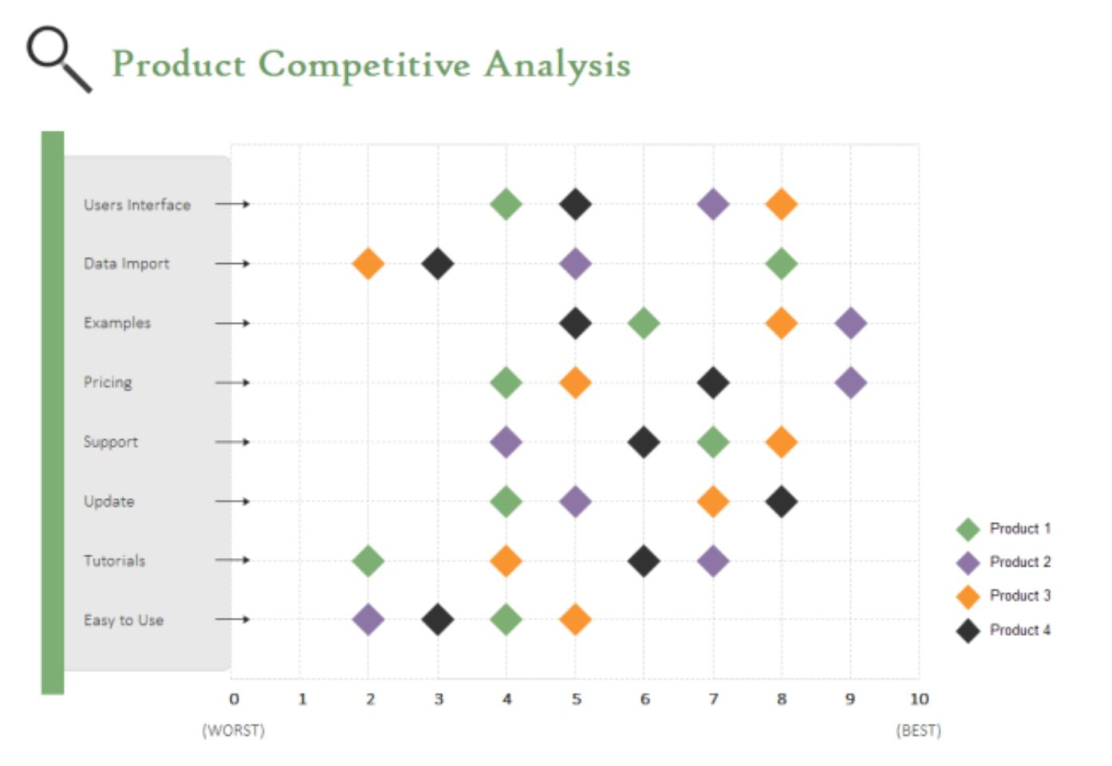

Slide 26

A word on “Big Data”
Big Data = Big analytics
Word counts = Analysis
“Machine Learning” will be a term we will be using….RPA will NOT provide analysis & insight in the NEAR future
Technology & the human interaction WITH it – THAT makes the difference
“Actionable Intelligence” is the goal….. forward views, not rear views

Slide 27

Key Industry Trends to Keep in Mind…..
Commoditization of basic products – especially in payments
Emergence of FinTech – but not the way you’d initially think
All providers, banks included, focusing on profit maximization, strategic customer retention and targeted growth
Innovation has to be BOTH practical and add analytics
Practical uses of AI / Machine Learning / RPA
Customer service and its contribution to YOUR efficiency and a long-term relationship / relationship building, with ANY provider
Non-bank providers targeting small business and high-volume transaction customers….VERY uneven experience in treasury & payment services

Slide 28
The Evolution in Treasury/Finance Continues
Evolving from a control and transaction focus to creating shareholder value and adding value to operations via ANALYSIS!
FROM
THROUGH
TO BEST PRACTICE
Financial Reporting
Risk Management
Business Decision Support
FINANCE’S ROLE
Transactions
Dollar Economic
Value
Customer Service &
Shareholder value
FOCUS
Loosely Defined
Rigid Adherence,
Defined Triggers/Controls
Automated Control Points and Escalation
POLICY
PROCESS
Reactive, Lacking Prioritization
Proactive
Focused & Efficient
ORGANIZATION
Autonomous Functions
Cross-functional
Customer Oriented Team
TOOLS
Multiple Non-
Integrated Systems
Multiple Integrated
Systems
Common Systems
METRICS
Results Oriented
Process Oriented
Forecast Oriented
Page 28

