Slide 1
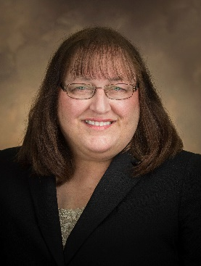
MARLA MILLER, CPA, LL.M, J.D., MBA
Managing Tax Director
EXPERIENCE
Marla has more than 25 years of experience in both the public and private sectors, practicing in the areas of federal, state, and local tax. As a member of the National Tax Office, Marla focuses on accounting method changes and is one of the firm leaders for Opportunity Zones. She has been a frequent presenter at AICPA, TEI, and state accounting societies. Marla has also authored numerous articles, including those for CCH, The Street, and The Tax Advisor. She has also been quoted in Barron’s, New York Times, and many other publications.
INDUSTRY FOCUS
Marla works with both multinational and domestic companies in various industries, including manufacturing and distribution, construction, real estate, financial services, retail, and restaurants.
PROFESSIONAL AFFILIATIONS
American Institute of Certified Public Accountants
Pennsylvania Bar Association
EDUCATION
LL.M. The Dickinson School of Law
J.D., The Dickinson School of Law
M.B.A., Shippensburg University
B.S.B.A., Accounting, Shippensburg University
mmiller@bdo.com
Direct: +215-636-5520
Mobile: +717-645-1992
1801 Market Street
Suite 1700
Philadelphia, PA 19103
Tel: +215-564-1900
Fax: +215-564-3940
www.bdo.com
Marla Miller

