Slide 1
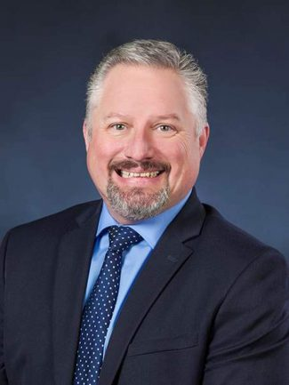
W. Scott Balestrier, CPA
Tax Office Managing Partner
EXPERIENCE
Scott is a seasoned financial executive, having served as a managing partner in a number of professional service firms over the course of his 29-year career in public accounting and consulting. As the Tax Office Managing Partner, Scott is responsible for overseeing the operations in the Philadelphia tax practice and developing and executing strategy with technical resources to bring additional value to clients and colleagues.
Scott’s primary focus has been on assisting clients in effectively managing their tax burden through strategic planning and implementing new technology solutions. He has a broad range of skills including tax, financial accounting, risk management, information technology, capital raise, employee benefits, succession planning, and mergers and acquisitions.
INDUSTRY FOCUS
Scott has been the lead coordinating partner for companies in a wide variety of industries, and has significant experience working with manufacturing & distribution, retail, and financial services companies.
PROFESSIONAL AFFILIATIONS
American Institute of Certified Public Accountants
Pennsylvania Institute of Certified Public Accountants
EDUCATION
B.S., Accounting, Kutztown University of Pennsylvania
sbalestrier@bdo.com
Direct: +215-636-5526
Mobile: +
1801 Market Street
Suite 1700
Philadelphia, PA 19103
Tel: +215-564-1900
Fax: +215-564-3940
www.bdo.com
Scott Balestrier

